Slide 1


Alarm System Orientation For Employees
Notes:
1
Welcome to the False Alarm Reduction Association’s Alarm System Orientation course. Just as 100 level courses in college provide the building blocks for later courses, this course is designed as a quick “alarms 101” overview to familiarize users with alarm systems and how to prevent false alarms. This course is a product of FARA’s Training & Certification Committee.

Slide 2
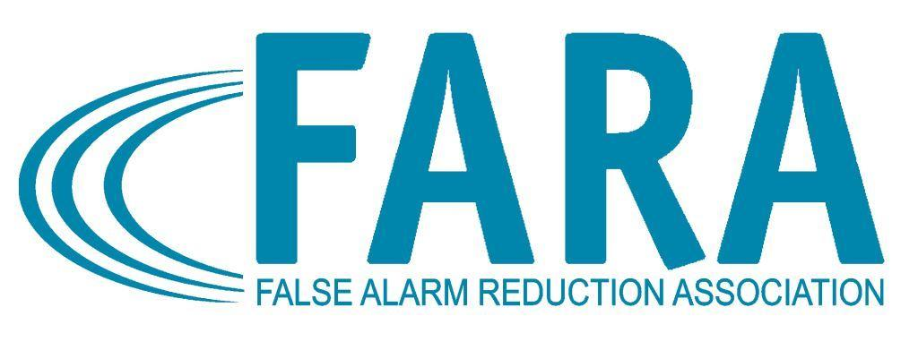
What We Will Cover
What is a false alarm?
How does an alarm system work?
What causes false alarms?
How to prevent false alarms?
Notes:
Alarm systems are designed to alert occupants to smoke and fire, to ward off intruders, and to summon emergency personnel. Unfortunately, alarm systems used or maintained improperly can have negative impacts as well.
Owning an alarm system comes with the responsibility to use it correctly.
During the course, we will define a false alarm. We will also discuss the components of an alarm system and how those components work together. As we progress through the course, we will look at common causes of false alarms. Finally, we will discuss how to reduce and prevent, false alarms.

Slide 3

Alarms are the First Line of Defense
Deter burglaries, break-ins and hold-ups.
Summon emergency personnel
There’s just one problem...
FALSE ALARMS
Notes:
Burglar and fire alarms are important, and they can be the first line of defense for keeping property and employees safe. They have been proven to lessen the chance of being burglarized. Studies show that just having an alarm system sign can reduce the chances of burglary. As the cost of alarm systems goes down, the number of alarm systems increase. Unfortunately, with this increase, the false alarm problem grows as well.
False alarms are a significant problem for public safety throughout the country because they waste resources and divert or delay response to calls that may be true emergencies. Working together we can preserve resources and prevent the expense of false alarms.
In order to prevent them, it is necessary to know what a false alarm is. According to the National Burglar and Fire Alarm Association and the FARA Model Burglar Alarm Ordinance, a “False Alarm means an Alarm Dispatch Request to a law enforcement agency, when the responding law enforcement officer finds no evidence of a criminal offense or attempted criminal offense after having completed a timely investigation of the Alarm Site.” A false fire alarm is “the activation of any Fire Alarm System which results in a response by the fire department and which is caused by the negligence or intentional misuse of the Fire Alarm System by the Owner, its employees, or agents or any other activation of a Fire Alarm System not caused by heat, smoke or fire, exclusive of a Nuisance Fire Alarm.”

Slide 4

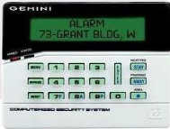
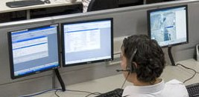
What Causes a Signal?
System sends
a signal
Monitoring center
receives signal
Sensor detects “something”
Notes:
65
We are going to change gears now and discuss the workings of a system. When an alarm system is armed and a sensor is tripped, the system sends a signal alerting the monitoring center of a possible breach. Whatever the cause or whatever the type of sensor, an alarm system follows the same basic steps to communicate what is happening at the alarm site to the monitoring center.
But lets delve a little deeper into the system and understand how each part operates so that you can understand why what you do on scene can make a difference.

Slide 5
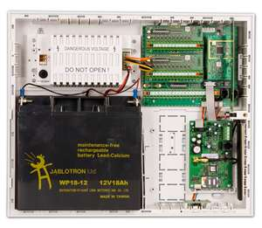
Control Panel
The “brain” of the system
Notes:
The control panel is the “brain” of an alarm system. When a sensor of any kind is activated, the signal is transmitted to the control panel which in turn can then activate a siren and/or make notification to a monitoring center. Depending on the type of connections installed, the alarm signal may seize the phone line and prevent any incoming or outgoing calls which can make it impossible for users to cancel the alarm. Having a phone line dedicated to the alarm system helps to eliminate this problem. New systems can also take advantage of modern technology and have a dedicated wireless phone capability which works exactly like your cell phone.
The control panel also includes the alarm system’s power supply and back-up battery. The control panel continuously monitors the system and can report any troubles within the system, such as a low battery, a communication failure, or power loss. Unfortunately, most users are either not informed or forget that the battery requires regular maintenance and replacement just like the batteries in a smoke detector. The alarm industry has set the standard that batteries should have enough power to run the system for a minimum of four hours in a power outage. Many jurisdictions charge for false alarms generated by low batteries when a power outage is shorter than 4 hours--so it is important to check the battery regularly.

Slide 6
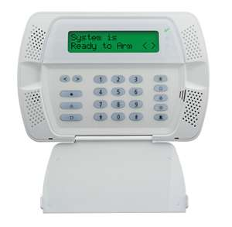
Keypad
The “translator” of the system.
Notes:
You can think of the keypad as the “translator” for the system and it is how users communicate with the system. The keypad is used to arm and disarm the system, and notify the monitoring center that you are authorized to be on the premises. The most important thing you can learn is how to responsibly use the keypad and your associated codes. Knowledge of the system keypad is essential to proper operation of the alarm system. Anyone who has a key to enter the premises should be fully trained in the basic features of the system keypad.
Entry/exit errors are one of the most common causes of false alarms. To prevent these errors:
Find out what your entry/exit delay times are and what doors can be used to exit the premises. It does matter.
Make sure all doors and windows are locked and that all other employees have exited before setting the alarm.
Understand how and when to use the hold-up/panic button, if there is one available.
And if you make a mistake, CALL the monitoring center and use your password to prevent a police dispatch.
These are just a few of the errors alarm units see on a daily basis, and we will be discussing
them further later on in the course.

Slide 7
Sensors
  Sensors are the figurative eyes and ears of an alarm system.
  Motion detectors
  Sound detectors
  Environmental sensors
  Video equipment
Notes:
Sensors are the figurative eyes and ears of an alarm system. These components are generally designed to detect one specific thing so well designed systems will use several types of sensors. Some of the sensors available today include:
Motion detectors
Sound detectors
Environmental sensors
Video equipment
Let’s look at some of these in more detail.

Slide 8

Motion Detectors
The “eyes” of the system.
Notes:
Motion detectors do just what the name implies, they sense motion in an area and act as the “eyes” of the system. Today, many systems also include cameras which can act as true eyes into an alarm site. However, the motion detectors are still needed to warn someone at the monitoring center of the need to look at the video.
In retail environments, one of the most common errors is hanging signs or other items from the ceiling or placing balloons in an area monitored by a motion detector. Because the motion detector is off during the day, there is no response. However, when the heat or A/C comes on at night, the balloons or signs move and can activate the motion sensor. This problem can be avoided by consulting with the alarm company and hanging signs out of the range of the motion detector. Another solution may be to turn off the heat or A/C at night.
Birds or small animals are another common cause of motion detector signals. If you have birds inside your business frequently, then do not set the motion sensors when you close. Another option might be to ask the alarm company to call you first if they receive a motion detector signal. If there is no signal from a perimeter sensor, it may be safe to assume that the signal is due to the bird and can be ignored. Remember to clean these devices regularly so that bugs or spiders don’t “move in” and set off the alarm.

Slide 9
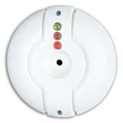
Glass Break Detector
“Hearing Aid”
Notes:
Glass doors or windows can be the easiest entry point for intruders --unless there is an unlocked door of course. Glass break detectors are designed to “listen” for the sound of breaking glass. They are generally installed on the ceiling or wall near a window. Once activated, the device sends a signal to the control panel.
Glass break detectors have limitations. They can only protect a limited area or space and should not be installed in high noise environments. Because the detectors work by detecting the frequency of a noise--if the frequency of any sound matches that of breaking glass, the detector will respond. Thus, they can be activated by thunder, weed-eaters, and barking dogs. Newer improved glass break sensors are “dual” technology and must sense a shock or “thump” along with the glass break frequency before they send a signal.

Slide 10


Contacts
The “ears” of the system.
Notes:
If motion detectors are the eyes, contact sensors can be considered the “ears” of the system. Before audio was available, these sensors warned of unauthorized entry. They still perform the same task, but they also warn the monitoring center to listen to an audio feed, if one is available. Door and window contacts are designed to detect the opening and closing of each door or window on the perimeter of an alarm site. Today, these sensors are also often applied to the doors of interior spaces such as cash offices. These sensors work by placing a sensor on the frame and a magnet on the door or window. When the door or window is opened, the contact is broken and a signal is sent.
Remembering to securely close all windows and doors when you leave, will go a long way to reducing false alarms. Know how long you have to reach the keypad once you enter the facility and how long you have to reach the door once the system is armed when you exit. Most systems allow 30-60 seconds but it can be shorter or longer. Consult with the alarm company on adjusting the time if you need more time to enter or safely depart. If you’ve forgotten something and must re-enter, be sure to enter the code to turn the system off and then reset it when you leave. Re-entering once the system is set and trying to “beat the clock” is another frequent cause of false alarms.

Slide 11
Siren/Speaker
The “voice” of the system.
Notes:
Alarm systems typically have two “voices”. The “voice” that users generally hear is the reminder that the system is armed and needs to be turned off, or the warning beep of an incorrect code entry. Another common beep warns that a door or window is still open when the alarm is being turned on.
The “voice” a burglar hears is the siren which is designed to frighten the intruder or be so annoying that they leave. If you are inside and have the perimeter sensors set, the siren can also act as a warning that someone has entered, or snuck out if you have teenagers.
Many new systems also may have the capability for users to speak directly to a monitoring center operator through the keypad using a two-way radio type communication system. This is especially helpful when a dedicated phone line is not available, because it allows the user to notify the monitoring center of any errors.

Slide 12
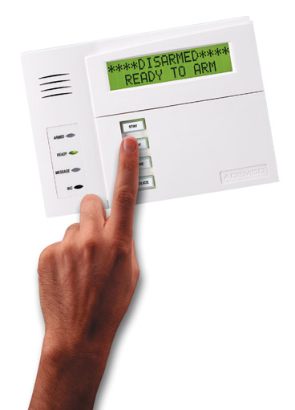
Alarm System- Disarmed
During regular business hours, the alarm system is usually turned off or is placed in the disarmed mode which puts the sensors to “sleep”, allowing for the opening and closing of doors and windows.
Notes:
During regular business hours, the alarm system is usually turned off or is placed in the disarmed mode which puts the sensors to “sleep”, allowing for the opening and closing of doors and windows.
But when the workforce leaves or the business closes, the system is turned on, or armed, which tells the control panel to begin monitoring the doors, windows, motion sensors, glass break detectors, and other sensors.

Slide 13

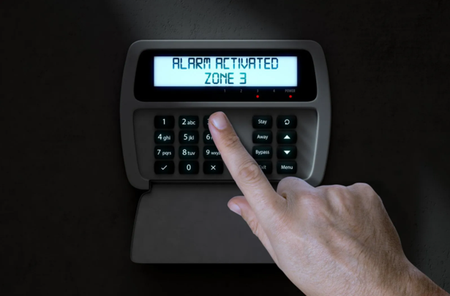
Alarm System- In Alarm
Notes:
We have been discussing the major parts of a system. Now we will discuss what happens when the system is armed and a sensor is activated.
First, the alarm is tripped by a door being opened, a window being broken, or motion being detected.
Then, a signal is sent to the control panel.
Which activates a siren at the premises.
This sends a signal to the alarm company monitoring center.
The monitoring center calls the premises or uses the two way speaker at the keypad to verify the alarm.
If the operator reaches someone, the alarm can be cancelled with a password or pass code.
If no one answers or they don’t have the correct password…the monitoring center calls the Police dispatch center, who then send out officers to the alarm site.
At some point the Alarm Company calls the emergency contacts provided by the customer.
Many jurisdictions allow the alarm to be cancelled without penalty until the officer arrives on scene; so if you can’t contact the alarm company, keep trying.
Also, it should be pointed out that most monitoring centers do not call the premise for
hold-up or panic alarms because these signals are meant to be used only in life
threatening situations and taking the time to call the site could mean the difference
between life and death. Also, if a crime is in progress, they don’t want to alert the
criminal that law enforcement is on the way.
Now let’s go into more detail about your role in using your alarm system accurately and
how you can prevent false alarms from occurring.

Slide 14
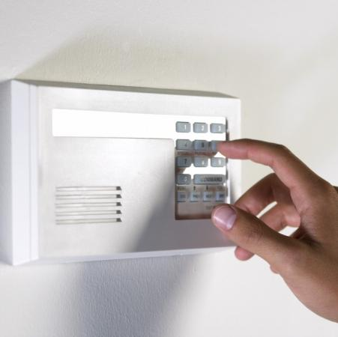
What causes false alarms?
User error
Lack of training
Lack of maintenance
Improper design
Installation quality
Notes:
In the early years of alarm systems, a majority of false alarms were caused by equipment failure, poor system design, and poor installation. User errors contributed to the problem but were not the major causes.
With new systems, improvements in system design and equipment standards adopted by the industry have virtually eliminated these issues as causes of false alarms. Poor installation does still have some impact, but today, most false alarms can be attributed to user error. One survey of alarm users shows that problems when entering and exiting the site account for the majority of false alarms. Lack of training and unsecured pets were also cited as causes.

Slide 15
What can YOU do?
Understand your system
Lock all doors & windows
Know cancellation code
Maintain the system
Respond to meet officers
Notes:
As an alarm user, it is your responsibility to prevent false alarms. This is an easy task that can be facilitated by understanding how the system works. This course is a good start on that knowledge. However, this knowledge needs to be passed along to all who have access to the system. Many businesses will train their employees but forget to provide training to cleaning crews or suppliers.
Before arming the system, users should lock and secure all doors and windows. Make sure everyone is out of the building or residence before arming the system.
Be sure to know the cancellation code and make sure all authorized users know the code as well. If the code is changed, make sure everyone is notified.
Perform the required maintenance and replace the battery no less than once every 5 years. In the event of an alarm, be available to respond to the site to meet officers. If you are unable to respond, have another responsible person who is willing to go for you.
These are the basics, but the following section will discuss in more detail what alarm users can do to prevent false alarms.

Slide 16
Call your alarm company….
Before you start any remodeling or construction.
To update your authorized contact list whenever employees are added and/or deleted or phone numbers have changed.
When you have changes in your phone service.
When you move or close your business
When you have an unexplained false alarm
Notes:
Alarm users should keep the responsible party or key holder list up to date.
Call the central station and inform them of any remodeling, repair, electrical, or telephone line work that is going to be done at the premises.
If you change anything at the premises, please call your alarm company to see if sensors need to be moved or adjusted.

Slide 17
Train ALL Alarm Users !
  Everyone who has a key needs to know how to arm and disarm your system
Notes:
Make sure everyone who has authorized access to the premises knows how to arm and disarm the alarm system and knows how to clear a false alarm with the monitoring company. This includes baby-sitters, maids, realtors, relatives, teachers, janitors, cleaning crews, contractors, and employees. Be sure that telephone repairmen, electricians, carpenters and other repairmen or servicemen are aware and careful of the alarm system. Every person who uses the system should know their password or identification code for verification with the central station.
Entry/exit errors are the leading cause of false alarms:
•How much time users have to set the alarm and exit.
•Ensure users know how much time they have to enter a location and disarm
the alarm system.
•Identify special entry/exit delay time requirements.
•Ensure that they know what door(s) is to be used for exit and entry as well as
where all the other system components are installed (cleaning crews are especially important—they often will exit the building to take out the trash which may not be the entry or exit door).
•Adjust the system during training to eliminate customer errors.
•Ensure that users understand the difference between knowing their
numeric entry/exit code (a sequence of numbers used to arm or disarm the alarm)
and having a password (a code word used to identify the customer as an authorized
user).
•Spend the extra time going over how to cancel a false alarm response.
•Explain how answering machines or call waiting will affect a cancellation
verification.
•Always show the alarm user how to cancel an accidental alarm activation. Let
them know whether you expect them to call the central station or whether they
should stay at the premises until the central station calls them. Different alarm
companies have varying procedures.
•Make sure user is aware of jurisdictional requirements (permits/fines).

Slide 18
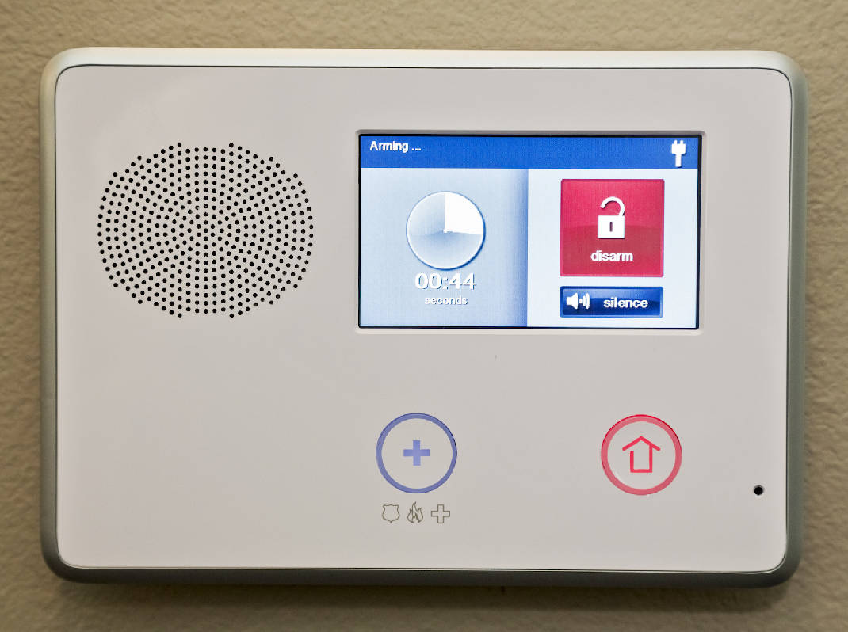
Re-Entering
If you
re-enter, turn off the alarm.
Don’t play beat the clock.
Notes:
If you re-enter the premises because you've forgotten something, turn off the alarm & re-set it when you leave again. Do this even if you think it will only be a few seconds!

Slide 19
Canceling Alarms
Answer the phone
Stay put
Be prepared
Follow your alarm company's instructions
Notes:
When an alarm is activated, most systems will send a signal to a monitoring station. If the alarm is a mistake, it is important for the user to communicate with the monitoring station to make sure that no police dispatch request is made. Keep the monitoring company phone number in a convenient, easily visible place near the phone, enter it as a contact in your cell phone, and put the phone number on a label at the keypad.
Many alarm companies instruct their customers to wait for a phone call. Unfortunately, the alarm system often uses the same phone line to send in the alarm signal that the user would use to call the monitoring station. This is why many alarm companies will instruct users to wait for them to call after the alarm. Some companies want users to call them as soon as the line clears. It is a common complaint that the alarm company never called. What people don’t realize is that the operator may have tried to call while the phone line was still tied up with the alarm. The operator has satisfied their requirement and they have moved on to the next alarm. Users are the ones who will pay the bill for a false alarm, if you don’t hear from the monitoring center in a reasonable time, contact them.
The second thing that users should do when they have an alarm is to stay put! Do not leave the alarm site until you have spoken with the monitoring station and assured them there is no emergency. If law enforcement response was requested, users need to wait until they have confirmation that the response was cancelled.
When the user makes contact with the monitoring station, they will need to verify that they are an authorized user. All alarm users should be prepared for this and know how to identify themselves to the alarm company.
And remember, it May Not Be Too Late When The Alarm Sounds. If the disarm code is entered fast enough, some systems will stop the alarm signal before it is sent to the monitoring station. Other systems may change the type of signal that is sent, so that the monitoring station knows there is no emergency. In any case, turning off the system as fast as possible after a mistake is a good idea.

Slide 20
Bypassing Zones
By-passing a zone
Turn off a zone (home/away)
Notes:
Alarm users should know what activity is permitted if the system is going to be armed and someone will be moving around inside.
Many alarm systems will allow interior motion and/or glass break sensors to be bypassed or “ignored” by the system when the alarm is turned on. The idea behind this is to allow the rest of the system to be active while the user occupies the site. Sometimes, the way that the user tells the system to turn on all or just part of the system is very similar. If the interior sensors are activated by mistake while the user is on site, this will lead to an alarm.
Some systems are designed to rely on doors to be closed to keep pets or people from entering certain rooms. If one of these doors is left unlocked or a person goes through the door by mistake, it will lead to an alarm. This happens frequently at local stores with cash rooms.

Slide 21
Inspect the System
Check the battery
Test your system
Schedule yearly system inspections
Notes:
A good way to prevent false alarms is to make frequent inspections of the system.
Almost all security systems have a rechargeable battery that powers the system in the event of a power outage. Low batteries are the most common equipment reason for false alarm activations. Even a short power failure of a second or less may be long enough to cause a false alarm if the battery is not charged.
The battery’s life depends on how often power outages occur and how many accessories the system is driving (i.e., keypads, motion detectors, smoke detectors, etc.) Most panels will send a low battery signal to the monitoring station when the battery’s voltage lowers to a certain level.
For battery backup to be successful, the alarm panel transformer must be plugged into a 24-hour outlet. The alarm system must have AC power. NEVER unplug the transformer, because you may forget to plug it back in. If you know your power must be off for more than 10 hours, please call your alarm company. They can give instructions on how to preserve the battery life. If you have a wireless system, you may have batteries in the sensors as well that will require maintenance.
Alarm users should test the system monthly & have annual inspections by the alarm company.
Always contact your alarm company before you test the system so that they won’t call the police.
At a minimum, have your system tested by a technician annually and any time you have an unexplained false activation.
Your system battery should be checked during the annual inspection and after any storm-related false alarm. It should be replaced when needed.

Slide 22
Holdup Buttons
Is this needed?
Proper training
Problems with hold-up/panic buttons
Notes:
The features that we will be discussing next are particularly prone to false alarms if users are not adequately trained.
Duress, hold-up and panic alarms are designed to allow alarm users to activate the system under specific emergency situations. They generally result in a heightened response, sometimes with lights and sirens, due to a raised likelihood of a criminal event in progress.
It is very important that you understand that activation of these types of alarms in non-emergency or improper situations may place law enforcement officers, alarm users and the general public at increased risk.
The use of hold-up alarms is not recommended for the general public, and businesses should consider carefully if this option is needed. Hold-up alarms should be reserved for those alarm users who are at greater risk because they have custody of large amounts of money or highly valuable goods, or for those who can otherwise demonstrate an extreme need for a hold-up alarm.
If a hold-up or panic option is available with your alarm system, training is a must.
These systems are usually activated by inconspicuous devices, such as a foot rail, money clip, or hidden button. Effective use of hold-up alarms requires special training and frequent drills to prevent false activations. Remember, nothing gets law enforcement response faster than placing a call to 9-1-1 --so do not use these except for what they are designed—to summon help without alerting the criminal.
The problem with hold-up devices is that they are used improperly which causes increased risk to law enforcement and the general public. The following instances are examples of when NOT to use the hold-up:
When you need fire or medical assistance.
To check to see how long it takes law enforcement officers to respond.
When someone has shoplifted merchandise.
To report a fight in a parking lot.
Any other circumstances in which you are not in a life-threatening or emergency situation.

Slide 23
1+Duress Codes
Is this necessary?
What happens when activated?
1+ Duress = False Alarms
Notes:
The one plus duress alarm feature is designed to allow alarm users to indicate when they are forced to disarm the alarm system under duress. To use this feature, the user is instructed to add the number one to the last digit of the code when faced with dangerous situation such as an intruder.
For example: a normal code might be 1234, the one plus duress code would be 1235
After the one plus duress code is entered, the alarm seems to be disarmed normally (turned off) and there is no indication at the alarm site that this function has been activated. However, a silent alarm is sent to the monitoring center to indicate a duress situation. Usually, no attempt is made to verify the situation so as not to alert the criminal, and a dispatch request is made immediately.
This is an equation for false alarms for a variety of reasons which include:
Users have too many codes to remember (internet, credit card PIN, alarm codes, etc), and it is too easy to confuse the regular code with the one plus duress code.
The user is often unaware of the mistake until the police arrive because no indication is made at the site that the duress alarm has been activated.
Because no attempt is usually made by the monitoring center to verify a one plus duress signal, the user does not get the opportunity to cancel a mistake.
Officer and user safety is threatened when public safety officers are asked to respond to a reported duress situation that is actually user error. Authorized users can be mistaken for intruders and users may confront the officers when surprised by a response.
Repeated inquiries at national, state and local alarm association meetings failed to find a single instance when this feature had been used as intended.

Slide 24
Public Safety Costs
Complacency
Billions of dollars in wasted resources
Wasted time
Not available for true emergencies
Notes:
We have been discussing ways to prevent false alarms, now it is time to discuss why preventing them is a good idea.
The single most dangerous result of false alarms is officer and fire fighter complacency. Responding to the same location over and over again and not finding any criminal activity or fire event creates a situation in the mind of the public safety official that the next call will also be a false alarm when it may be the real thing. When that happens, the officer or fire fighter may not be as prepared as he or she should be, which could lead to catastrophic results. This is when officers, fire fighters and others, can get hurt or worse.
False alarms cost police, fire and EMS billions of dollars every year in wasted time, manpower and money. These are resources that can never be recovered.
How would you like to be the victim of a crime and have no police officer available to help you because he or she is on scene at what turns out to be a false alarm? What if a fire starts in your business and the closest fire trucks are already out on a false alarm call? Everything you own and your life savings have been put into your business and you are watching it go up in smoke because a fire company from farther away had to be called to assist. False alarms take police and fire units out of service, where they are not able to respond to true emergencies, placing the entire community at increased risk. This is a risk that we cannot afford.

Slide 25

Alarm Industry Costs
Staff
Training
Complacency
Fines
Notes:
You might think that there is no cost to the alarm industry for false alarms. After all, alarm systems are their business. However, there is a great cost.
More false alarms mean more:
Staff at central stations to answer calls, technicians to respond to troubleshoot, customer service staff to deal with alarm users.
Increased training costs, and time.
False alarms cause central station operators dispatching to the same location over and over again and hearing no criminal activity to become complacent, so they may not be prepared for the “real thing” when it happens.
Many jurisdictions fine alarm companies

Slide 26
Alarm User Costs
Fees/fines
Maintenance costs
Time and aggravation
Discontinue use of alarm system
Complacency
Notes:
False alarms cost consumers as well.
Alarm users are faced with paying false alarm response fees/fines imposed by local jurisdictions, which may range from $25 to as much as $4000 per false alarm. It can be very difficult to justify throwing money away in fees and fines on a problem that is easily correctible.
If a user doesn’t have a maintenance agreement with their alarm company, they can incur significant costs to troubleshoot and repair any equipment related alarm problems.
Users can expend a great deal of time and aggravation trying to understanding why they were charged with a false alarm and what can be done to correct the problem. For business owners, this can mean taking time away from managing the business and possibly missing out on opportunities that could increase income and keep the business going.
Alarm users may become so annoyed with their alarm system that they just stop using it. This in turn, could affect their insurance rates or a carrier may deny a claim if they find out the system was not in use.
False alarms cause alarm users to become complacent as well so they may not be prepared for the “real thing” when it happens.

Slide 27
General Public Costs
Officers not available
Subsidies
Increased risk of car crashes
Annoyance
Notes:
The public at large also bears costs associated with false alarms, when they themselves may not even have an alarm system.
Officers not available when you need them - If officers are responding to what turns out to be a false alarm, they may not be available to respond to real criminal activity, which puts citizens at greater risk.
Subsidizing those with alarm systems - The huge costs to public safety to respond to false alarms can be borne by the entire community through higher taxes, etc. So the net result is that those without alarm systems actually subsidize those who have them and cause false alarms.
Increased risk of car crashes - When officers do respond to alarm signals with lights and sirens, which some still do, there is an increased risk to the general public on the highways. We see time and time again that drivers have no idea what to do when a fire truck or police car with lights and sirens blaring come up behind them. Some actually stop right in the middle of the road! They become a hazard to themselves and everyone else on the road.
Annoyance - There is also an annoyance factor when the neighboring community, including both residences and other businesses, have to listen to your alarm siren going off all hours of the day and night. Think about how your alarm affects the entire community and put yourself in their shoes. This alone should be enough to prompt you to fix whatever your false alarm problem is. Your false alarms may cost you fees or fines assessed by your local jurisdiction and then you lose business due to an angry community.

Slide 28
Local Ordinances
Be sure to familiarize yourself with the requirements in your area.
Notes:
Take the time to familiarize yourself with the regulations in your local area. Find out if you are required to permit your alarm. Check to see what the alarm companies are required to do.
State
County
City

Slide 29

Contact Us
False Alarm Reduction Association
10024 Vanderbilt Circle #4
Rockville MD 20850
301- 519-9237
Brad Shipp, Executive Director
bradshipp@4yoursolution.com
www.faraonline.org
Notes:
There is a great deal of information available at our website Faraonline.org. If you have any questions, please contact FARA’s Executive Director Brad Shipp.
Thank you so much for your participation and I hope that you found the information helpful.

