Slide 1
Audio and Video Verification

Slide 2
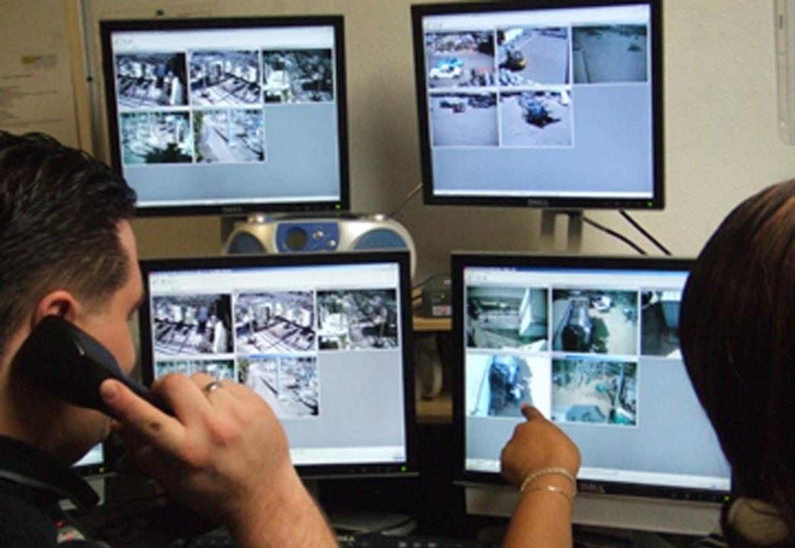
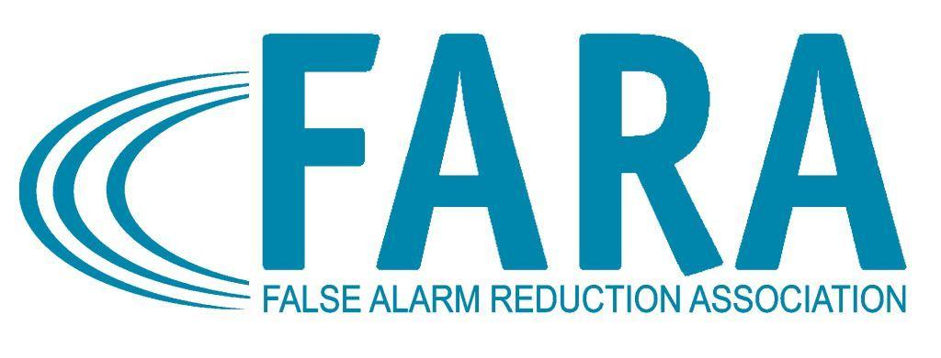
What is Audio/Video Verification?
Allows the monitoring center to either “hear” or “see” into the alarm site to decide what caused the alarm.
Notes:
When utilized in an electronic security application, audio/video verification allows the monitoring center to either “hear” or “see” into the protected premise to decide what caused the alarm.

Slide 3
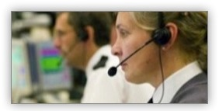
Listen-In Audio
Open door, window or movement activates listen-in device
Monitoring center listens to hear what is happening at the alarm site
Notes:
When a security device has been activated, such as a door contact or motion detector, the listen-in device is also activated to allow the monitoring center to hear what is happening at the protected premises

Slide 4
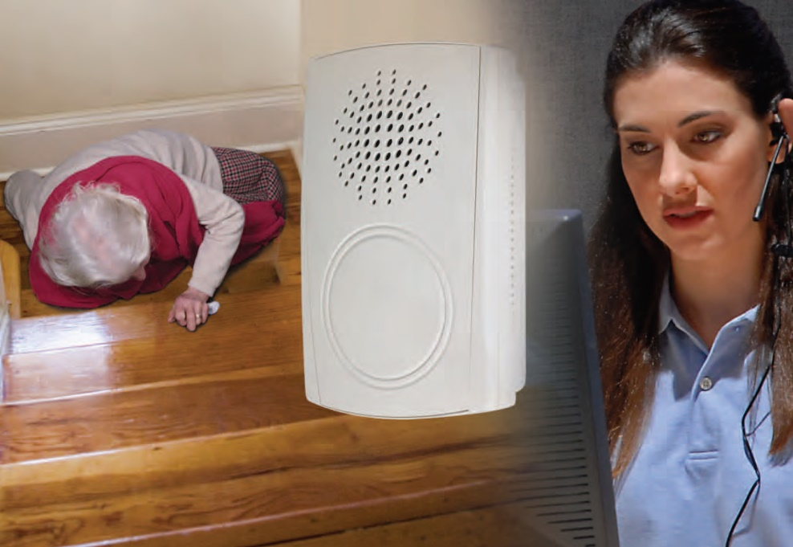
Two-Way Audio
Alarm user and Monitoring Center talk through the alarm system
Notes:
A hands-free communication session takes place between the alarm user and monitoring center to assist in determining the cause of an alarm activation in the protected premise.
This method is most commonly used with the alarm user’s keypad.

Slide 5
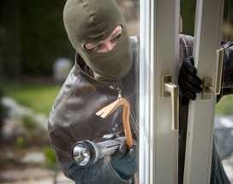
Impact Activated Audio
Sounds of break-in trip the alarm (ex: glassbreak detector)
Monitoring Centers can listen in to alarm site
Notes:
An audio sensor, which can hear an actual intrusion as it is taking place, transmits sounds to the monitoring center from the protected premises. This is different from the listen-in capability in that no other security device needs to be activated for this technology to function.

Slide 6
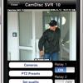
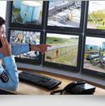
Video Verification
Open door, window or movement activates video device
Monitoring center and/or user watches what is happening at the alarm site
Notes:
Video is typically transmitted to the monitoring center when another security device in the protected premise has been activated.
It is effective in outdoor applications where audio verification and other technologies are not as effective.
It is often used to determine who (if anyone) is at the protected premise when the premise is breached.
Coverage need will vary depending on the application. Discuss your needs and expectations with your security consultant.
This technology allows the monitoring center to provide additional information to public safety, which can lead to the apprehension of intruders.

Slide 7
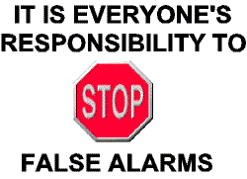
Solving False Alarms
Audio & Video Verification reduces false alarms
Notes:
False alarms can be drastically reduced with proper system design and a consciously applied training program.
Legislators, law enforcement officials and false alarm reduction units are searching for answers to solve the false alarm problem and verification can play a key role in reducing the number of unnecessary calls to public safety
agencies. It is important that the consumer understand all the technologies available to them.

Slide 8
Contact Us
False Alarm Reduction Association 10024 Vanderbilt Circle #4 Rockville MD 20850
301- 519-9237
Brad Shipp, Executive Director bradshipp@4yoursolution.com
www.faraonline.org

