Slide 1
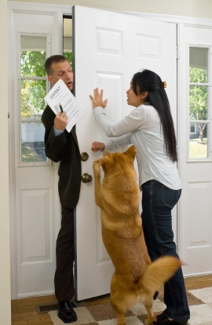
Door to Door Sales Beware of Potential Fraud

Slide 2
Beware!
Not all door-to-door sales people are ethical
This presentation is designed to cover those who do not play by the rules

Slide 3
Companies Push Door to Door Sales
Neatly dressed salespeople are knocking on the doors of homes
Usually college-aged people, with recent experience soliciting door-to-door
Notes:
Reputable alarm companies will not send technicians to your home unannounced.
They may read your name off the mailbox or look at property records to determine the owner’s name.
Never take their word for it, immediately contact your alarm company for verification.

Slide 4
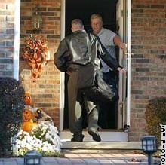
Companies Push Door to Door Sales
Four-month selling season uses college students in the summer
Managers hire large temporary sales teams in cities across the nation

Slide 5
Common Tactics
Imply they are from the alarm user’s alarm company and need to test or upgrade the system
Offer a free upgrade or free system, when they are actually adding another contract for service under their company
Notes:
Reputable alarm companies will provide you with the time you need to carefully consider your purchase. U.S., State or Provincial laws provide you with a cooling off period of 3 days or more where you can cancel any contract when a company representative visits your home. You have a right to cancel your contract even if the alarm company has installed the equipment.

Slide 6
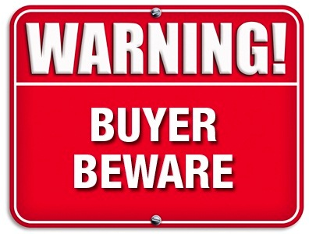
Common Tactics (continued)
Claim
Claim your alarm company has gone out of business
Take
Say you need to take advantage of the offer today
State
State your alarm system is vulnerable or can be disabled easily
Notes:
They do not know what type of alarm system you have so they cannot make this claim.
Pressure you to make a decision quickly – they may say the offer is only good that day

Slide 7
Common Tactics (continued)
Wear
Wear polo shirts with alarm manufacturer names on them
Give
Give you inflated crime rates for your neighborhood
Claim
Claim your neighbor just bought their system or sent them over to your home
Claim
Claim they are working with or for local law enforcement
Notes:
Wear brands such as GE or Honeywell, claim to work for them and need to inspect your keypad or control panel because it may be slated for replacement. This is just a trick utilized to gain entry to your home. Often these salespeople will exaggerate neighborhood crime rates or recent events in your neighborhood. These salespeople have been known to claim they are working with the local police or sheriff’s department or have their endorsement. Most public safety agencies do not endorse one company over another. Additionally, a reputable company will schedule an appointment in advance to upgrade your system.

Slide 8
Avoid Being Scammed
Do not let any door-to-door solicitor into your home
Call your alarm company
Notes:
Some consumer protection agencies warn homeowners not to even open their doors to solicitors but rather to speak to them through the closed door and send them on their way.
If you tell a salesperson you are not interested but he or she persists in pressuring you, call the police!
If the salesperson claims to be a representative of your alarm company and is trying to get you to sign a contract or work on your alarm system call your alarm company.

Slide 9
Unlicensed Alarm Companies
Report Unlicensed Activity
Notes:
Contact your state or local agency that regulates the alarm industry in your area. In most cases, U.S. States or Canadian Provinces require a government issued license. Most licensed alarm companies have been through a background check as part of their license requirements.

Slide 10
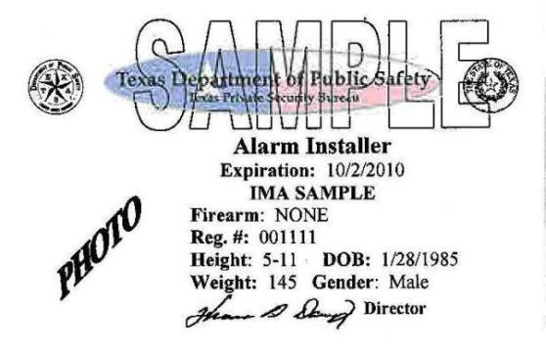
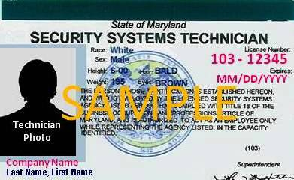
Ask for a License
Notes:
This may be a license issued by the state for either the alarm company or the individual to engage in the business of selling, installing or monitoring alarms; or it could be a solicitor’s license that permits them to engage in door-to-door sales. In most cases, having this license on their person is required by law. If the sale person does not present a license or registration card on demand, or claims it is at their office or with their supervisor, they may be trying to scam you!

Slide 11
Contact Us
False Alarm Reduction Association 10024 Vanderbilt Circle #4 Rockville MD 20850
301- 519-9237
Brad Shipp, Executive Director bradshipp@4yoursolution.com
www.faraonline.org

