Slide 1
Holiday False Alarm Prevention
Notes:
Welcome to FARA’s presentation on Holiday False Alarm Prevention.

Slide 2
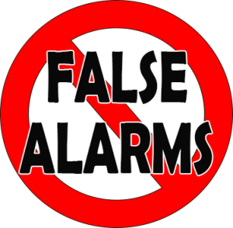
Don’t Let False Alarms Ruin Your Holiday!
Learn how to enjoy your holidays without the disruption of costly false alarms
Notes:
Don’t let your holiday be ruined by false alarms! There are simple steps you can take to avoid what could be costly mistakes, while at the same time creating a lovely holiday atmosphere in your home or business

Slide 3
Motion Detectors and Holiday Decorations
When decorating your home or business…
Ensure decorations will not activate your alarm
Know where motion sensors are located and coverage area
Ask your alarm company for assistance
Notes:
Always ensure that hanging or moving decorations will not activate motion detectors, especially when HVAC systems come on. If you don’t know the location of your motion detectors or the area they cover, contact your alarm company for assistance. They should be able to tell you what your motion sensors “see” and you will then be better able to avoid potential false alarms.

Slide 4
Door and Window Contacts
Once decorations have been placed…
Check for interference with door or window contacts
Secure outside lights around doors or windows in the event of bad weather
Check for cracks or loose fits in doors and windows
Get loose doors and windows repaired, but contact alarm company first!
Notes:
Once your decorations have been placed, inspect to make sure that they do not interfere with any window or door contacts.
Firmly secure outdoor lights around doors and windows so that they will not activate glass break detectors in the event of winds or storms.
Check doors and windows for cracks or a loose fit in the frame, as inclement weather and wind gusts during the winter season could cause false alarms.
If your doors and windows are loose, coordinate their repair with your alarm company to avoid unnecessary false alarms.

Slide 5
Family, Friends, Temporary Users and Holiday Travel
Have houseguests? Hiring temporary employees?
Train everyone with a key to your home or business on alarm operations
Remind children home from college about passwords, passcodes and procedures
Teach everyone with access on cancellation procedures
Notes:
Holidays provide an opportunity for family and friends to visit, children are home from college, and law enforcement reports indicate that false alarms do increase during this time.
Ensure that everyone with a key to your home or business knows how to properly operate your alarm system.
Retrain your children home from college and remind them of the passcode and password.
Instruct everyone with access to your home or business on the appropriate procedures for canceling law enforcement response should a false alarm occur.

Slide 6
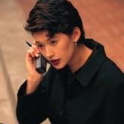
Contact Your Alarm Company
Alarm Company and House-sitters
Advise your alarm company when you are out of town
Provide phone numbers to contact you while you’re gone.
Request temporary passwords for house-sitters
Train house-sitters in alarm system operations, cancellation procedures and use of temporary passwords
Notes:
Advise your alarm company if you will be out of town and provide them with phone numbers to contact you in the event of an alarm activation.
If you have house-sitters, ensure they know how to operate the alarm system, cancel a dispatch, and have been provided with temporary passwords.
Inform your alarm company of those temporary passwords and contact phone numbers for the house-sitters.

Slide 7
Safe and Happy Holidays!
With everyone’s help, you make your holidays safe, happy and false alarm free!
Notes:
With everyone’s help, you can make Holidays safe, happy and false alarm free!

Slide 8
Contact Us
False Alarm Reduction Association 10024 Vanderbilt Circle #4 Rockville MD 20850
301- 519-9237
Brad Shipp, Executive Director bradshipp@4yoursolution.com
www.faraonline.org

