Slide 1
Lightning & Alarms
Do Thunderstorms, Lightning and Power Outages equal False Alarms?
Notes:
Power surges and lightning strikes should not cause false alarms!

Slide 2
Lightning & Alarms
A properly designed, installed & maintained alarm system should not generate false alarms and fines due to power surges or power interruptions
Notes:
REMEMBER . . . Properly designed, installed and maintained alarm systems should not generate false alarm activity (AND FINES) due to power surges or power interruptions! Taking the proper precautions will GREATLY reduce false alarms during a storm. However, in the case of a catastrophic lightning strike, the system may malfunction or suffer damage. If this occurs, contact your alarm company to check and or repair your alarm system.

Slide 3
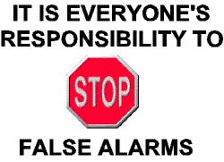
Steps to Avoid False Alarms
Follow the steps on the next slides to avoid false alarms from Lightning

Slide 4
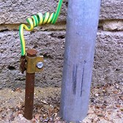
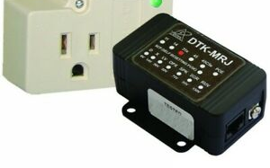
Ground
Alarm systems should be properly grounded
Notes:
False alarms caused by lightning strikes are controllable through the proper grounding of alarm systems and the use of power AND phone line surge suppressors.

Slide 5
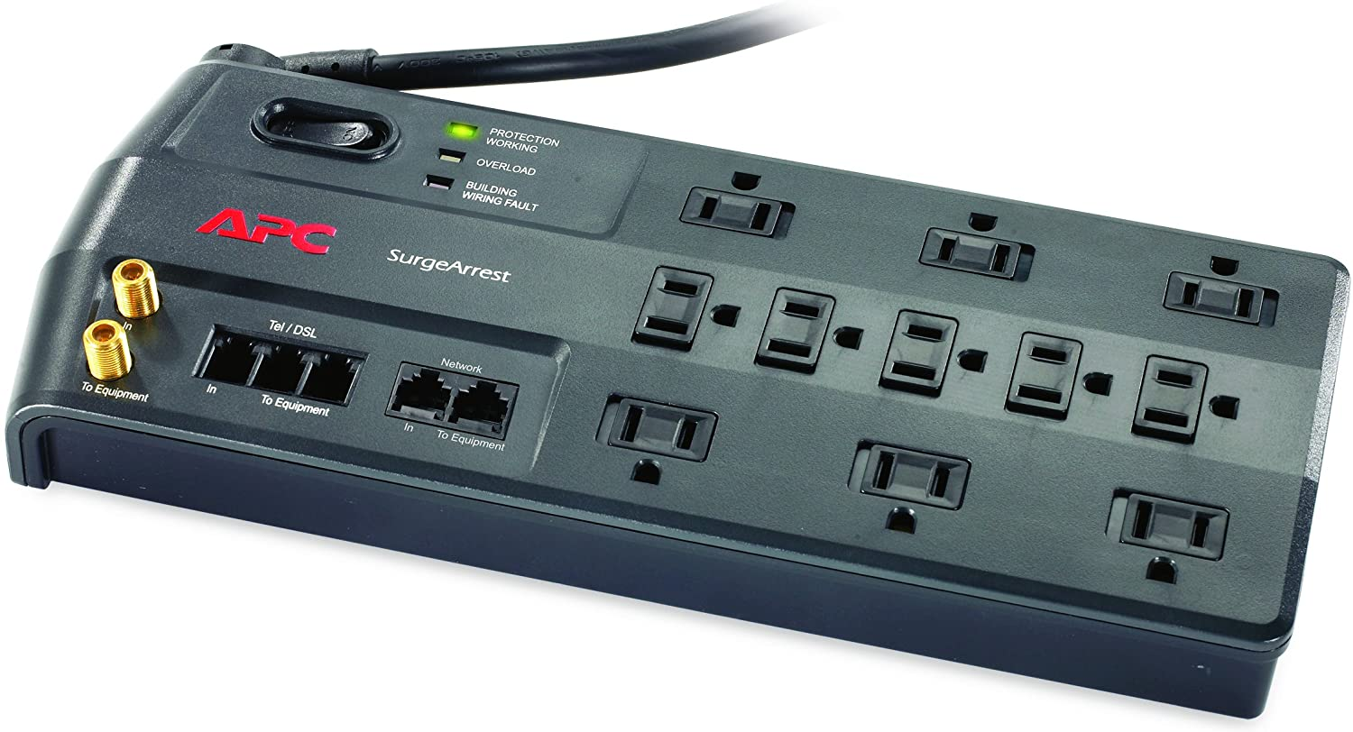
Surge Suppressors
Electrical and phone line surge suppressors should be installed
Notes:
Use of surge suppressors greatly reduces false alarms by redirecting and dissipating electrical current to the ground.

Slide 6
Battery Backup
Ensure the back-up battery is working and will hold a charge for four hours
Notes:
Power outages or interruption of power should not cause false alarms!

Slide 7
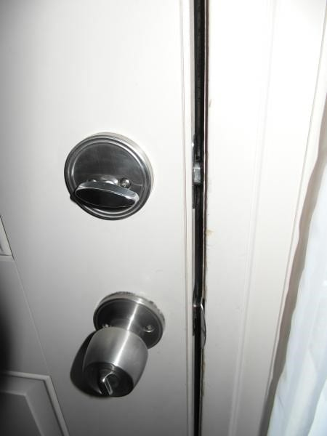
Inspect Doors & Windows
Other Steps to Reduce False Alarms
Repair Loose fitting doors & windows
Ensure all alarm contacts are firmly in place
Use wide-gap door & window contacts
Notes:
In order to avoid costly false alarms that may occur during inclement weather, contact your alarm dealer and follow these simple steps:
• Repair loose fitting doors and windows.
• Ensure that all alarm contacts are firmly in place.
• Use wide-gap door and window contacts.
• Use surge protectors/suppressors on both the alarm system and the phone line sending the alarm signal to the monitoring center.
• Ensure that the battery back-up protection is in good working order, is fully charged and will hold that charge for a minimum of four hours.
• Ensure that your alarm system is properly grounded.

Slide 8
Contact Us
False Alarm Reduction Association 10024 Vanderbilt Circle #4 Rockville MD 20850
301- 519-9237
Brad Shipp, Executive Director bradshipp@4yoursolution.com
www.faraonline.org

