Slide 1

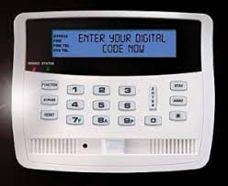
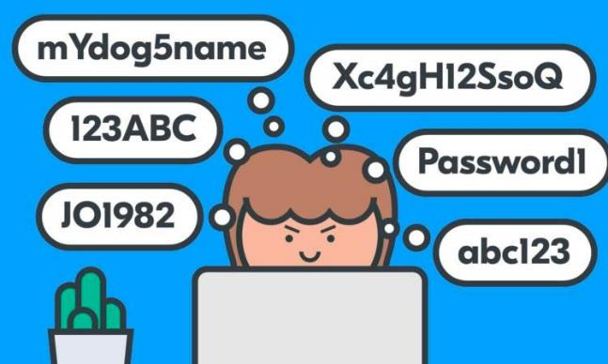
Password vs Passcode
What is the Difference?

Slide 2


Overview
What is a False Alarm?
Password vs Passcode
What is Your Identity Password?
The secret code
Forgot your code?
Contact your Alarm Company
Entry/Exit Passcode vs. Password
What Can My Alarm Company do to Help Me?

Slide 3
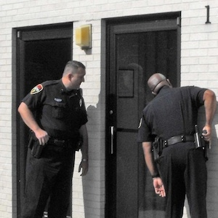
What is a False Alarm?
Notification of an alarm to law enforcement when the responding authority finds no evidence of criminal offense or attempted criminal offense

Slide 4
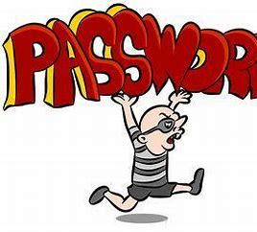
What is the Role of the Password?
Your password is a critical part of avoiding a false alarm
It verifies you are authorized to use the system

Slide 5
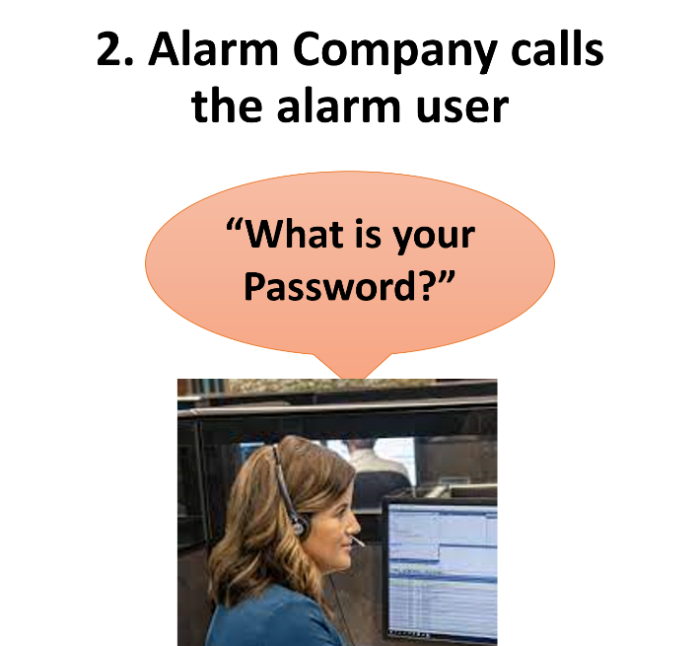
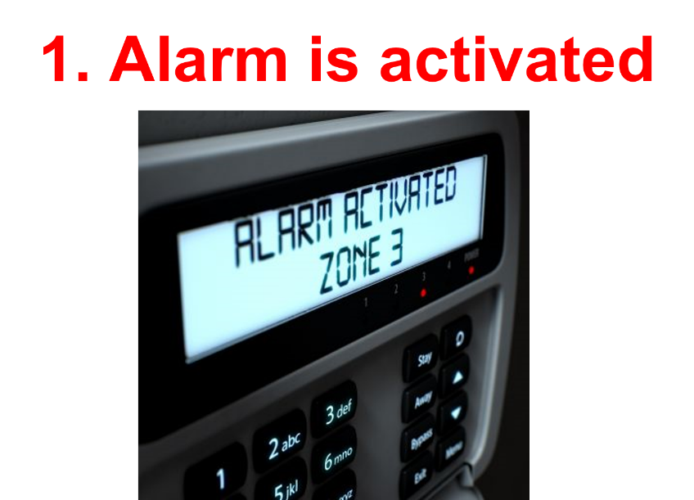
When it Works Correctly….

Slide 6
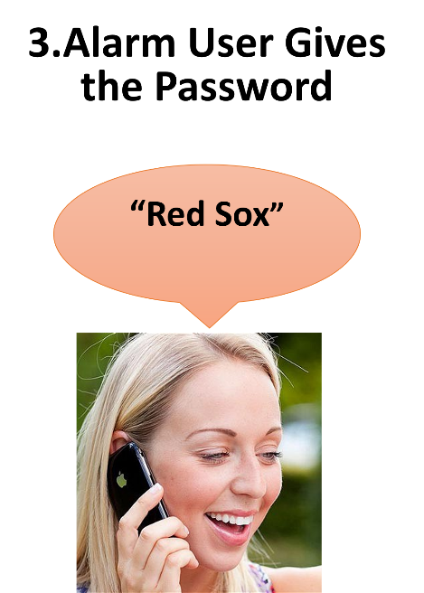
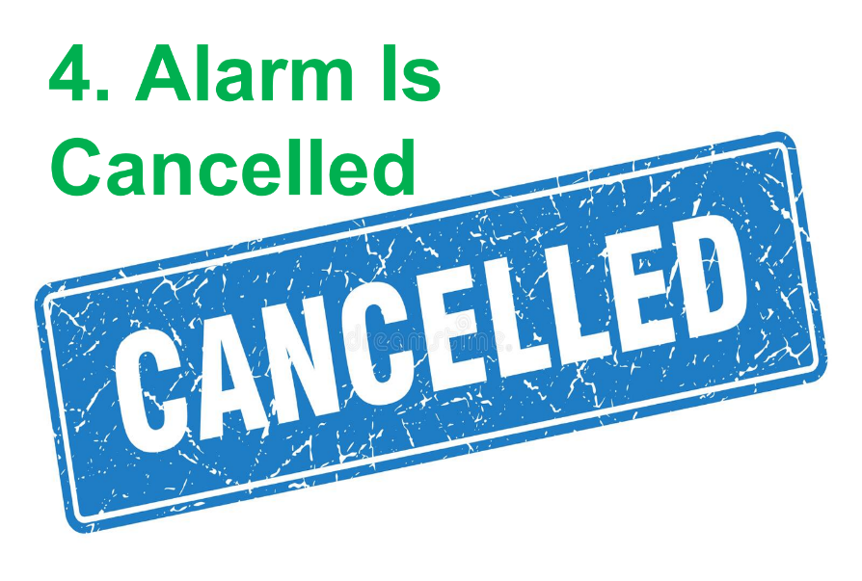
When it Works Correctly

Slide 7

Reality
Few customers will answer correctly on the first try

Slide 8
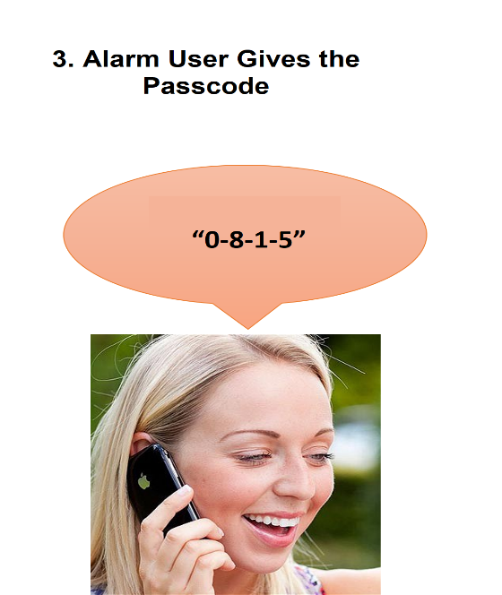
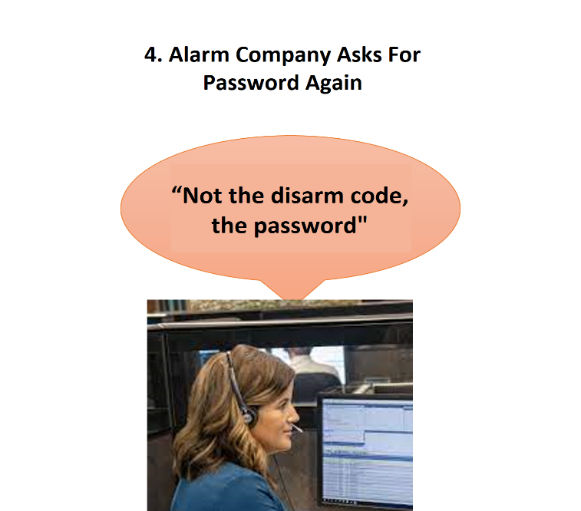
Reality
Few customers will answer correctly on the first try

Slide 9
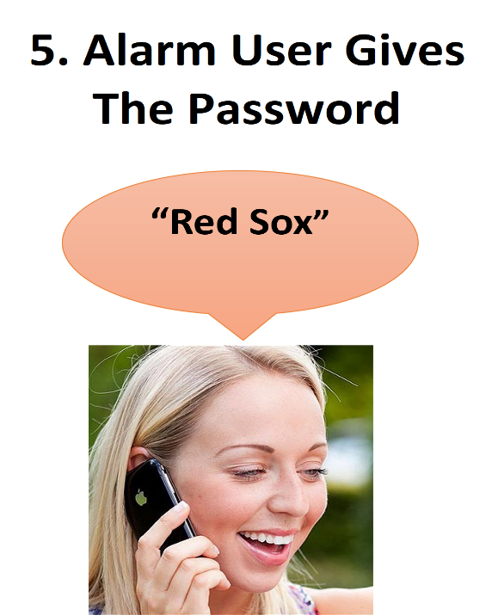
Reality
Few customers will answer correctly on the first try
If you confuse the password & passcode it wastes time
If you forget the password it can lead to a false dispatch

Slide 10
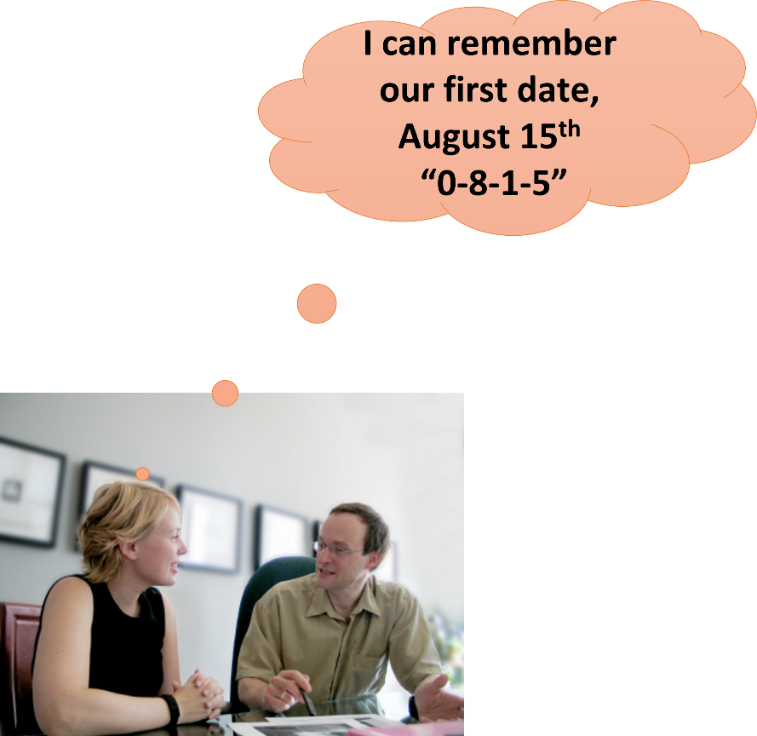
Your Secret Code
When your alarm system was installed
You chose a secret entry/exit code
The sequence of numbers (usually 4 digits)
You enter this into the keypad to arm or disarm your system
You selected a number that was
Easy to remember
For you and others who would be using your system.

Slide 11
Passcode vs Password
Passcode
Used to turn the system on & off
The entry/exit code cannot identify you as an authorized user to the alarm monitoring company, because it is not on file with them
Password
Used to verify you are authorized
The Identity Password is the word you gave the alarm company when you had the alarm system installed
It should be familiar to you and easily recalled
“0815”
We went to a
“Red Sox” game

Slide 12
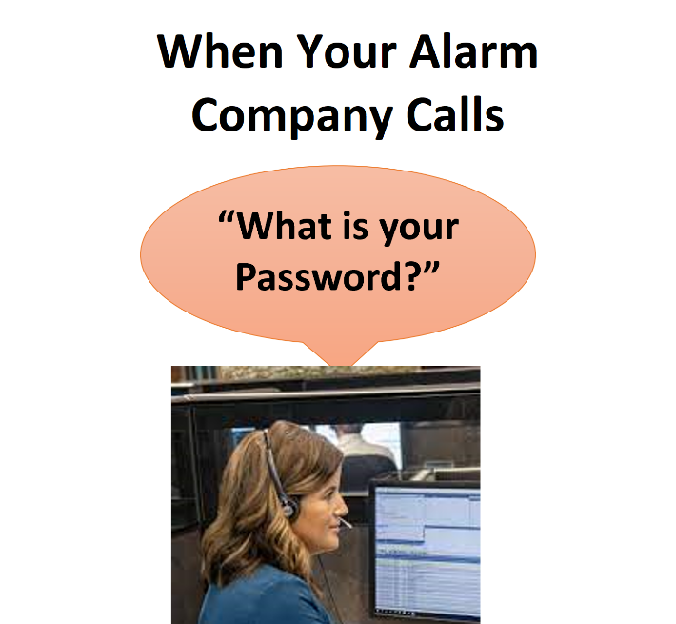

Pop Quiz

Slide 13

Forgot Your Code?
Contact your alarm company
  Your safety is important to them
  You are their customer
The Password is on file with them
  Use something that you will remember
The Passcode is not on file with them
  The alarm company can help you reset your arm/disarm code if you’ve forgotten it

Slide 14



Do You Give People Keys?
Family
Child or Home Care Givers
Domestic help
Real Estate Agents
Contractors
Dog Walkers
Etc.

Slide 15
If You Give Them a Key….
Give Them Both:
Arm/Disarm Passcode AND a Password
EXAMPLE
Your Arm/Disarm Code is 0155
Your Password is “Domestic”

Slide 16
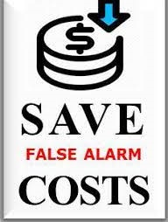
Recap
Keep your monitoring center’s phone number easily accessible
  Do not post the arm/disarm code and password by the panel or with the alarm company phone number
Make sure everyone who has access to your home or business
  Has a valid arm/disarm code
  Has the password used to identify themselves to your alarm company as a valid alarm user
Knowing the difference can save precious minutes in an emergency situation and prevent costly false alarms

Slide 17

Contact Us
False Alarm Reduction Association
10024 Vanderbilt Circle #4
Rockville MD 20850
301- 519-9237
Brad Shipp, Executive Director
bradshipp@4yoursolution.com
www.faraonline.org

