Slide 1
Rearranging-Your-Home-Environment!

Slide 2
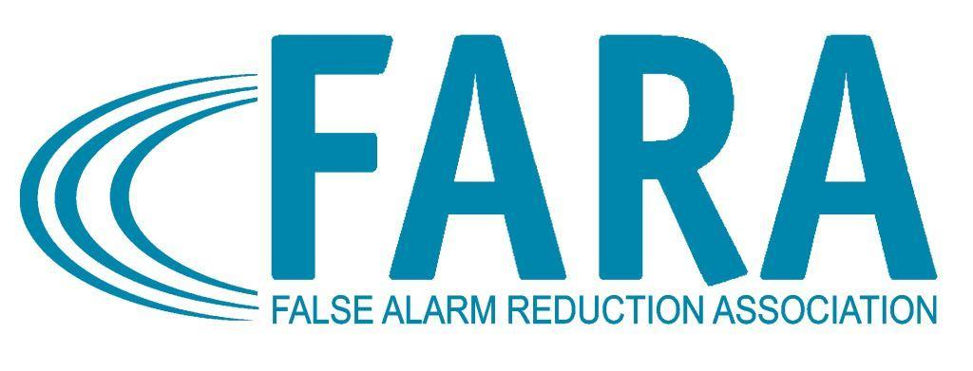
Moving? Buying?
Moving furniture or buying something new can impact your alarm
Notes:
Moving furniture or buying something new?
Don’t forget the impact it could have on your alarm system equipment.

Slide 3
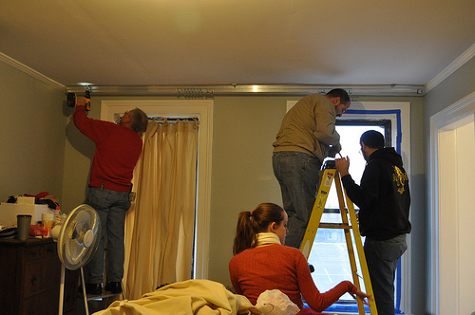
Double Check
Make sure your new furniture, curtains or drapes will not cause a false alarm
Notes:
Before you rearrange your furniture or put up the new spring curtains or drapes, you should first determine whether the design change would interfere with the operation of your security system equipment.

Slide 4
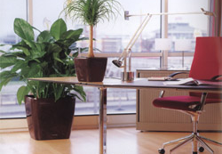
Keep Clear
Keep things out of the view of motion detectors
Notes:
Ensure that nothing is placed in the path of motion detectors, which could cause false alarms, especially when home heating and cooling systems are turned on!
Do not move items such as plants or accessories in view of your motion sensors. Plants and other hanging home accessories can sway and cause your motion sensors to activate.

Slide 5
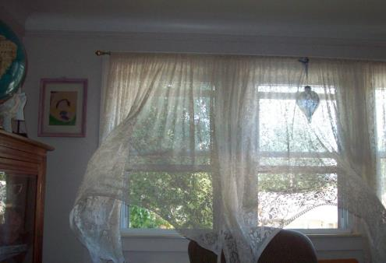
Stay Clear of Windows
Keep new things clear of door & window sensors
Notes:
Ensure that newly placed items or decorations around doors and windows, as well as new window treatments, do not interfere with either the door and window contacts or the motion sensors or glass break sensors.

Slide 6
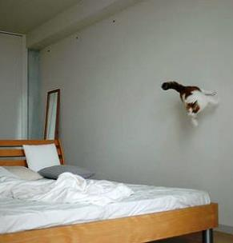
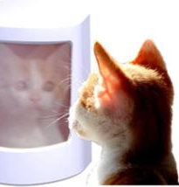
New Pets?
Ensure that your new pet will not cause false alarms
Notes:
Pets can wreak havoc with an alarm system. If your alarm system was designed and installed prior to acquiring a pet, call your alarm company immediately so that a technician can review your system and ensure that your new pet will not cause false alarms.

Slide 7
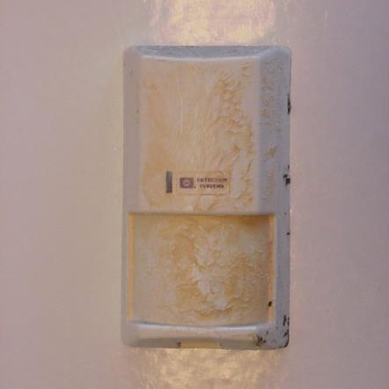
Clean off Dust
Dust will cause false alarms
Notes:
Moving any furniture, painting or remodeling in your home may either uncover or create an accumulation of dust and debris. In order to work properly, the sensors in your alarm system must remain dust and bug free. Make sure to include checking the sensors for dust and spider webs when making any changes to your living environment.

Slide 8
Get a Checkup
When making design or decoration changes have your alarm company do a check up
Notes:
Remember, when making design or decoration changes in your home, it is also a great time to schedule a routine maintenance check-up of your alarm system equipment and to get advice from your alarm company about your proposed design changes.

Slide 9
Contact Us
False Alarm Reduction Association 10024 Vanderbilt Circle #4 Rockville MD 20850
301- 519-9237
Brad Shipp, Executive Director bradshipp@4yoursolution.com
www.faraonline.org
Notes:
There is a great deal of information available at our website Faraonline.org. If you have any questions, please contact FARA’s Executive Director Brad Shipp.
Thank you so much for your participation and I hope that you found the information helpful.

