Slide 1



False Alarm Prevention
For Businesses
Notes:
1
Thank you for taking an interest in preventing false alarms at business sites. This presentation is brought to you by the False Alarm Reduction Association, an international organization dedicated to supporting false alarm reduction professionals in their mission to reduce false alarms.

Slide 2

Introduction
What is a false alarm?
Why are false alarms a problem?
How do alarm systems work?
What are some causes of false alarms?
What can you do to prevent false alarms?
Notes:
This purpose of this presentation is to educate the alarm user on false alarms in the home. We will go over these topics:
What is a false alarm?
Why are false alarms a problem?
How do alarm systems work?
What are some common causes of false alarms?
Tips for avoiding false alarms

Slide 3

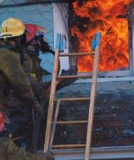
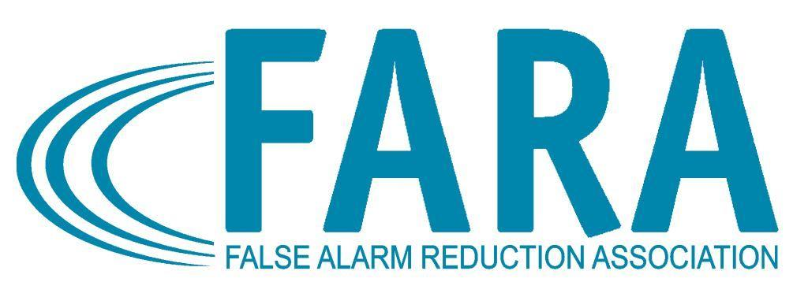
What is a False Alarm?
False Burglar Alarm - A notification of an alarm to law enforcement when the responding authority finds no evidence of criminal offense or attempted criminal offense
False Fire Alarm - A notification of a fire signal, resulting from a cause other than an actual fire
Notes:
Any time an alarm activation caused for any reason other than criminal or fire-related activity is considered a “False Alarm!”

Slide 4

Impacts of False Alarms
Takes officers and fire fighters away from real emergencies
Delay response when you really need it
Wastes public resources
Notes:
False alarms take officers and fire fighters away from real emergencies. The time emergency officials spend responding to false alarms can have devastating effects. This takes away from their ability to do their job effectively, wasting valuable tax payer resources and it delays response when you really need it.

Slide 5
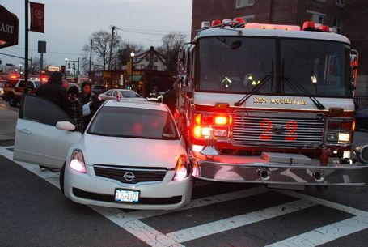
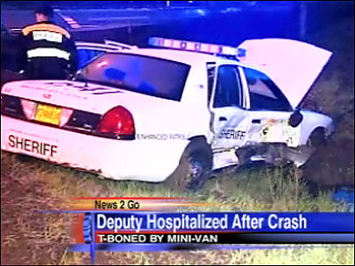
False Alarm Impacts
Endangers responding authorities and the whole community
Notes:
Time emergency officials spend responding to false alarms can have devastating effects. This takes away from their ability to do their job effectively, wasting valuable tax payer resources. When your alarm “crys wolf!”, several times, the community as a whole will not take the actual valid alarm seriously when it happens.

Slide 6

Another False Alarm
Desensitizes to actual crime/fire
Leads to ignoring alarms going off
Notes:
When your alarm “cries wolf!”, several times, the community as a whole will not take the actual valid alarm seriously when it happens.
Desensitize communities to actual incidents of crime and fire.

Slide 7


Impacts Continued…
May make you reluctant to arm your system, exposing your business to undetected theft
Notes:
When your alarm is not used or maintained effectively, it cannot do the job it was designed to do.

Slide 8

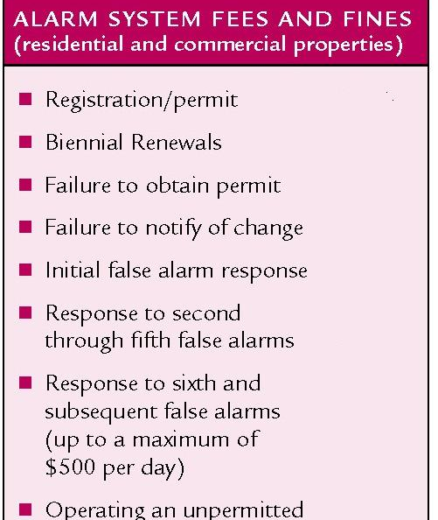
Impacts Continued…
Cost time & money
False alarm fines
Lost time
Service charges
Notes:
This is basically “throwing money down the drain.” Multiply this factor by many careless alarm users and everyone pays in the end, including those individuals who are responsible for their alarm systems or choose not to use one. Many cities and counties have passed ordinances imposing stiff fines or fees for excessive false alarm responses.

Slide 9




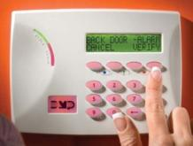

The Alarm Process
Siren Sounds- But Silent On Holdup
Employee Trips
Control Panel
Alarm Sent to Alarm Company Central Station
Intruder Trips
Control Panel
Police Dispatched
Alarm Company
Calls to Verify
Then Calls
Public Safety
Fire Dispatched
Fire Trips
Control Panel
Notes:
Sensors Report - A master control unit - the brains of an alarm - system interprets signals from the sensors based on the nature of the emergency. It can notify all occupants of the home or business by noise or beeping.
Monitoring Center Notification - A monitored security system sends a signal to the alarm dealers central station. Automation within the central station interprets the signal and directs the central station operator to the proper course of action.
Alarm is Verified - The monitoring operator contacts your location to obtain a code word confirming or discounting the alarm activation prior to requesting public safety dispatch.
Responding Authority Notification - This may include notification to the police, fire, medical or just owner notification for non-emergency events.

Slide 10



Common Causes of False Alarms…
Lack of proper training for people given access to your business, such as cleaning people, delivery personal, repairmen, etc…
Notes:
Majority of false alarms are caused by human error, usually by those individuals who have not been properly trained on how to use the system.

Slide 11

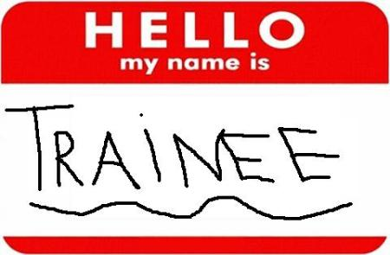
More Common Causes
Improperly trained new staff
Notes:
In many businesses frequent turnover of managers and staff can lead to false alarms unless the new staff is properly trained.

Slide 12
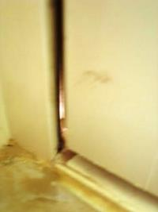
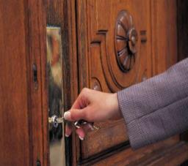
More Common Causes
Open, unlocked or loose fitting doors and windows
Notes:
It is not uncommon for alarm users, particularly those in a hurry, fail to properly secure their doors or windows when setting the alarm system. If doors or windows do not fit properly, this may also cause false activations.

Slide 13
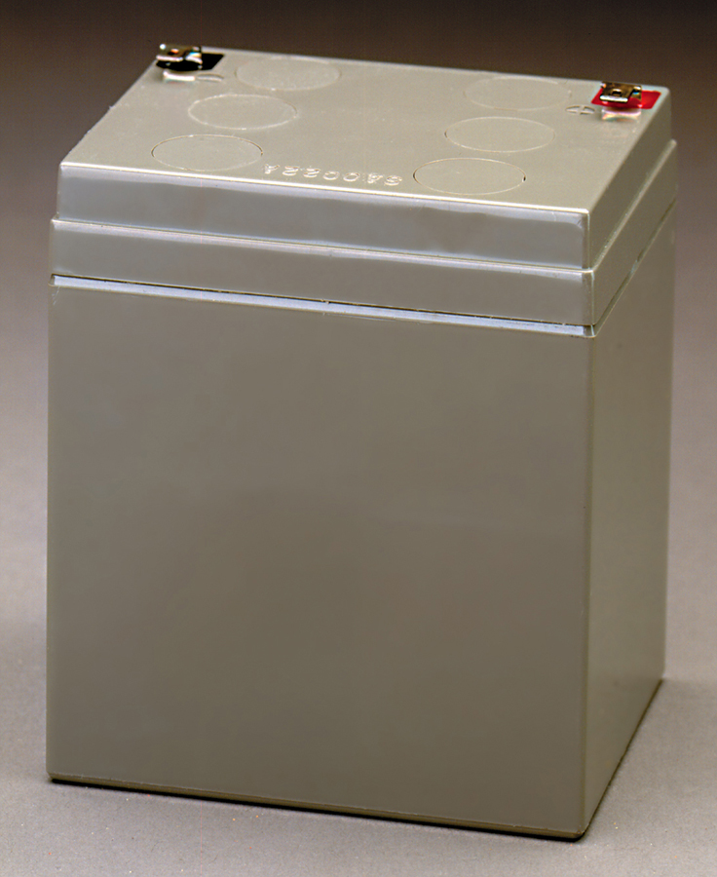
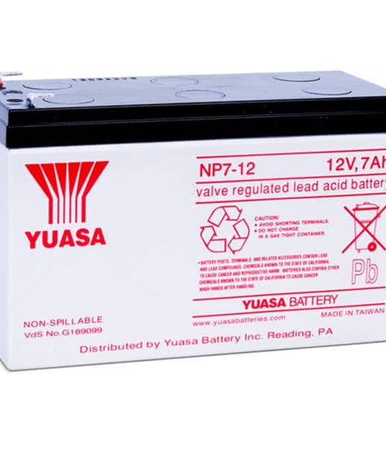
More Common Causes
Weak batteries
Notes:
It is not uncommon for alarm users, particularly those in a hurry, fail to properly secure their doors or windows when setting the alarm system. If doors or windows do not fit properly, this may also cause false activations.
Often times, emergency personnel find loose animals in the home, setting off motion sensors.
It is also not uncommon for an old or weak battery to set off alarm activations after a power outage or surge.

Slide 14




Another...
Drafts from heating/air conditioning systems and signs moving plants, balloons, etc.
Notes:
Motion sensors will not only pick up movement of humans in the premises, they will also detect movement from the “non-human” variety.
Look for items that can move within the “view” of your motion detectors causing false alarms. This will include drape and plant movements caused by drafts from heating/ac vents and the like. Another frequent offender are balloons or signs floating in front of motion sensors.

Slide 15
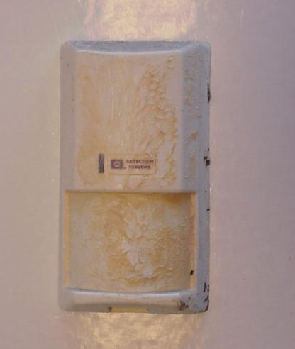


And a Few More...
Insects, dust or dirt on motion or smoke sensors
Notes:
Cleaning motion sensors are important, because things like insects or heavy dust and dirt on them will cause false activations.
Remember! Motion sensors are designed to pick up movement!

Slide 16
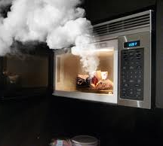
Last but not Least...
Cooking fumes will trip smoke detectors

Slide 17

False Alarm Prevention Tips for Businesses
Notes:
So! What can you do to prevent false alarms in your business? Let’s talk about that.
Fully train new system users! Hold monthly training sessions to teach proper operation and how to cancel accidental activations.
Thoroughly train temporary holiday employees to avoid holiday-related false alarms.
Look for items that can move within the “view” of your motion detectors, causing false alarms.
Give special consideration to the installation of motion detectors in high bay areas with overhead doors, large exhaust fans or ceiling vents, which allow entry of birds.
Ensure all doors and windows are secure and locked before arming your system.
Ensure that floor mounted contacts are not being used on overhead/rollup doors. Instead, use track-mounted wide gap contacts on BOTH sides of the door. Require activation by BOTH contacts to trigger the alarm.
Don’t change pass codes and/or arming codes without advising your authorized users. If a pass code is changed notify your alarm company.
Your central monitoring station should not request a law enforcement dispatch for power outages, low battery signals or loss of telephone connections.
Immediately contact your alarm provider if you alarm system is not working properly.
Service and maintain your system (including batteries) regularly before false alarms occur.
If your business requires hold-up protection, use dual-action devices only.
Upgrade old alarm systems to current equipment that conform to Security Industry Association (SIA) false alarm prevention standards.

Slide 18
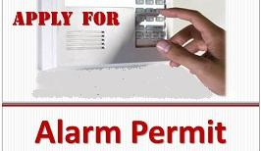
Before You Activate
Check with your local jurisdiction for registration requirements
Notes:
Check with your local jurisdiction for registration requirements.
Notify your local Alarm Coordinator when phone numbers or situations change.

Slide 19

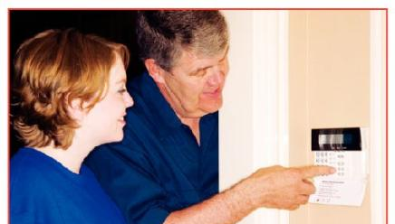

Before You Activate
Understand how the alarm system works; what it does and does not do
Ask your alarm company for written instructions, a DVD and a demonstration
Notes:
Completely understand how the alarm system works; what it does and does not do.
Ensure that all users of your system are provided thorough instruction on using and testing the system and cancelling unnecessary false alarm dispatch requests.
Ask your alarm company for written instructions and a physical demonstration of the use of your alarm system.

Slide 20

Before Turning on your Alarm System when leaving…
Make sure all alarmed doors and windows are locked
Notes:
Take to do a check anytime you leave your home before turning on your alarm system.
Make sure all windows and doors are secured and properly locked.
Restart the exit time if you reenter the business (forgot something, get the phone, etc)

Slide 21
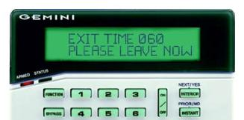
Before Turning on your Alarm System when leaving…
Restart the exit time if you reenter
Notes:
Take to do a check anytime you leave your home before turning on your alarm system.
Make sure all windows and doors are secured and properly locked.
Restart the exit time if you reenter the business (forgot something, get the phone, etc)

Slide 22


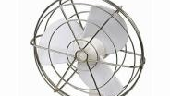

Keep Clear of Motion Detectors
Keep balloons, fans, heaters, plants, curtains, decorations & pets from motion sensor areas
Notes:
Look for items that can move within the “view” of your motion detectors, causing false alarms.
Secure or move fans, heaters, plants, curtains and decorations away from motion sensor areas.
Give special consideration to the installation of motion detectors in high bay areas with overhead doors, large exhaust fans or ceiling vents, which allow entry of birds.
Ensure stock is securely stored on shelves.

Slide 23
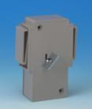


Holdup or Panic Switches
Use switches that need simultaneous two-button activation
Train all personnel on when the button should and should not be used
Do not use in areas where items will be stored around or on top of the device
Notes:
Use switched that need simultaneous two-button activation.
Train all personnel on when the button should and should not be used.
Do not use in areas where items will be stored around or on top of the device.

Slide 24
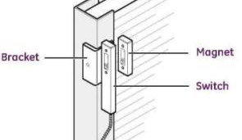
Overhead Doors
Do not use floor mounted contacts on overhead/rollup doors
Instead, use track-mounted wide gap contacts on BOTH sides of the door
Require activation by BOTH contacts to trigger the alarm
Notes:
Ensure that floor mounted contacts are not being used on overhead/rollup doors. Instead, use track-mounted wide gap contacts on BOTH sides of the door. Require activation by BOTH contacts to trigger the alarm.

Slide 25
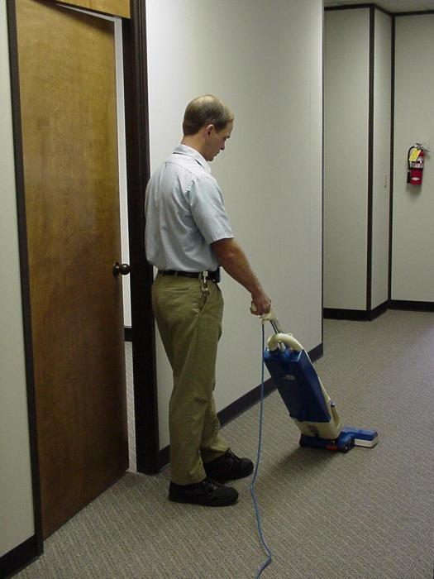
Training is Important!
Teach ALL users how to operate your system, including:
Arming codes
Passwords
Phone numbers
Cancellation procedures
Notes:
Educate everyone who has legal access to your businesses such as cleaners, repairmen or delivery persons.
All users should be properly trained in how to operate your system, including knowledge of correct arming codes, passwords, telephone numbers and cancellation procedures for accidental activations.
Don’t change pass codes and arming codes without advising the appropriate authorized users. If pass codes are changed notify your alarm company.

Slide 26

Train Early & Often
Train all new employees
Include in monthly meetings
Follow-up after false alarms
Be proactive - cover common causes before they occur
Notes:
Thoroughly train all authorized alarm users.
Hold monthly training sessions to teach proper operation of the alarm system and how to cancel accidental activations.
Thoroughly train temporary employees to avoid false alarms.
Thoroughly train temporary holiday employees to avoid holiday-related false alarms.
Have your alarm system instructions readily available in case of an accidental alarm activation.

Slide 27
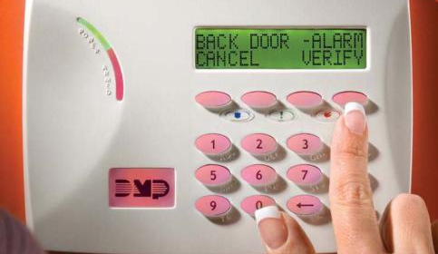
Identify the Cause
Make sure your alarm system identifies the sensor that caused the alarm activation
Notes:
Ensure your alarm system identifies the device that caused the alarm activation.

Slide 28


Notify your alarm company …
Before you test your system
If your system is not working properly
If you plan to remodel or install new wiring of any kind (telephone, DSL, VoIP, etc.)
Notes:
Notify your security company if…
Your system is not working properly
You plan to remodel or install new wiring of any kind (telephone, DSL, VoIP, etc.)
You hire domestic help, get a new pet, or plan to sell your house
Before you test your system

Slide 29
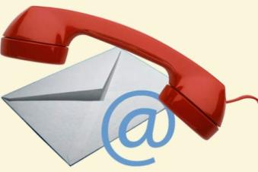
Update Your Alarm Company
When you get new employees who will open or close
When phone numbers change
Before you do remodeling
Change your hours
Notes:
Update Your Alarm Company:
When you get new employees who will open or close your site
When phone numbers for the site or contacts change
When you do remodeling
Communicate business hours to your monitoring company.

Slide 30
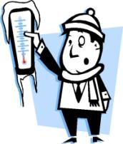
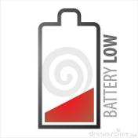

Tell Your Alarm Company
Do Not dispatch public safety on
Power outages
Weather related signals
Low battery signals
Temperature sensors
Notes:
Your central monitoring station should not request a public safety dispatch for power outages, low battery signals or loss of telephone connections, weather related signals, or temperature sensors.
Your central monitoring station should be notifying you so someone at the location can make sure the system is working properly. Call for Technical Assistance if required.

Slide 31



Request ECV!
Tell your monitoring company to use Enhanced Call Verification (ECV)
ECV requires making two calls to a responsible party prior to requesting a dispatch
Notes:
Tell your monitoring company to use Enhanced Call Verification (ECV), which requires making two calls to a responsible party prior to requesting a law enforcement dispatch.

Slide 32
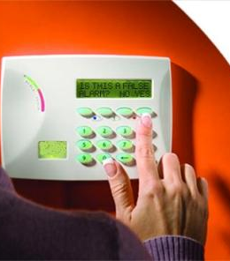
Cancel False Alarms
Follow your alarm companies instructions to cancel all false alarms
Notes:
Review alarm cancellation procedures with anyone who has access to the alarm site.

Slide 33
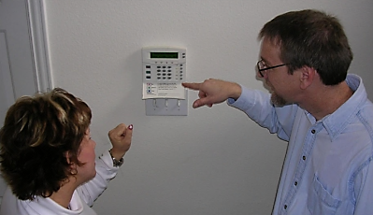
Ask For Help!
Ask your alarm company for help
To train new users
Find the cause for each false alarm
Plan for a new addition or remodel
Notes:
Review alarm cancellation procedures with anyone who has access to the alarm site.

Slide 34
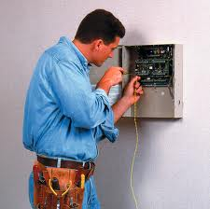
Maintain Your Alarm
Keep your alarm system in proper operating condition
Upgrade old systems
Notes:
Accept the responsibility to keep your alarm system in proper operating condition.
Immediately contact your alarm provider if you believe your alarm system is not working properly.
Service and maintain your system (including batteries) per your alarm company/alarm manufacturer’s recommendation before false alarms occur.
Upgrade old alarm systems to current equipment that conform to Security Industry Association (SIA) false alarm prevention standards.

Slide 35
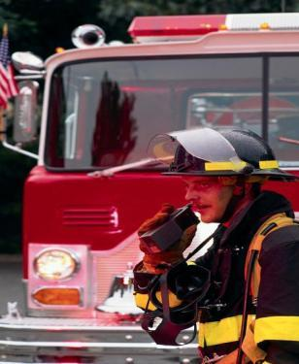
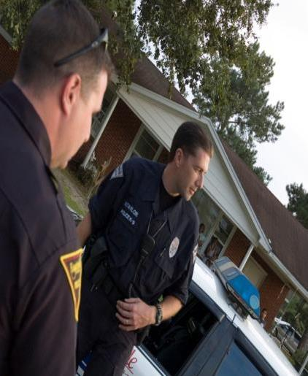

Why?
Public safety resources are limited and should never be wasted
Thousands of hours are spent investigating alarm reports that turn out to be “false alarms”
Notes:
Public safety resources are limited and should never be wasted. Thousands of patrol hours are spent investigating alarm reports that turn out to be “false alarms”.
When used and maintained properly, alarm systems are important tools for Public Safety and the community. When you pay for an alarm system, you want it to do its job and assist in protecting your school. Everyone is entitled to quick emergency response, so make sure your system is not depriving someone else in need by taking the steps to prevent false alarms.
In the end, everyone benefits.

Slide 36
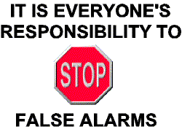
Remember

Slide 37

Contact Us
False Alarm Reduction Association
10024 Vanderbilt Circle #4
Rockville MD 20850
301- 519-9237
Brad Shipp, Executive Director
bradshipp@4yoursolution.com
www.faraonline.org

