Slide 1



False Alarm Prevention For
Places of Worship
Notes:
1
Thank you for taking an interest in preventing false alarms at places of worship. This presentation is brought to you by the False Alarm Reduction Association, an international organization dedicated to supporting false alarm reduction professionals in their mission to reduce false alarms.

Slide 2

Introduction
What is a false alarm?
Why are false alarms a problem?
How do alarm systems work?
What are some causes of false alarms?
What can you do to prevent false alarms?
Notes:
This purpose of this presentation is to educate the alarm user on false alarms in places of worship. We will go over these topics:
What is a false alarm?
Why are false alarms a problem?
How do alarm systems work?
What are some common causes of false alarms?
Tips for avoiding false alarms

Slide 3

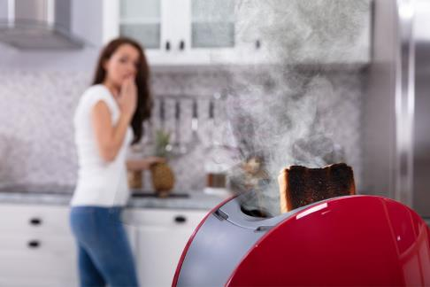
What is a False Alarm?
False Burglar Alarm - A notification of an alarm to law enforcement when the responding authority finds no evidence of criminal offense or attempted criminal offense
False Fire Alarm –
A notification of a fire signal, resulting from a cause other than an actual fire

Slide 4
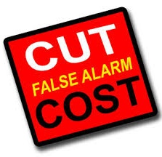
Impacts of False Alarms
Takes officers and fire fighters away from real emergencies
Delay response when you really need it
Wastes public resources
4

Slide 5
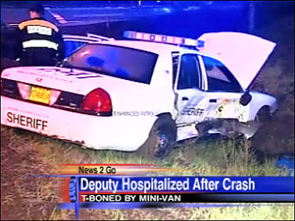
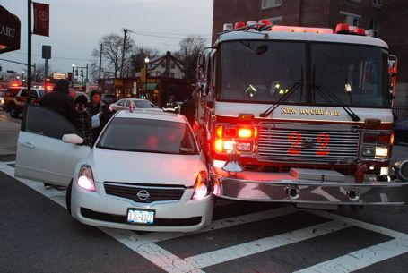
False Alarm Impacts
Endangers responding authorities and the whole community

Slide 6

Another False Alarm
Desensitizes to actual crime/fire
Leads to ignoring alarms going off
Notes:
When your alarm “cries wolf!”, several times, the community will not take the actual valid alarm seriously when it happens.
Numerous false alarms desensitize communities to actual incidents of crime and fire.

Slide 7

False Alarm Impacts Continued…
May make you reluctant to arm your system, exposing your school to undetected theft
Notes:
When your alarm is not used or maintained effectively, it cannot do the job it was designed to do.

Slide 8

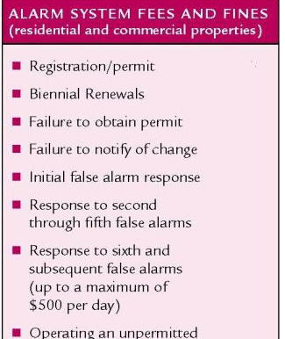
False Alarm Impacts Continued…
Cost time & money
False alarm Fines
Lost time
Service charges
Notes:
This is basically “throwing money down the drain.” Multiply this factor by many careless alarm users and everyone pays in the end, including those individuals who are responsible for their alarm systems or choose not to use one. Many cities and counties have passed ordinances imposing stiff fines or fees for excessive false alarm responses. The list of alarm system fees and fines are some examples of items that could accrue fees and will change depending on your local alarm ordinance.

Slide 9
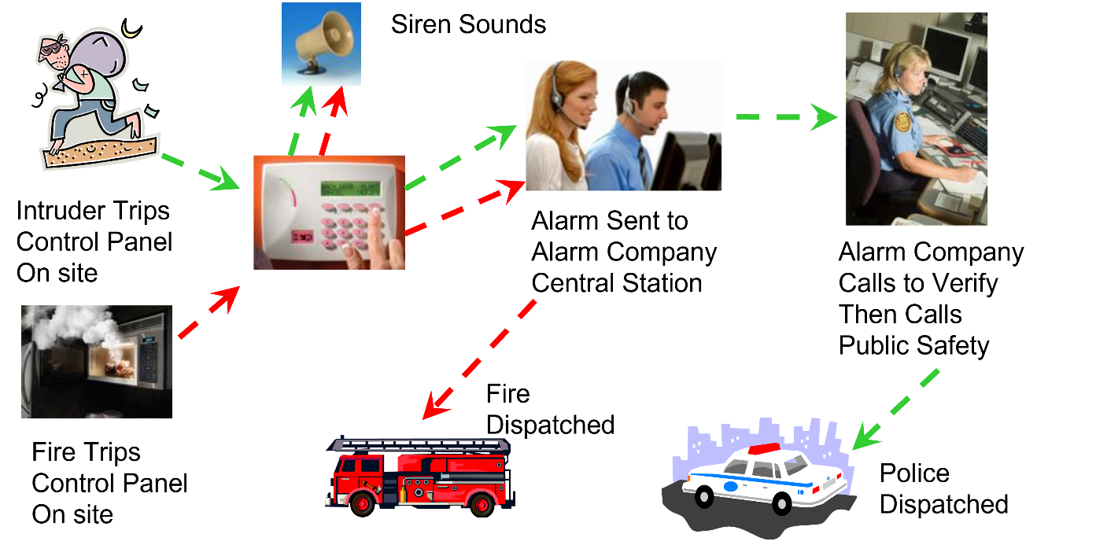
The Alarm Process

Slide 10
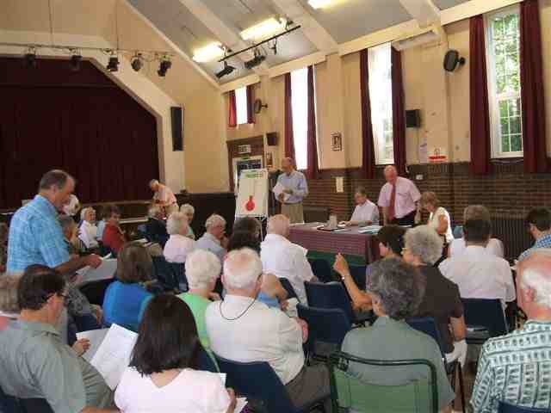

COMMON CAUSES OF FALSE ALARMS…
Lack of proper training for people given access to your building, such as teachers, workers, meeting attendees, etc…
Notes:
Majority of false alarms are caused by human error, usually by those individuals who have not been properly trained on how to use the system.

Slide 11

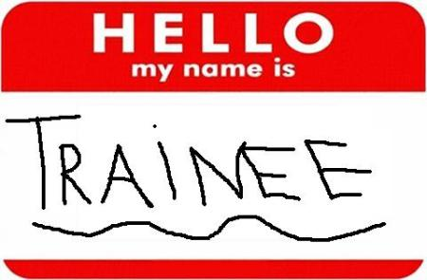
More Common Causes
Improperly trained new staff
Notes:
In many places of worship frequent turnover of staff can lead to false alarms unless the new staff is properly trained.

Slide 12
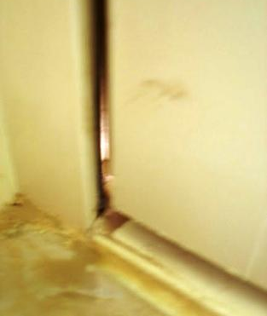
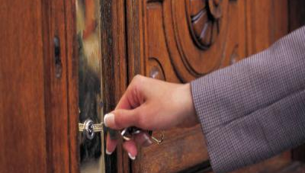
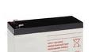
More Common Causes
Open, unlocked or loose fitting doors and windows
Weak batteries
Notes:
It is not uncommon for alarm users, particularly those in a hurry, fail to properly secure their doors or windows when setting the alarm system. If doors or windows do not fit properly, this may also cause false activations.
It is also not uncommon for an old or weak battery to set off alarm activations after a power outage or surge.

Slide 13
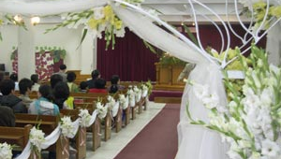



Another...
Drafts from heating/air conditioning systems and signs moving plants, balloons, decorations, etc.
Notes:
Motion sensors will not only pick up movement of humans in the premises, they will also detect movement from the “non-human” variety. This will include drape and plant movements caused by drafts from heating/ac vents and the like.
Another frequent offender are balloons floating in front of motion sensors.

Slide 14
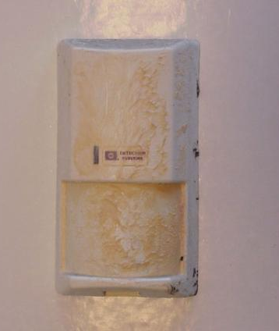


And a Few More...
Insects, dust or dirt on motion or smoke sensors
Notes:
Cleaning motion sensors are important, because things like insects or heavy dust and dirt on them will cause false activations.
Remember! Motion sensors are designed to pick up movement!

Slide 15
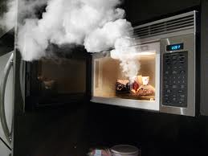
Last but not Least...
Cooking fumes will trip smoke detectors

Slide 16


False Alarm Prevention Tips for Places of Worship
Notes:
So! What can you do to prevent false alarms in your place or worship? Let’s talk about that.
Worship facilities share unique circumstances often contributing to the overall false alarm problem. These circumstances include frequent turnover of volunteers, constant public access, in-house schools and daycare centers, fundraising activities, and multiple service providers and delivery personnel.
Thoroughly train all authorized alarm users.
Limit the number of people who have keys to the facility.
Hold monthly training sessions to teach proper operation of the alarm system and how to cancel accidental activations.
Thoroughly train temporary holiday alarm users to avoid holiday-related false alarms.
Look for items that can move within the “view” of your motion detectors causing false alarms.
Ensure that an authorized church member is on-site to properly arm and disarm the alarm when community or other groups use the facility.
Secure and lock all doors and windows before arming your system.
Don’t change pass codes and arming codes without advising the appropriate authorized users. If pass codes are changed notify your alarm company.
Your central monitoring station should not request a law enforcement dispatch for power outages, low battery signals or loss of telephone connections.
Immediately contact your alarm provider if you believe your alarm system is not working properly.
Service and maintain your system (including batteries) regularly before false alarms occur.
If your facility requires wireless hold-up protection, use dual-action devices only.
Upgrade old alarm systems to current equipment that conform to Security Industry Association (SIA) false alarm prevention standards.

Slide 17
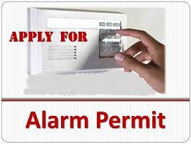
Before You Activate
Check with your local jurisdiction for registration requirements
Notes:
Check with your local jurisdiction for registration requirements.
Notify your local Alarm Coordinator when phone numbers or situations change.

Slide 18

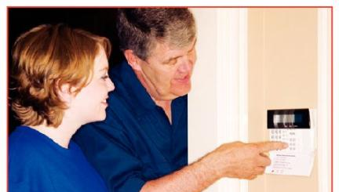

Before You Activate
Understand how the alarm system works; what it does and does not do
Ask your alarm company for written instructions, a DVD and a demonstration
Notes:
Completely understand how the alarm system works; what it does and does not do.
Ensure that all users of your system are provided thorough instruction on using and testing the system and cancelling unnecessary false alarm dispatch requests.
Ask your alarm company for written instructions and a physical demonstration of the use of your alarm system.

Slide 19
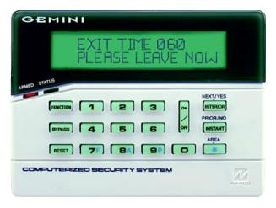

Before Turning on your Alarm System when leaving…
Make sure all alarmed doors and windows are locked
Restart the exit time if you reenter
Notes:
Take to do a check anytime you leave your place of worship before turning on your alarm system.
Make sure all windows and doors are secured and properly locked.
Restart the exit time if you reenter the business (forgot something, get the phone, etc)

Slide 20


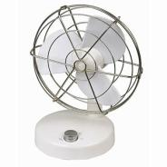
Keep Clear of Motion Detectors
Keep balloons, fans, heaters, plants, curtains, & decorations from motion sensor areas
Notes:
Look for items that can move within the “view” of your motion detectors, causing false alarms.
Secure or move fans, heaters, plants, curtains and decorations away from motion sensor areas.

Slide 21
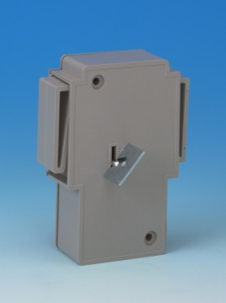


Holdup or Panic Switches
Use switches that need simultaneous two-button activation
Train all personnel on when the button should and should not be used
Do not use in areas where items will be stored around or on top of the device
Notes:
Use switched that need simultaneous two-button activation.
Train all personnel on when the button should and should not be used.
Do not use in areas where items will be stored around or on top of the device.

Slide 22
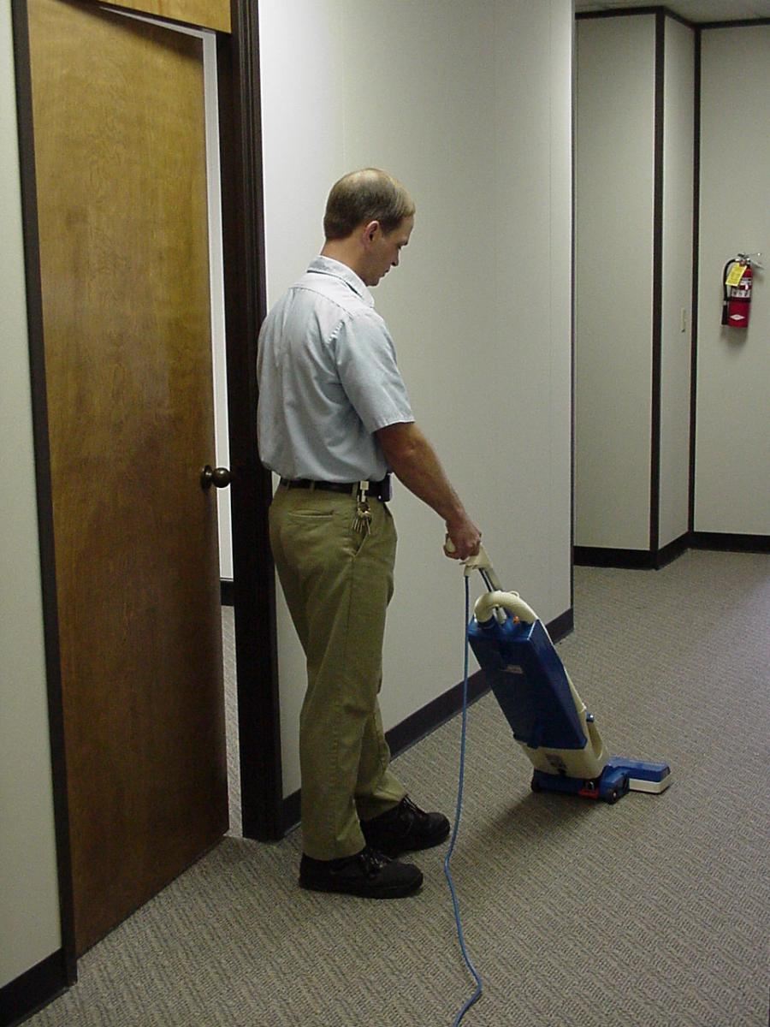
Training is Important!
Teach ALL users how to operate your system, including:
Arming codes
Passwords
Phone numbers
Cancellation procedures
Notes:
Educate everyone who has legal access to your place or worship such as cleaners, repairmen or delivery persons.
All users should be properly trained in how to operate your system, including knowledge of correct arming codes, passwords, telephone numbers and cancellation procedures for accidental activations.
Don’t change pass codes and arming codes without advising the appropriate authorized users. If pass codes are changed notify your alarm company.

Slide 23

Train Early & Often
Train all new employees
Include in Monthly meetings
Follow-up after false alarms
Be proactive – cover common causes before they occur
Notes:
Thoroughly train all authorized alarm users.
Hold monthly training sessions to teach proper operation of the alarm system and how to cancel accidental activations.
Thoroughly train temporary employees to avoid false alarms.
Thoroughly train temporary holiday employees to avoid holiday-related false alarms.
Have your alarm system instructions readily available in case of an accidental alarm activation.

Slide 24
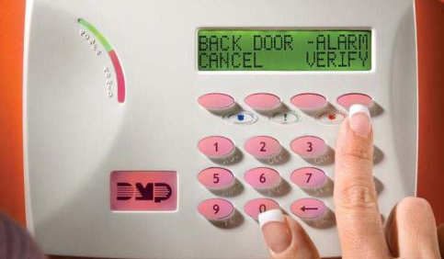
Identify the Cause
Make sure your alarm system identifies the sensor that caused the alarm activation
Notes:
Ensure your alarm system identifies the device that caused the alarm activation.

Slide 25
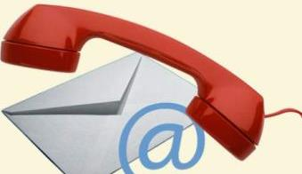
Update Your Alarm Company
When you get new employees who will open or close
When phone numbers change
Before you do remodeling

Slide 26
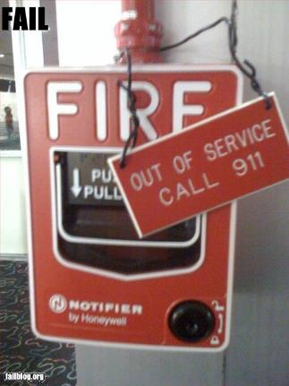

Notify your alarm company …
Before you test your system
If your system is not working properly
If you plan to remodel or install new wiring of any kind (network, telephone, DSL, VoIP, etc.)
Notes:
Notify your security company if…
Your system is not working properly
You plan to remodel or install new wiring of any kind (telephone, DSL, VoIP, etc.)
Before you test your system

Slide 27
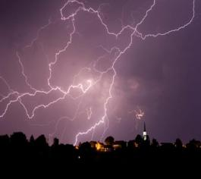
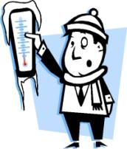
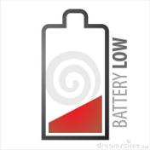
Tell Your Alarm Company
Do Not dispatch public safety on
Power outages
Weather related signals
Low battery signals
Temperature sensors
Notes:
Your central monitoring station should not request a public safety dispatch for power outages, low battery signals or loss of telephone connections, weather related signals, or temperature sensors.
Your central monitoring station should be notifying you so someone at the location can make sure the system is working properly. Call for Technical Assistance if required.

Slide 28



Require ECV!
Tell your monitoring company to use Enhanced Call Verification (ECV)
ECV requires making two calls to a responsible party prior to requesting a dispatch
Notes:
Tell your monitoring company to use Enhanced Call Verification (ECV), which requires making two calls to a responsible party prior to requesting a law enforcement dispatch.

Slide 29
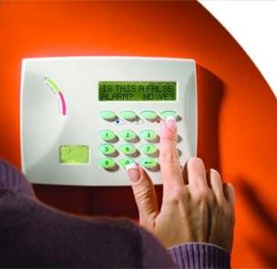

Cancel False Alarms
Follow your alarm company’s instructions to cancel all false alarms
Notes:
Review alarm cancellation procedures with anyone who has access to the alarm site.

Slide 30
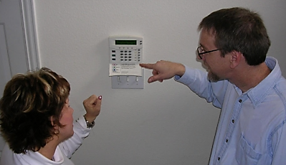
Ask For Help!
Ask your alarm company for help
To train new users
Find the cause for each false alarm
Plan for a new addition or remodel
Notes:
Review alarm cancellation procedures with anyone who has access to the alarm site.

Slide 31
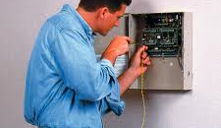
Maintain Your Alarm
Keep your alarm system in proper operating condition
Upgrade old systems
Notes:
Accept the responsibility to keep your alarm system in proper operating condition.
Immediately contact your alarm provider if you believe your alarm system is not working properly.
Service and maintain your system (including batteries) per your alarm company/alarm manufacturer’s recommendation before false alarms occur.
Upgrade old alarm systems to current equipment that conform to Security Industry Association (SIA) false alarm prevention standards.

Slide 32
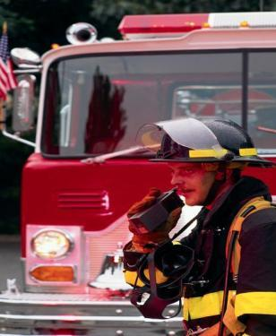
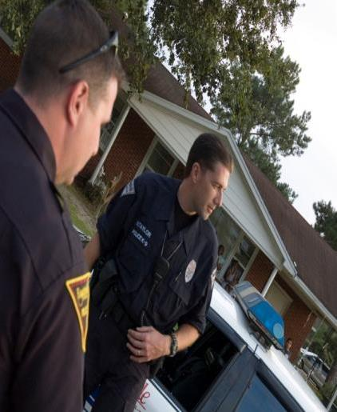
Why?
Public safety resources are limited and should never be wasted
Thousands of hours are spent investigating alarm reports that turn out to be “false alarms”
Notes:
Public safety resources are limited and should never be wasted. Thousands of patrol hours are spent investigating alarm reports that turn out to be “false alarms”.
When used and maintained properly, alarm systems are important tools for Public Safety and the community. When you pay for an alarm system, you want it to do its job and assist in protecting your school. Everyone is entitled to quick emergency response, so make sure your system is not depriving someone else in need by taking the steps to prevent false alarms.
In the end, everyone benefits.

Slide 33
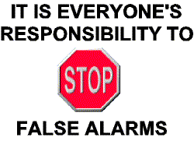
Remember

Slide 34

Contact Us
False Alarm Reduction Association
10024 Vanderbilt Circle #4
Rockville MD 20850
301- 519-9237
Brad Shipp, Executive Director
bradshipp@4yoursolution.com
www.faraonline.org

