Slide 2
Checklist
House & Pet Sitters hired
Mail & Newspapers stopped or picked up
Lawn Service to care for the yard
Timers set on interior lighting
Credit Card Company notified of your travel plans
Local Police house watch arranged
Notes:
You’ve been counting the days until it is time to leave. You are certain that you haven’t forgotten anything you need to do to ensure your home is secure and running smoothly while you are gone.

Slide 3
Before You Go- What about your alarm system?
Notify your alarm company
When you will be gone
Who is authorized to be in your home
Update your contact information
Give them a number where you can be reached
Notes:
WHAT ABOUT YOUR SECURITY SYSTEM?
Most security alarm users don’t give a second thought about the alarm system. They automatically arm it as they leave and never stop to consider that it could cause numerous false alarms while they are gone, because they failed to take a few minutes to update vital information and train all temporary users!
Call your alarm company and:
➢ Tell them what days you will be gone
➢ Update your emergency contact information, including who has keys to your home
➢ Give them a number to reach you, preferably a cell phone number, should your alarm system activate while you are away

Slide 4
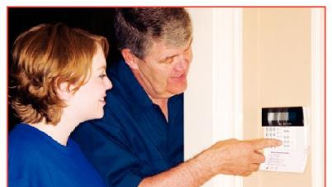
Before You Go
Train each person who will enter
how to use the system
how to cancel an alarm
what to do if a false alarm occurs
Notes:
Train each person who will enter the premises on how to use the system, including bypassing the motion detector, what to do if an alarm occurs, and how to cancel an alarm.

Slide 5
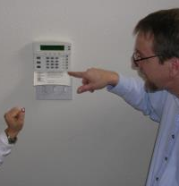
Before You Go
Give each person their own disarming code for the system and their own password for the monitoring center
Notes:
Give each person who will enter the premises their own disarm code for the keypad and a passcode/password to give to the monitoring center if an accidental alarm occurs.

Slide 6
Contact Us
False Alarm Reduction Association 10024 Vanderbilt Circle #4 Rockville MD 20850
301- 519-9237
Brad Shipp, Executive Director bradshipp@4yoursolution.com
www.faraonline.org

