Slide 1
Appropriate Use of Duress, Hold-up, and Panic Alarms.

Slide 2
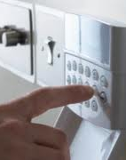
Duress Alarm
Silent alarm
Alarm user enters a Duress code into the keypad.
Duress code is different from the regular arm and disarm codes.
Alerts the monitoring company that the alarm user is being forced to turn the alarm system off against the user’s will
Notes:
A duress alarm is a silent alarm, which is generated when an alarm user enters a designated code into the alarm system keypad. This designated code is different from the regular arm and disarm codes. It alerts the monitoring company that the alarm user is being forced to turn the alarm system off against the user’s will.

Slide 3
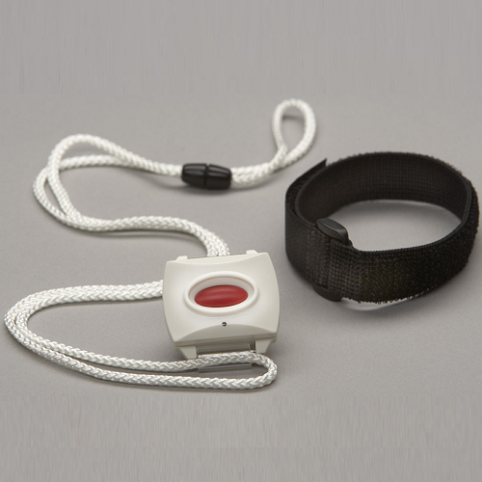
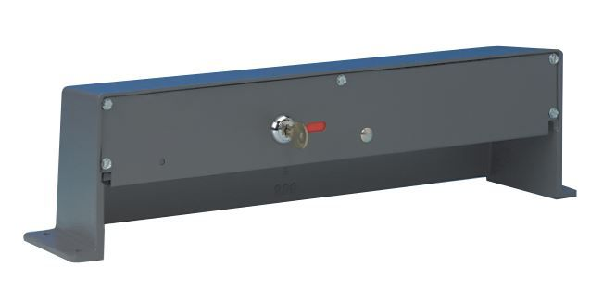
Holdup Alarm
Silent alarm
User manually activates a device (button, floor pedal, money clip, key fobs and pendants, etc.)
Intended to alert the monitoring company that a robbery is in progress
Notes:
A hold-up (or robbery alarm), is a silent alarm, which is generated when an alarm user manually activates a device (button, floor pedal, money clip, key fobs and pendants, etc.) that is intended to alert the monitoring company that a robbery is in progress.

Slide 4
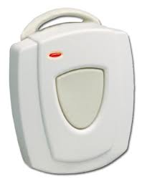
Panic Alarm
Audible alarm
Manual activation of a device
Intended to alert the monitoring company that a life threatening, or emergency situation is occurring
Notes:
A panic alarm is generally an audible alarm, which is generated by the manual activation of a device intended to alert the monitoring company that a life threatening or emergency situation is occurring, much like the hold-up alarm but not indicating a robbery in progress.

Slide 5
When to Use Holdup, panic, duress
Armed Robbery
Life threatening situation
Forced to turn off alarm
Emergency situation when you are unable to dial 9-1-1

Slide 6
When not to use Holdup, panic, duress
For fire or medical assistance
To report a theft, or a fight
To ask for an Officer for a nonthreatening situation
Car accident
When you are able to dial 9-1-1
A verbal report will usually get a higher priority response

Slide 7
Contact Us
False Alarm Reduction Association 10024 Vanderbilt Circle #4 Rockville MD 20850
301-519-9237
Brad Shipp, Executive Director bradshipp@4yoursolution.com
www.faraonline.org

