Slide 1
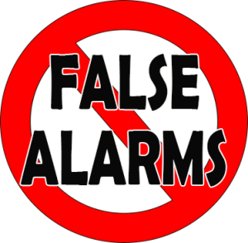
ENHANCED CALL VERIFICATION ECV

Slide 2
What is Enhanced Call Verification?
Enhanced Call Verification is a way to double check on an alarm before law enforcement is called
Notes:
Enhanced Call Verification is a simple and effective way that you can prevent law enforcement from responding to a false burglar alarm at your home or business. It requires your alarm company to attempt to verify a burglar alarm activation by making a minimum of two phone calls to two different numbers prior to dispatching law enforcement.
The first call is to the home or business where the alarm is occurring, and, having failed to reach a responsible party, a second call is made to a different phone number that will be answered after hours or when the alarm owner is away. The most effective second call is to a cell phone.
The Enhanced Call Verification procedure is only used for burglar alarm signals. All fire, medical, panic, hold-up or duress and robbery signals would follow the dispatch procedures required by your local ordinance and/or policies and in accordance with the alarm company’s standard operating procedures.

Slide 3
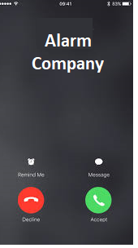
Two Calls are Made
Option One
Two people are called before Law Enforcement is contacted

Slide 4
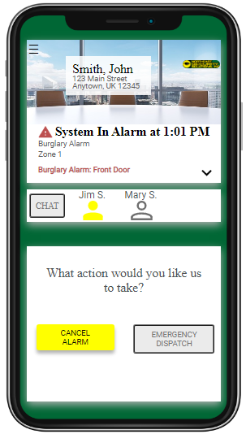
Text
Option Two
Alarm Company texts the user to confirm or cancel the alarm

Slide 5
Use An App
Option Three
User can confirm or cancel the alarm on an app

Slide 6
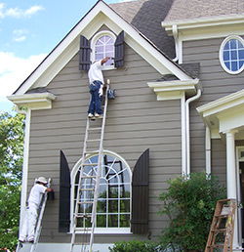
ECV provides opportunities to cancel accidental alarm activations before requesting law enforcement response
When activity, such as home repairs, cleaning crews, employees closing, etc. causes an alarm
With Enhanced Call Verification, and the knowledge of what is happening at your home or business, you can stop these types of false alarms from leading to a call to law enforcement
Notes:
Enhanced Call Verification works because it provides two opportunities to cancel accidental alarm activations before requesting law enforcement response. As the alarm user, you are familiar with the activity occurring at your home or business, such as home repairs, cleaning crews, employees closing, etc. However, when that activity causes a false alarm, you may not be present to cancel the alarm activation, and a request for law enforcement response is made.
With Enhanced Call Verification, and the knowledge of what is happening at your home or business, you can prevent these types of false alarms from occurring.

Slide 7
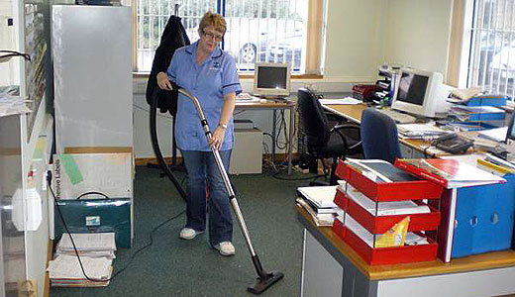
How can ECV benefit you?
Enhanced Call Verification is a simple way to avoid false alarms caused by:
After-hours cleaning crews, scheduled maintenance work, or employees who forget their password
Forgetting to close a window or door before activating your alarm system
Leaving pets in areas protected by motion detectors
Authorized users returning home and not remembering their password
Notes:
Enhanced Call Verification provides alarm users with a simple way to help avoid false alarms and the fines imposed by many cities and counties, including alarms caused by:
After-hours cleaning crews, scheduled maintenance work, or employees who forget their password.
Forgetting to close a window or door before activating your alarm system.
Leaving pets in areas protected by motion detectors.
Authorized users returning home and not remembering their password.

Slide 8
How will ECV benefit the Community?
Communities where Enhanced Call Verification is required have seen law enforcement response to false alarms reduced by 30%-50%
These reductions lower costs, save tax dollars, and help ensure officers will be available to respond to real emergencies
Notes:
Communities where Enhanced Call Verification is required have seen law enforcement response to false alarms reduced by 30%-50%. These reductions lower costs, save tax dollars, and help ensure officers will be available to respond to real emergencies.

Slide 9
How do I request ECV from my Alarm Company?
Contact your alarm company and tell them you want Enhanced Call Verification monitoring procedures for your account
Most alarm companies already offer this service at no cost to the alarm user, and many have made it their standard operating procedure for burglary alarms
Make sure your emergency call list is up-to-date and provide your cell phone number.
Ensure the people selected for Enhanced Call Verification is educated on the correct procedure and knows the necessary passwords

Slide 10
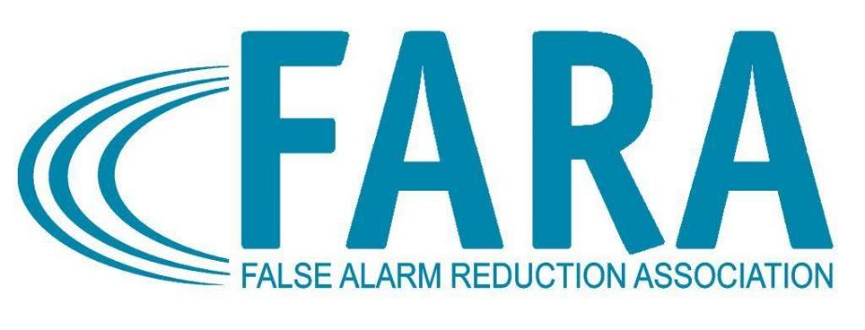
Enhanced Call Verification is endorsed by the International Association of Chiefs of Police and the False Alarm Reduction Association as an effective tool in reducing the number of police dispatches to false burglar alarms
Notes:
Enhanced Call Verification is endorsed by the International Association of Chiefs of Police and the False Alarm Reduction Association as an effective tool in reducing the number of police dispatches to false burglar alarms.

Slide 11
Contact Us
False Alarm Reduction Association 10024 Vanderbilt Circle #4 Rockville MD 20850
301- 519-9237
Brad Shipp, Executive Director bradshipp@4yoursolution.com
www.faraonline.org
http://alarmuser.org/

