Slide 1
False Alarms, Pets and Rodents Cat Burglars on the Prowl?

Slide 2
Consider Pets
Pets can lead to false alarms.
Notes:
Many times officers are dispatched to an alarm triggered by a family pet moving throughout the premises.

Slide 3
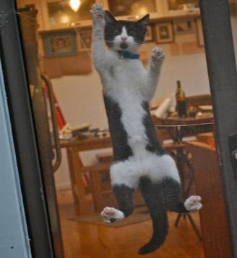
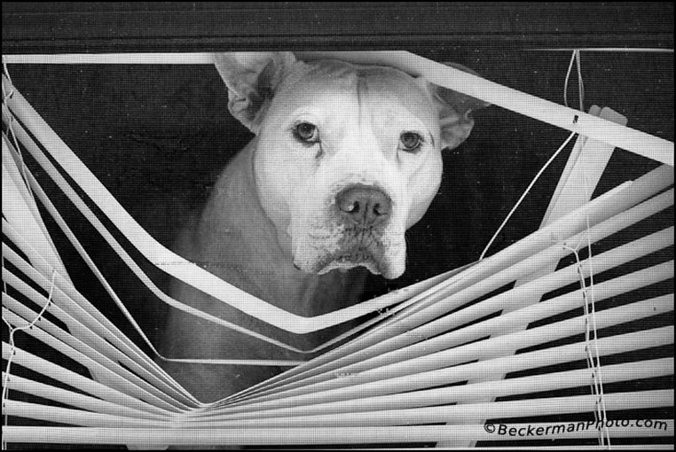
Windows & Doors
Pets will jump at windows & doors.
Avoid window shock sensors.
Notes:
Many pets, especially dogs and cats will jump at windows and doors. Avoid using window shock sensors if you have indoor pets that may jump.

Slide 4
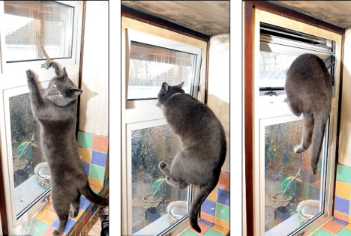
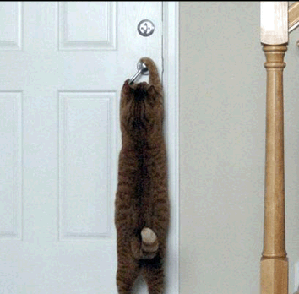
Secure All Doors & Windows
Make sure dogs & cats cannot open doors or windows.
Notes:
Secure all doors and windows before arming the system to prevent any kind of movement or swinging doors. Program an adequate delay time on entry/exit doors. A delay of 45 seconds or more is recommended. Also check to make sure all contacts or sensors are not broken, chipped, or have pinched wiring. Loose door frames will most likely cause a false alarm if they are not tight. These type of repairs should be made immediately. If windows and doors are not tight in their frames, the contacts may become separated or out of alignment, which can signal an alarm activation.

Slide 5
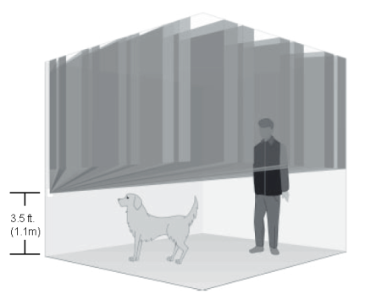
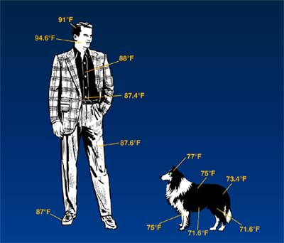
Install Pet Friendly Devices
Some devices ignore lower areas.
Some devices analyze the temperature pattern.
Notes:
Install a pet friendly device to reduce the risk of false alarms on the motion. Special sensors are available to adapt to some pets because problems can occur with new pets or as pets grow over time. Check with your alarm company.

Slide 6
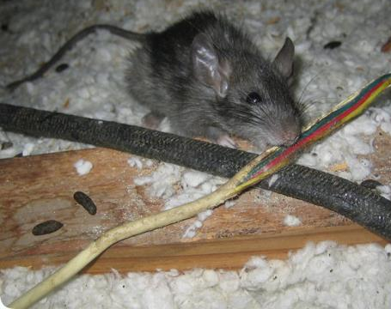
Rodents
Rats and other rodents will chew on wires
Notes:
Have a technician thoroughly inspect the system for possible broken or damaged wires caused by rodents or pests.

Slide 7
Rodents
Rodents will trip motion sensors.
Notes:
Rodents climbing on sensors or running through rooms can also trigger motion detectors.

Slide 8
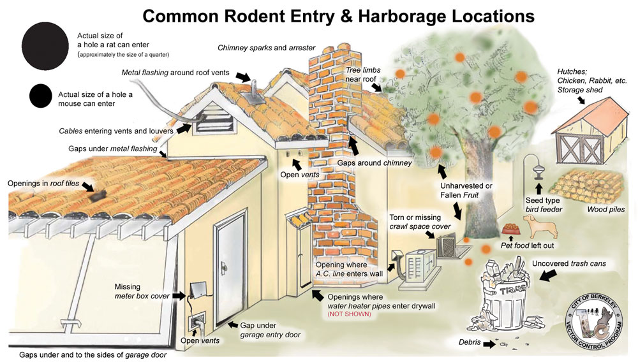
Seal up Rodent Entrances
Notes:
Seal up areas where rodents may enter the premises. Keep garbage containers covered and emptied regularly. Be mindful of areas that are attractive to rodents, reptiles and other vermin, such as wood piles, bird feeders, outside sheds, animal hutches, etc.

Slide 9
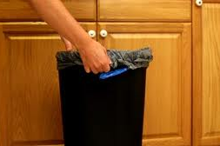
Trash
Take out garbage to minimize the food attraction.
Notes:
Businesses should take out the garbage daily to minimize the food attraction for rodents. Rodents can easily climb shelves and appear larger to the lens and set off the motion.

Slide 10
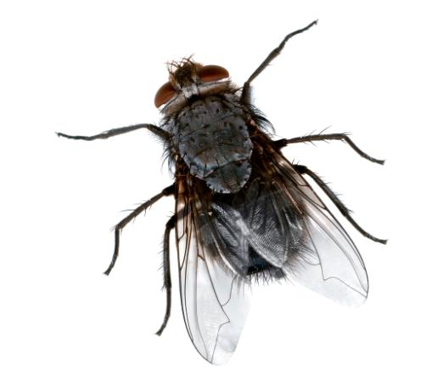
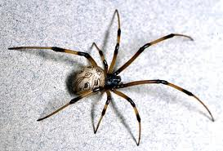
Bugs
Bugs & spider webs can lead to false alarms.
Notes:
Rodents, spiders and critters climbing on the sensor can also trigger motion detectors. Preventative maintenance such as cleaning the sensors and an annual inspection, will prevent unnecessary police response.

Slide 11
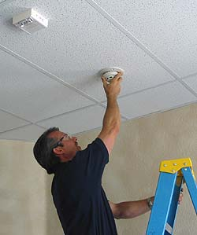
Clean Sensors
Clean sensors on a routine basis.
Notes:
Regular Maintenance
Both the alarm system and the physical site need regular maintenance. Door and windows sensors need to be checked. Alarm systems should be inspected on an annual basis by a licensed or certified alarm technician to ensure the system and all components of the system are in good working order.

Slide 12
Enhanced Call Verification
“No, it is my pet inside. Thank you!”
“This is your alarm company, would you like me to send the police?”
Notes:
Enhanced Call Verification
The central station operators call the customer premises and then, if necessary, a second customer-provided phone number, such as a cell phone, to attempt to verify an alarm before law enforcement is called. Enhanced Call Verification is becoming an industry standard, and during the past year has shown a significant reduction in alarm calls to 911 dispatch centers. False alarm calls to police can be reduced by as much as 40 percent as companies implement the second or multiple-call procedure.

Slide 13
Contact Us
False Alarm Reduction Association 10024 Vanderbilt Circle #4 Rockville MD 20850
301- 519-9237
Brad Shipp, Executive Director bradshipp@4yoursolution.com
www.faraonline.org

