Slide 1
FALSE ALARMS TO GO! FALSE ALARM PREVENTION FOR RESTAURANTS
Notes:
False Alarm Prevention Training for Restaurants

Slide 2
Restaurant Environments are Prone to False Alarms
Notes:
The fast paced and ever changing atmosphere of a restaurant is a breeding ground for false alarms.
Let’s talk about some of the precautions you can take to reduce false alarms in your business.

Slide 3
Hold Monthly Employee Training Sessions
Notes:
Hold Monthly Employee Training Sessions emphasizing the following:
Remind employees to properly secure the building windows and doors before arming the alarm system.
Review the false alarm cancellation procedure including alarm company phone number and password.
Discuss the proper use of hold up or panic buttons and their locations.
Provide thorough instruction on arming and disarming the alarm system.

Slide 4
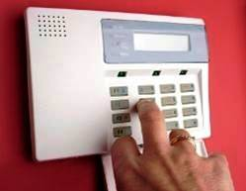
Train Employees in Opening and Closing Procedures
Notes:
Make sure opening and closing employees have the current alarm code and passwords and know how to use each.
The alarm code arms and disarms the system.
The password cancels a public safety dispatch and avoids a false alarm.
Post the alarm monitoring company phone number in an area that is highly visible for employees.

Slide 5
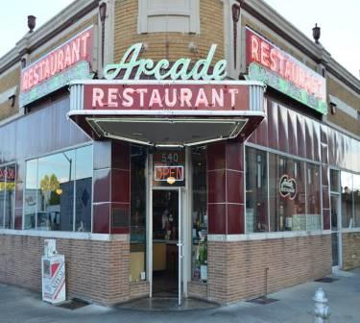
Check Doors and Windows
Notes:
Make sure all doors and windows latch and lock properly. Doors blown open by the wind are still considered false alarms!

Slide 6
Watch Those Decorations!
Notes:
Seasonal decorations, promotional signs and balloons will cause false alarms. Be conscious of your displays.

Slide 7
Maintain Your Alarm System!
Notes:
Be proactive with your alarm system maintenance and battery replacement.
Have the alarm serviced on a regular basis and contact your alarm company to schedule a test at least quarterly.

Slide 8
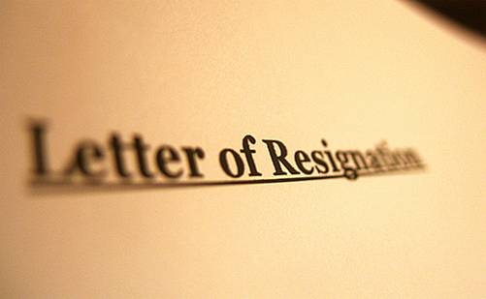
Don’t Forget Alarm Codes and Passwords When Employees Leave!
Notes:
Change alarm codes and passwords when key employees leave or are terminated or assign each employee with their own alarm code and password.

Slide 9
Don’t Let False Alarms Eat Your Profits!
Notes:
False alarms waste precious resources and cost businesses money. Work with your alarm company and local public safety agencies to eliminate false alarms. For more false alarm reduction techniques, please visit ww.faraonline.org.

Slide 10
False Alarm Reduction Association 10024 Vanderbilt Circle #4 Rockville MD 20850
301- 519-9237
Brad Shipp, Executive Director bradshipp@4yoursolution.com
www.faraonline.org
Notes:
For more false alarm reduction techniques, please visit www.faraonline.org.

