Slide 1

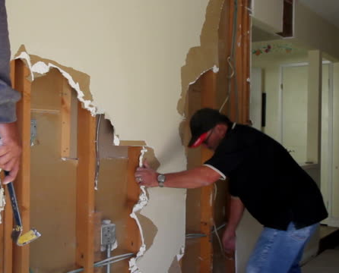

How Remodeling Your Home or Business Can
Cause False Alarms

Slide 2


Contact Your Alarm Co.
Contact your alarm Company BEFORE you remodel
Notes:
Always, always, always contact your alarm company prior to starting any remodeling project. You need to work with your alarm company to make sure the remodeling process does not cause false alarms and that your system will continue to work properly after the work is completed.

Slide 3
Avoid False Alarms
“This is your alarm company, would you like me to send the police?”
Tell your alarm company to call your site and your cell phone before they dispatch
“No, I have workers on site. Thank you!”
Notes:
Consider adding your cell phone as a second contact before law enforcement dispatch is requested.
If you know contractors are on scene doing work, a false alarm dispatch can be avoided.

Slide 4

Possible Problems
Moving or Opening up Walls Ceilings or Floors can
  Disrupt wiring
  Change motion detector patterns
Notes:
Discuss the following situations with your alarm company to determine the best course of action:
▪ Wiring concealed in your walls, floors or ceilings can be disrupted by remodeling projects.
▪ Erecting new walls may inhibit the area your motion detector was designed to see, preventing detection.
▪ New walls can shorten the area the detector is sensing, which may cause a false alarm due to increased sensitivity. New walls may also block radio signals that allow some systems to indicate an alarm.
▪ Tearing down old walls may cause a motion detector to pick up movement it would not normally see with the wall in place. This could include cars on the street, sunlight streaming through a window, or your pet walking through “his part of the house.”

Slide 5

Possible Problems
Outside work can also be a problem
Notes:
▪ Work outside your home including the installation of new siding, roofs, windows and doors will cause a huge ruckus and produce vibration and dust. In some cases alarm wiring may be concealed behind exterior siding. So, even if you are not letting trade people into your home, you still need to be aware of the effects of outside work on your alarm system.

Slide 6


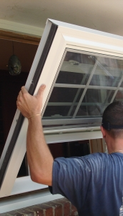
Possible Problems
Removing doors or windows that have alarm sensors can make your system inoperable
Notes:
▪ Removing doors or windows that have alarm sensors can make your system inoperable. Ask your security company about bypassing these zones during construction and have them send a technician to reinstall sensors when the work is complete.

Slide 7
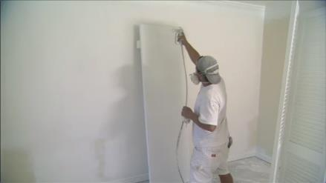
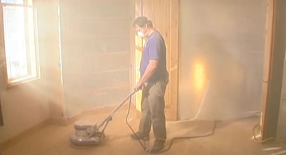
Possible Problems
Dust and Dirt will create issues
Particles will adhere to smoke and motion sensors and will affect their proper operation.
Notes:
▪ Dust and dirt are a necessary evil in all remodeling projects. Particles will adhere to smoke and motion sensors and will affect their proper operation.

Slide 8

Possible Problems
If contractors have keys – train them to use the alarm
Notes:
▪ If you will be away from your home or business during any portion of the remodeling project and decide to provide contractors with keys to your home, ensure that they know how to properly operate your system, understand the procedures to cancel a false alarm dispatch and are provided with temporary passwords.
▪ If a contractor causes a false alarm, you, the alarm user, will be responsible for the unnecessary public safety response.

Slide 9

Possible Problems
Have your system checked after the remodel is finished
Notes:
▪ When the remodeling is completed, have your alarm company inspect and evaluate your alarm system to make sure that it will continue to operate properly.

Slide 10

Avoid False Alarms
Take the time to consider your alarm system and the effects the project will have on it.
Always consult with your alarm company throughout the remodeling project.
Notes:
False alarms during and after a remodeling project can be avoided, if you
take the time to consider your alarm system and the effects the project will
have on it. Always consult with your alarm company throughout the remodeling project.

Slide 11

Contact Us
False Alarm Reduction Association
10024 Vanderbilt Circle #4
Rockville MD 20850
301- 519-9237
Brad Shipp, Executive Director
bradshipp@4yoursolution.com
www.faraonline.org
Notes:
There is a great deal of information available at our website Faraonline.org. If you have any questions, please contact FARA’s Executive Director Brad Shipp.
Thank you so much for your participation and I hope that you found the information helpful.

