Slide 1

Alarm User Awareness Class

Slide 2

What We Will Cover
What is an Alarm System?
What Happens when an Alarm is Activated?
What is a False Alarm
Causes & impacts of false alarms
How to reduce & eliminate false alarms
How Our Alarm Ordinance Impact You
And more….

Slide 3

What is a
False Alarm?
When an alarm is reported and the responding Police or Fire agency investigates and finds no evidence of criminal activity or fire related event.
But it takes several steps to get
to a False Alarm
Notes:
https://youtu.be/pY0imTygoHA

Slide 4


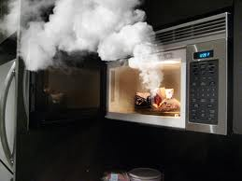
Step 1- An Alarm Activation
Indicates a possible emergency
An alarm activation indicates that a possible emergency requiring follow-up has been detected
As we know not all activations are true emergencies

Slide 5
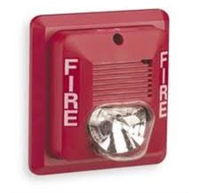

Step 2- An Alarm Sounds
May sound or show the alarm
After the alarm is triggered, one or more sounding or visual indicating devices may activate

Slide 6

Step 3- Notify The Monitoring Center
The alarm activation may then transmit an electronic signal to a monitoring facility

Slide 7
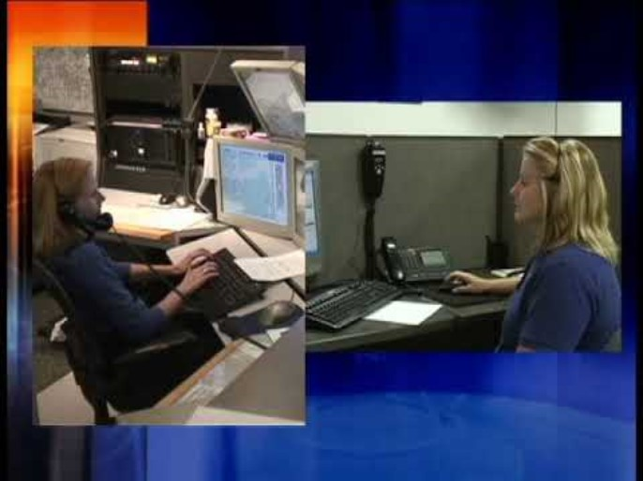
Step 4 -An Alarm Dispatch Request
Verification attempt
Public safety agency is notified
Public safety may request alarm permit number
This leads to a Dispatch….
Notes:
https://youtu.be/sdOcyC1ueDg

Slide 8
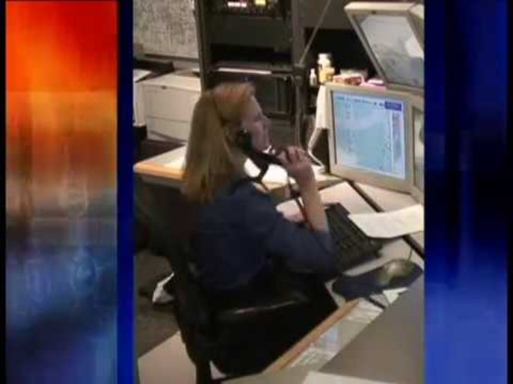
Step 5- Dispatch
Location history may be checked
Hazard information relayed to responder
Type of alarm is given
Next is the Response ….
Notes:
The public safety dispatch center may call the site before dispatching.
If the alarm is cancelled before the responder arrives, fines may not apply.
https://youtu.be/MgCpDy2bwqk

Slide 9
Step 6 - Response
After investigation if no fire or evidence of a crime is found…..
It is a false alarm
Notes:
https://youtu.be/Fq7Hz5Q8P0g

Slide 10
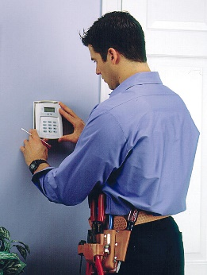
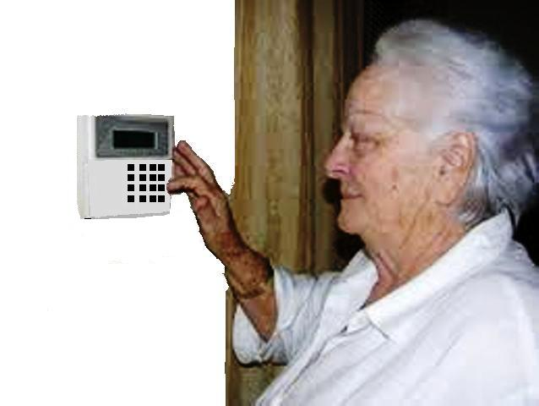


False Alarms Impact Everyone
Alarm industry
Public safety
Alarm users
Public at large
Notes:
We have learned what a false alarm is and can now distinguish between an alarm dispatch request and a false alarm. Now it is time to learn about various costs associated with false alarms.
Every segment of our communities bear some cost for false alarms including the alarm industry, public safety, the alarm user and even the public at large who don’t even have an alarm system.
We will now explore all of those costs.

Slide 11

False Alarm Impacts
Public Safety Availability
Financial Support
Notes:
https://youtu.be/Ez8-N3neu-g

Slide 12
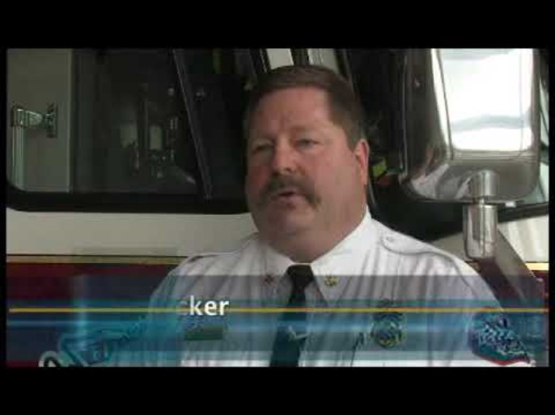
False Alarm Impacts
Causes delays response to Actual Emergencies
Notes:
https://youtu.be/5PtMjlRN9Ss

Slide 13
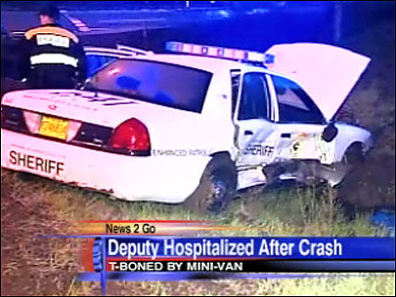
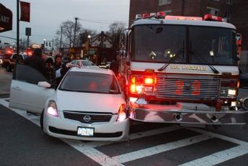
Impacts of False Alarms
Endangers responding authorities and everyone in the community
Notes:
Time emergency officials spend responding to false alarms can have devastating effects. This takes away from their ability to do their job effectively, wasting valuable tax payer resources.

Slide 14

Another False Alarm
Desensitizes to actual crime/fire
Leads to ignoring alarms going off
Notes:
When your alarm “cries wolf!”, several times, the community as a whole will not take the actual valid alarm seriously when it happens. False alarms desensitize communities to actual incidents of crime and fire.

Slide 15
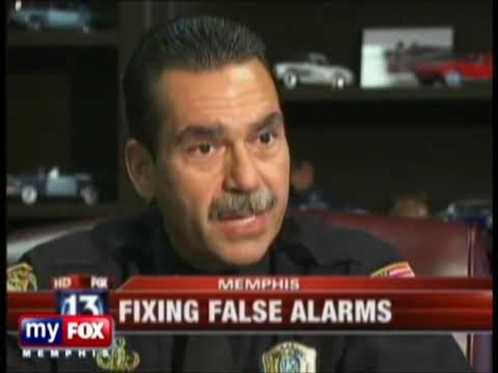
False Alarm Impacts
Cost Billions of Dollars
Notes:
https://youtu.be/DMDln_l3PJY

Slide 16


False Alarm Impacts
Leads to Complacency
Notes:
https://youtu.be/_R5R1_EjdX0

Slide 17
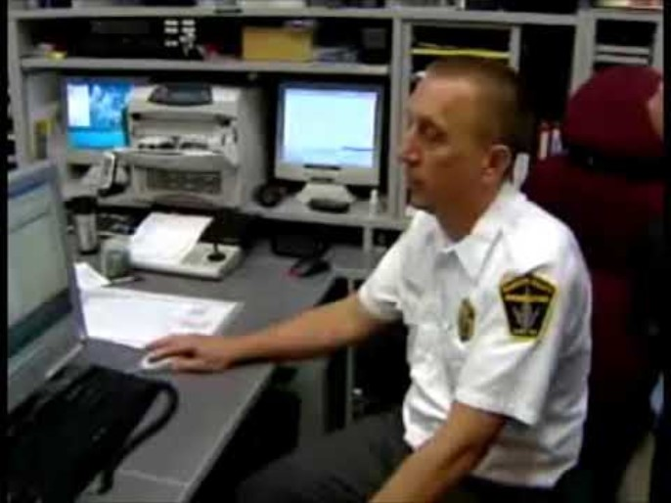
False Alarm Impacts
Leads to Increased 911 Calls
Notes:
https://youtu.be/YJLkYd87_hQ

Slide 18
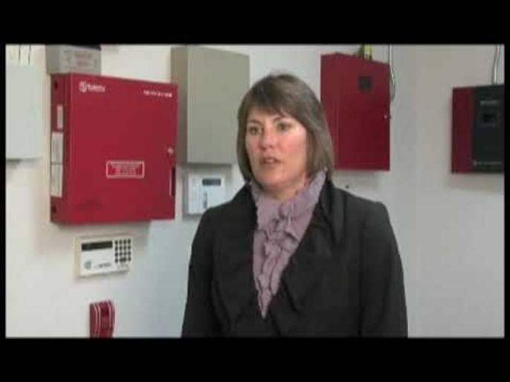
False Alarm Impacts
Cost time & money
False alarm fines
Lost time
Service charges
Notes:
https://youtu.be/S1eLCxeMHd0

Slide 19
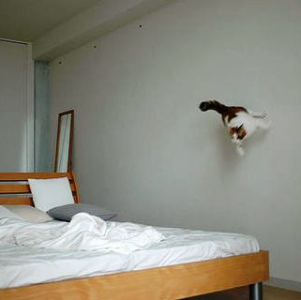
Pets Cause False Alarms
Make sure pets will not interfere with the system now or in the future
Remember many pets will grow

Slide 20

Vibration & Sounds Cause False Alarms
Consider Possible sounds & vibrations
  Is there a lot of truck traffic?
  Will birds fly at the windows?
Notes:
https://youtu.be/GanQO58bKLI

Slide 21
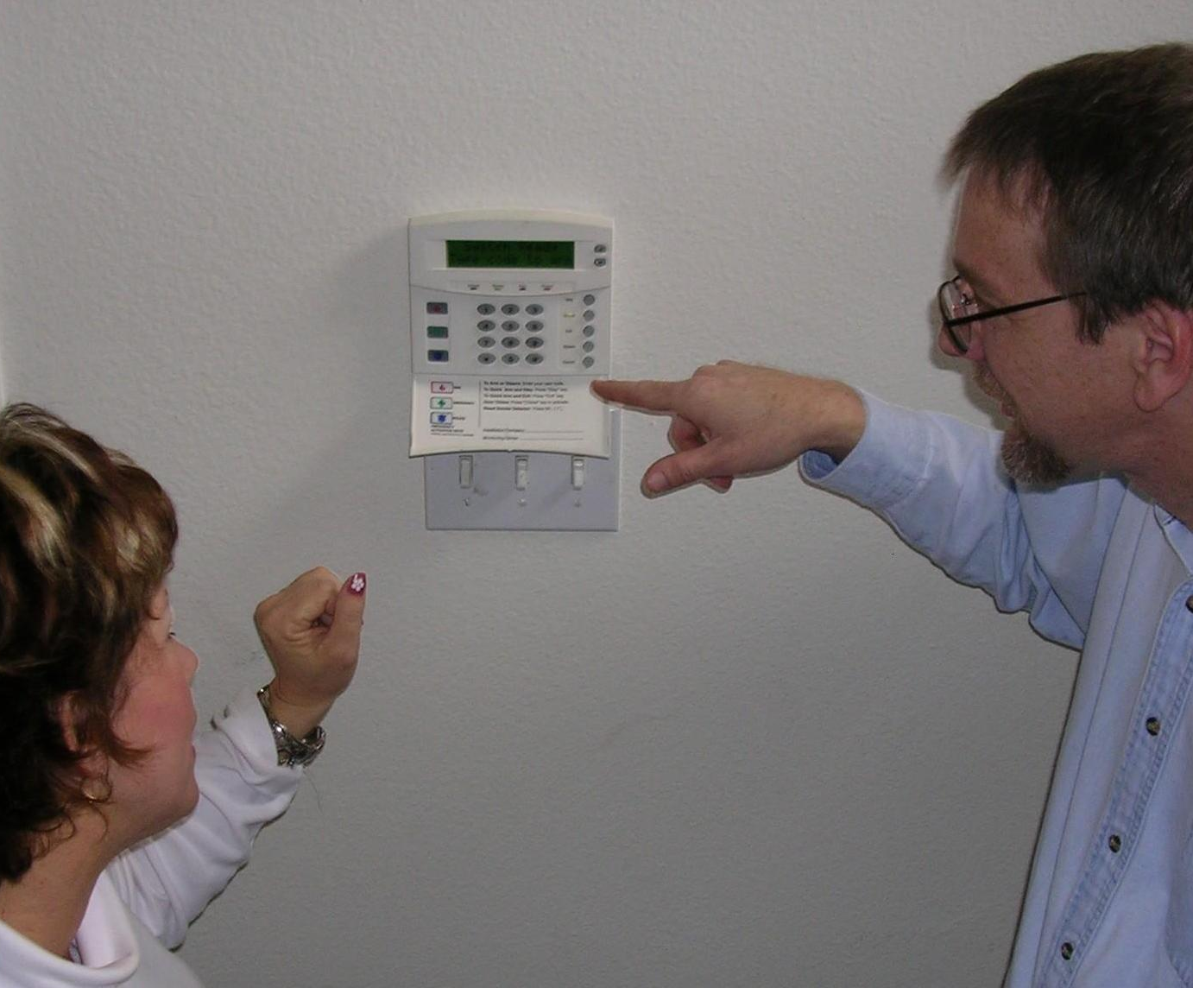
Lack of training Causes False Alarms
Learn how to use the system, what to do if the system activates and how to cancel a false alarm
Train new users

Slide 22

Temporary Users & Guests Cause False Alarms
Teach everyone who has a key to the alarm site how to use the system and how to cancel an alarm

Slide 23
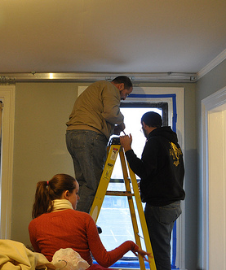
Environmental Changes
Cause False Alarms
New occupants or employees move in, buildings settle on their foundations, doors and windows get loose in their frames, sites are remodeled and users acquire new furniture, pets or hang new displays

Slide 24
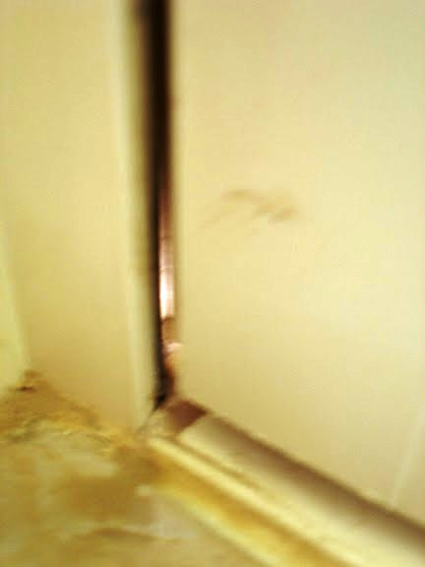
Lack of Maintenance Causes False Alarms
Sensors need to be cleaned, batteries need to be changed and settings need be checked.
Doors need to be checked

Slide 25

Confusing Procedures Cause False Alarms
Sometimes people fail to follow procedures because they are just set in their ways, but often it is because the procedure is unclear or has not been properly communicated to them
Make sure your procedures are clear, are communicated correctly and do their part to reduce false alarms
Notes:
https://youtu.be/ScwKprIYNBo

Slide 26
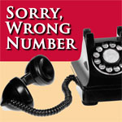
Outdated information Causes False Alarms
If the alarm company has the wrong phone number, you may not be able to cancel a false alarm

Slide 27
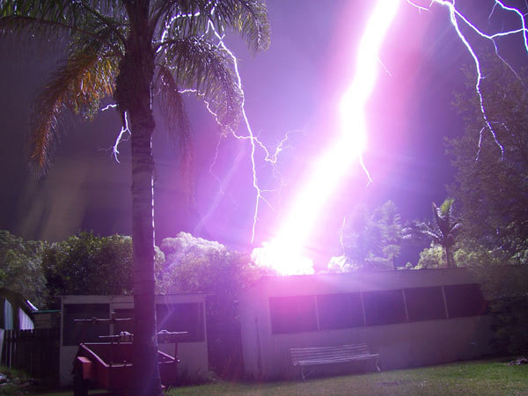
Storms Should Not Cause False Alarms
An alarm system should not activate just because there is a thunderstorm
If lightning directly hits the alarm site an alarm is understandable, but modern systems should not react to nearby strikes

Slide 28
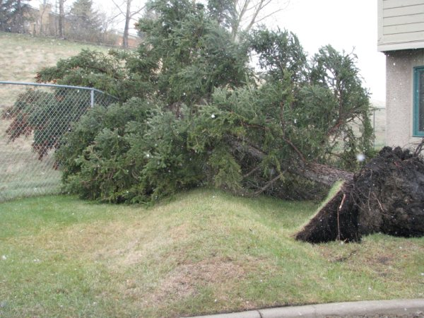
High Winds Should Not Cause False Alarms
High winds will shake and rattle the walls, doors ands windows of your site.
Make sure these vibrations do not lead to false alarms.

Slide 29
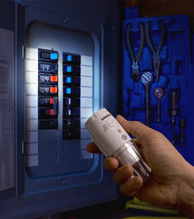
Weather Can Cause Power Failures
Power failures can drain batteries to below operating levels – especially if the battery is old or the system has more devices than the battery can handle.

Slide 30
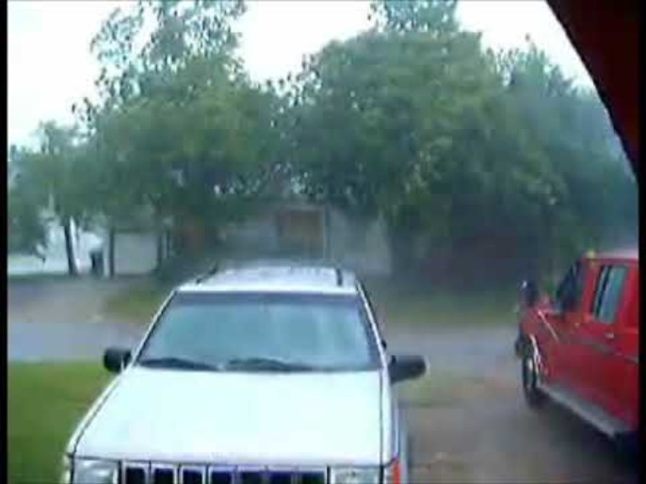
Weather Can Cause Loud Noise &
Vibration
Loud noises and vibrations are common during weather events – try to anticipate them
False alarms should not occur during all but the most extreme weather events
Notes:
https://youtu.be/0cLbw9ch9rw

Slide 31

Causes of False Fire Alarms
False alarm = any event not created by fire
Not putting the system in test mode
Cooking food
Mechanical failure
Home users have more control
Commercial users must wait for fire response
Notes:
https://youtu.be/RLfS1ebGPoQ

Slide 32
What can YOU do?
Understand your system
Lock all doors & windows
Know cancellation code
Maintain the system
Respond to meet officers
Notes:
As an alarm user, it is your responsibility to prevent false alarms. This is an easy task that can be facilitated by understanding how the system works. This course is a good start on that knowledge. However, this knowledge needs to be passed along to all who have access to the system. Many businesses will train their employees but forget to provide training to cleaning crews or suppliers.
Before arming the system, users should lock and secure all doors and windows. Make sure everyone is out of the building or residence before arming the system.
Be sure to know the cancellation code and make sure all authorized users know the code as well. If the code is changed, make sure everyone is notified.
Perform the required maintenance and replace the battery no less than once every 5 years. In the event of an alarm, be available to respond to the site to meet officers. If you are unable to respond, have another responsible person who is willing to go for you.
These are the basics, but the following section will discuss in more detail what alarm users can do to prevent false alarms.

Slide 33
Call your alarm company….
Before you start any remodeling or construction
To update your authorized contact list whenever employees are added and/or deleted or phone numbers have changed
When you have changes in your phone service
When you move or close your business
When you have an unexplained false alarm
Notes:
Alarm users should keep the responsible party or key holder list up to date.
Call the central station and inform them of any remodeling, repair, electrical, or telephone line work that is going to be done at the premises.
If you change anything at the premises, please call your alarm company to see if sensors need to be moved or adjusted.

Slide 34
Train ALL Alarm Users !
  Everyone who has a key needs to know how to arm and disarm your system
Notes:
Make sure everyone who has authorized access to the premises knows how to arm and disarm the alarm system and knows how to clear a false alarm with the monitoring company. This includes baby-sitters, maids, realtors, relatives, teachers, janitors, cleaning crews, contractors, and employees. Be sure that telephone repairmen, electricians, carpenters and other repairmen or servicemen are aware and careful of the alarm system. Every person who uses the system should know their password or identification code for verification with the central station.
Entry/exit errors are the leading cause of false alarms:
•How much time users have to set the alarm and exit.
•Ensure users know how much time they have to enter a location and disarm
the alarm system.
•Identify special entry/exit delay time requirements.
•Ensure that they know what door(s) is to be used for exit and entry as well as
where all the other system components are installed (cleaning crews are especially important—they often will exit the building to take out the trash which may not be the entry or exit door).
•Adjust the system during training to eliminate customer errors.
•Ensure that users understand the difference between knowing their
numeric entry/exit code (a sequence of numbers used to arm or disarm the alarm)
and having a password (a code word used to identify the customer as an authorized
user).
•Spend the extra time going over how to cancel a false alarm response.
•Explain how answering machines or call waiting will affect a cancellation
verification.
•Always show the alarm user how to cancel an accidental alarm activation. Let
them know whether you expect them to call the central station or whether they
should stay at the premises until the central station calls them. Different alarm
companies have varying procedures.
•Make sure user is aware of jurisdictional requirements (permits/fines).

Slide 35
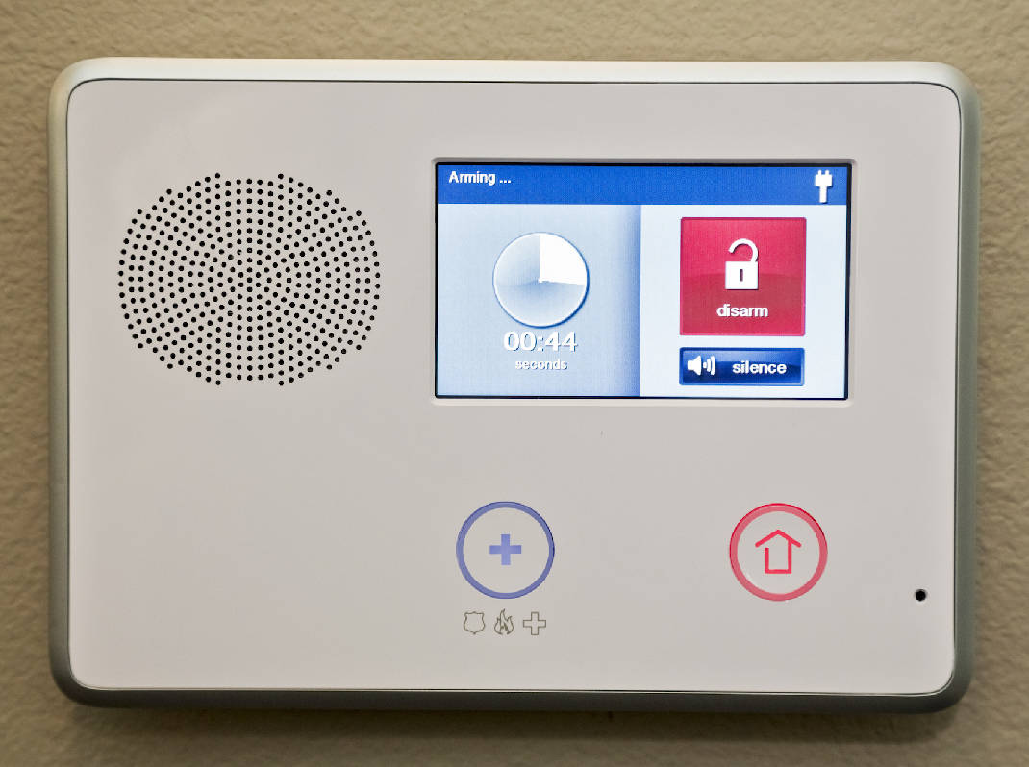
Re-Entering
If you
re-enter, turn off the alarm.
Don’t play beat the clock.
Notes:
If you re-enter the premises because you've forgotten something, turn off the alarm & re-set it when you leave again. Do this even if you think it will only be a few seconds!

Slide 36
Canceling Alarms
Answer the phone
Stay put
Be prepared
Follow your alarm company's instruction
Notes:
When an alarm is activated, most systems will send a signal to a monitoring station. If the alarm is a mistake, it is important for the user to communicate with the monitoring station to make sure that no police dispatch request is made. Keep the monitoring company phone number in a convenient, easily visible place near the phone, enter it as a contact in your cell phone, and put the phone number on a label at the keypad.
Many alarm companies instruct their customers to wait for a phone call. Unfortunately, the alarm system often uses the same phone line to send in the alarm signal that the user would use to call the monitoring station. This is why many alarm companies will instruct users to wait for them to call after the alarm. Some companies want users to call them as soon as the line clears. It is a common complaint that the alarm company never called. What people don’t realize is that the operator may have tried to call while the phone line was still tied up with the alarm. The operator has satisfied their requirement and they have moved on to the next alarm. Users are the ones who will pay the bill for a false alarm, if you don’t hear from the monitoring center in a reasonable time, contact them.
The second thing that users should do when they have an alarm is to stay put! Do not leave the alarm site until you have spoken with the monitoring station and assured them there is no emergency. If law enforcement response was requested, users need to wait until they have confirmation that the response was cancelled.
When the user makes contact with the monitoring station, they will need to verify that they are an authorized user. All alarm users should be prepared for this and know how to identify themselves to the alarm company.
And remember, it May Not Be Too Late When The Alarm Sounds. If the disarm code is entered fast enough, some systems will stop the alarm signal before it is sent to the monitoring station. Other systems may change the type of signal that is sent, so that the monitoring station knows there is no emergency. In any case, turning off the system as fast as possible after a mistake is a good idea.

Slide 37



Request ECV!
Tell your monitoring company to use Enhanced Call Verification (ECV)
ECV requires making two calls to a responsible party prior to requesting a dispatch
Notes:
Tell your monitoring company to use Enhanced Call Verification (ECV), which requires making two calls to a responsible party prior to requesting a law enforcement dispatch.

Slide 38
Bypassing Zones
By-passing a zone
Turn off a zone (home/away)
38
Notes:
Alarm users should know what activity is permitted if the system is going to be armed and someone will be moving around inside.
Many alarm systems will allow interior motion and/or glass break sensors to be bypassed or “ignored” by the system when the alarm is turned on. The idea behind this is to allow the rest of the system to be active while the user occupies the site. Sometimes, the way that the user tells the system to turn on all or just part of the system is very similar. If the interior sensors are activated by mistake while the user is on site, this will lead to an alarm.
Some systems are designed to rely on doors to be closed to keep pets or people from entering certain rooms. If one of these doors is left unlocked or a person goes through the door by mistake, it will lead to an alarm. This happens frequently at local stores with cash rooms.

Slide 39
Inspect the System
Check the battery
Test your system
Schedule yearly system inspections
Notes:
A good way to prevent false alarms is to make frequent inspections of the system.
Almost all security systems have a rechargeable battery that powers the system in the event of a power outage. Low batteries are the most common equipment reason for false alarm activations. Even a short power failure of a second or less may be long enough to cause a false alarm if the battery is not charged.
The battery’s life depends on how often power outages occur and how many accessories the system is driving (i.e., keypads, motion detectors, smoke detectors, etc.) Most panels will send a low battery signal to the monitoring station when the battery’s voltage lowers to a certain level.
For battery backup to be successful, the alarm panel transformer must be plugged into a 24-hour outlet. The alarm system must have AC power. NEVER unplug the transformer, because you may forget to plug it back in. If you know your power must be off for more than 10 hours, please call your alarm company. They can give instructions on how to preserve the battery life. If you have a wireless system, you may have batteries in the sensors as well that will require maintenance.
Alarm users should test the system monthly & have annual inspections by the alarm company.
Always contact your alarm company before you test the system so that they won’t call the police.
At a minimum, have your system tested by a technician annually and any time you have an unexplained false activation.
Your system battery should be checked during the annual inspection and after any storm-related false alarm. It should be replaced when needed.

Slide 40
Holdup Buttons
Is this needed?
Proper training on When to activate
40
Notes:
The features that we will be discussing next are particularly prone to false alarms if users are not adequately trained.
Duress, hold-up and panic alarms are designed to allow alarm users to activate the system under specific emergency situations. They generally result in a heightened response, sometimes with lights and sirens, due to a raised likelihood of a criminal event in progress.
It is very important that you understand that activation of these types of alarms in non-emergency or improper situations may place law enforcement officers, alarm users and the general public at increased risk.
The use of hold-up alarms is not recommended for the general public, and businesses should consider carefully if this option is needed. Hold-up alarms should be reserved for those alarm users who are at greater risk because they have custody of large amounts of money or highly valuable goods, or for those who can otherwise demonstrate an extreme need for a hold-up alarm.
If a hold-up or panic option is available with your alarm system, training is a must.
These systems are usually activated by inconspicuous devices, such as a foot rail, money clip, or hidden button. Effective use of hold-up alarms requires special training and frequent drills to prevent false activations. Remember, nothing gets law enforcement response faster than placing a call to 9-1-1 --so do not use these except for what they are designed—to summon help without alerting the criminal.
The problem with hold-up devices is that they are used improperly which causes increased risk to law enforcement and the general public. The following instances are examples of when NOT to use the hold-up:
When you need fire or medical assistance.
To check to see how long it takes law enforcement officers to respond.
When someone has shoplifted merchandise.
To report a fight in a parking lot.
Any other circumstances in which you are not in a life-threatening or emergency situation.

Slide 41
1+Duress Codes
Is this necessary?
What happens when activated?
1+ Duress = False Alarms
Notes:
The one plus duress alarm feature is designed to allow alarm users to indicate when they are forced to disarm the alarm system under duress. To use this feature, the user is instructed to add the number one to the last digit of the code when faced with dangerous situation such as an intruder.
For example: a normal code might be 1234, the one plus duress code would be 1235
After the one plus duress code is entered, the alarm seems to be disarmed normally (turned off) and there is no indication at the alarm site that this function has been activated. However, a silent alarm is sent to the monitoring center to indicate a duress situation. Usually, no attempt is made to verify the situation so as not to alert the criminal, and a dispatch request is made immediately.
This is an equation for false alarms for a variety of reasons which include:
Users have too many codes to remember (internet, credit card PIN, alarm codes, etc), and it is too easy to confuse the regular code with the one plus duress code.
The user is often unaware of the mistake until the police arrive because no indication is made at the site that the duress alarm has been activated.
Because no attempt is usually made by the monitoring center to verify a one plus duress signal, the user does not get the opportunity to cancel a mistake.
Officer and user safety is threatened when public safety officers are asked to respond to a reported duress situation that is actually user error. Authorized users can be mistaken for intruders and users may confront the officers when surprised by a response.
Repeated inquiries at national, state and local alarm association meetings failed to find a single instance when this feature had been used as intended.

Slide 42
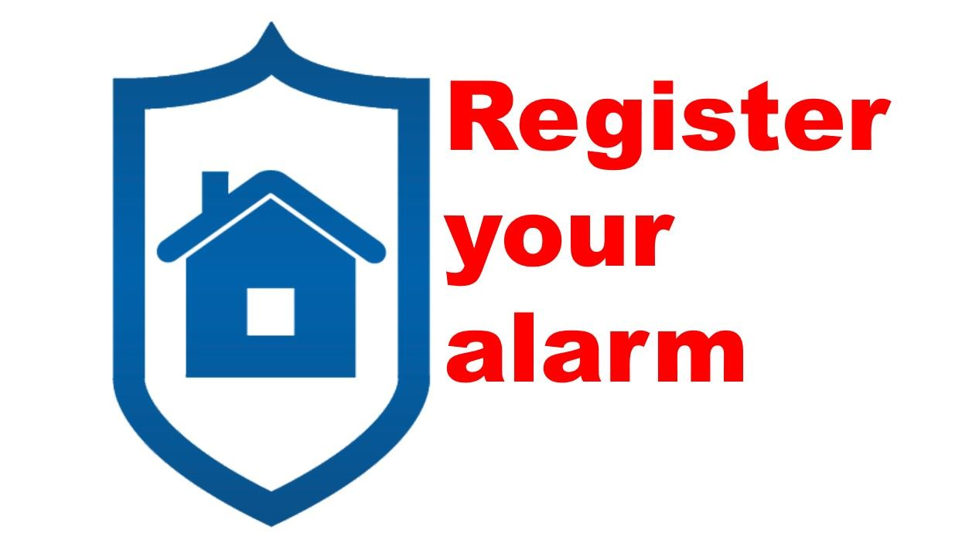
The Alarm Ordinance
Each alarm system must be registered

Slide 43
The Alarm Ordinance
Permit Fees:
Residential $ ________
Renewal(annual) $ ________
Commercial $ ________
Renewal(annual) $ ________

Slide 44
The Alarm Ordinance
_______"Free" false alarms per year
Review Schedule of fines for false alarms in excess of this number

Slide 45
The Alarm Ordinance
Suspension:
Alarm permit may be suspended after ____ false alarms
One chargeable false alarm waived if you attend Alarm User Awareness School

Slide 46

Contact Us
False Alarm Reduction Association
10024 Vanderbilt Circle #4
Rockville MD 20850
301- 519-9237
Brad Shipp, Executive Director
bradshipp@4yoursolution.com
www.faraonline.org
For More Info
visit Alarmuser.org

