Slide 1
Alarm User Awareness Class

Slide 2
What We Will Cover
What is an Alarm System?
What Happens when an Alarm is Activated?
What is a False Alarm
Causes & impacts of false alarms
How to reduce & eliminate false alarms
How Our Alarm Ordinance Impact You
And more….

Slide 3
What is a False Alarm?
When an alarm is reported and the responding Police or Fire agency investigates but finds no evidence of criminal activity or fire related event.
But it takes several steps to get to a False Alarm
Notes:
https://youtu.be/pY0imTygoHA

Slide 4
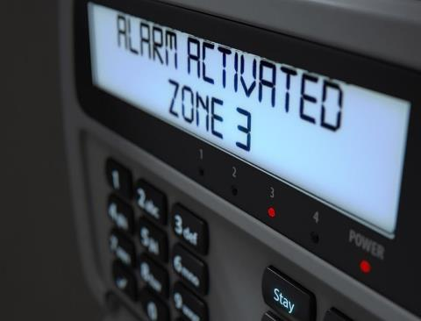
Step 1- An Alarm Activation
An alarm activation indicates that a possible emergency requiring follow-up has been detected
A detected alarm activation may require follow up

Slide 5
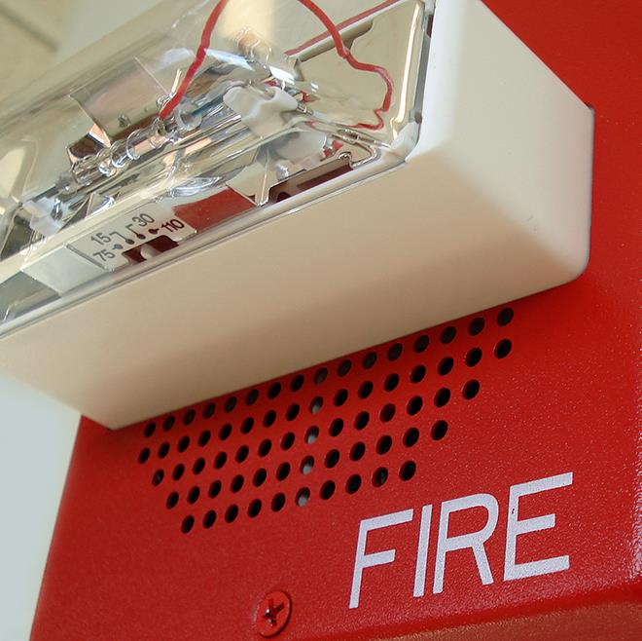
Step 2- An Alarm Sounds
May sound or show the alarm
After the alarm is triggered, one or more sounding or visual indicating devices such as a strobe light may activate

Slide 6
Step 3- Notify The Monitoring Center
The alarm activation may then transmit an electronic signal to a monitoring facility

Slide 7
Step 4 -An Alarm Dispatch Request
Verification attempt
A call for service is placed with the Public safety agency.
This leads to a Dispatch….
Notes:
https://youtu.be/sdOcyC1ueDg

Slide 8
Step 5- Dispatch
Information relayed during the dispatch request includes:
Type of alarm
Area of activation
Hazard information
Pets on site
Owner and key holder contact information
Callback # & Operator/Dispatch ID
Location history may be checked
A permit number may be required
Next is the Response ….
Notes:
The public safety dispatch center may call the site before dispatching.
If the alarm is cancelled before the responder arrives, fines may not apply depending on your local ordinance.
https://youtu.be/MgCpDy2bwqk

Slide 9
Step 6 - Response
After investigation if no fire or evidence of a crime is found…..
It is a false alarm
Notes:
https://youtu.be/Fq7Hz5Q8P0g

Slide 10
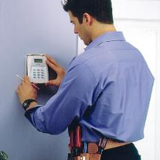
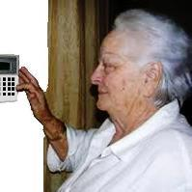
False Alarms Impact Everyone
Alarm industry
Public safety
Alarm users
Public at large
Notes:
We have learned what a false alarm is and can now distinguish between an alarm dispatch request and a false alarm. Now it is time to learn about various costs associated with false alarms.
Every segment of our communities bear some cost for false alarms including the alarm industry, public safety, the alarm user and even the public at large who don’t even have an alarm system.
We will now explore all of those costs.

Slide 11
False Alarm Impacts
Can reduce Public Safety Availability for real emergencies
Require Financial Support for more responders
Notes:
https://youtu.be/Ez8-N3neu-g

Slide 12
False Fire Alarm Impacts
Causes delays response to Actual Emergencies
Notes:
https://youtu.be/5PtMjlRN9Ss

Slide 13
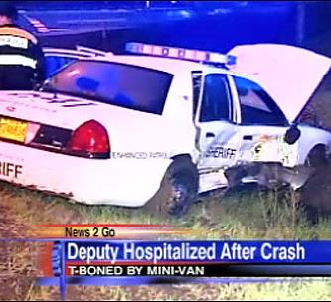
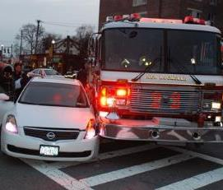
Impacts of False Alarms
Endanger responding authorities and everyone in the community
Notes:
Time emergency officials spend responding to false alarms can have devastating effects. This takes away from their ability to do their job effectively, wasting valuable tax payer resources.

Slide 14
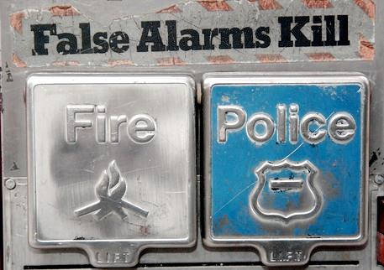
Another False Alarm
Desensitizes to actual crime/fire
Leads to ignoring alarms going off
Notes:
When your alarm “cries wolf!”, several times, the community as a whole will not take the actual valid alarm seriously when it happens. False alarms desensitize communities to actual incidents of crime and fire.

Slide 15
False Alarm Impacts
Cost billions of dollars in public safety resources
Leads to complacency
Increased 911 calls
False alarm fines & service charges
Notes:
https://youtu.be/DMDln_l3PJY

Slide 16
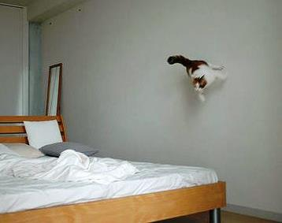
Pets Cause False Alarms
Make sure pets will not interfere with the system now or in the future
Remember many pets will grow
Be sure your alarm technician is aware there are pets in your home

Slide 17
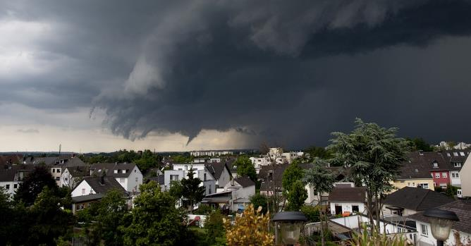
Vibration & Sounds Cause False Alarms
Consider Possible sounds & vibrations
Loud truck traffic
Passing trains
Thunderstorms
Birds flying into windows

Slide 18
Lack of training Causes False Alarms
Learn how to use the system, what to do if the system activates and how to cancel a false alarm
Train new users

Slide 19
Temporary Users & Guests Cause False Alarms
Teach everyone who has a key to the alarm site how to use the system and how to cancel an alarm

Slide 20
Environmental Changes Cause False Alarms
New occupants or employees move in
Buildings settle on their foundations
Doors and windows get loose in their frames
Sites are remodeled
Occupants acquire new furniture, new window coverings pets or hang new displays

Slide 21
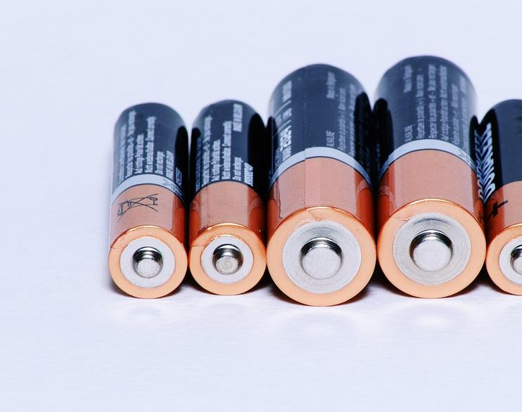
Lack of Maintenance Causes False Alarms
Sensors need to be cleaned and settings need be checked.
Know battery life expectancy
Doors and windows need to be checked to ensure they close properly

Slide 22
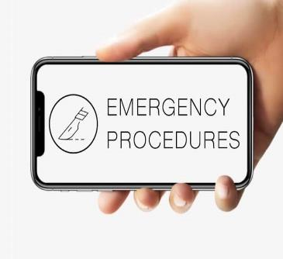
Confusing Procedures Cause False Alarms
Sometimes people fail to follow procedures because they are set in their ways, but often it is because the procedure is unclear or has not been properly communicated to them
Make sure you understand your alarm company’s procedures so you can do your part to reduce false alarms

Slide 23
Outdated information Causes False Alarms
If the alarm company has the wrong phone number, you may not be able to cancel a false alarm

Slide 24
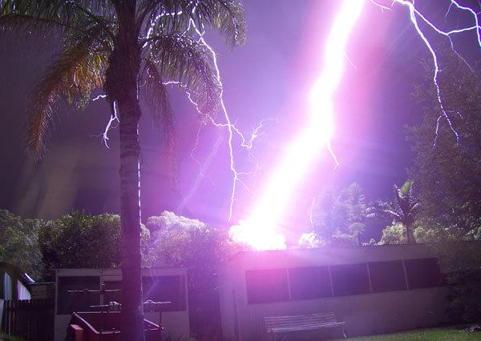
Storms Should Not Cause False Alarms
An alarm system should not activate during a thunderstorm unless the alarm site takes a direct hit.
Reach out to your alarm company if you are experiencing false alarms during storms.

Slide 25
High Winds Should Not Cause False Alarms
High winds will shake and rattle the walls, doors and windows of your site.
Ensure all sensors are secure and windows are closed.
Utilize wide-gap sensors to decrease false alarms.

Slide 26
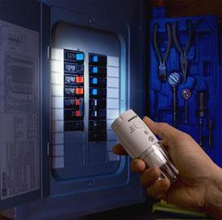
Weather Can Cause Power Failures
Power failures can drain batteries to below operating levels – especially if the battery is old or the system has more devices than the battery can handle.
Ensure your system is plugged into a surge protector
Change batteries when low
Notes:
Some cities may have minimum backup battery requirements

Slide 27
Common Causes of False Fire Alarms
Not putting the system in test mode when needed
Cooking food
Mechanical failure
Notes:
https://youtu.be/RLfS1ebGPoQ

Slide 28
What can YOU do?
Understand
Understand your system
Lock
Lock all doors & windows
Know
Know cancellation code
Maintain
Maintain the system
Respond
Respond to meet officers
Notes:
As an alarm user, it is your responsibility to prevent false alarms. This is an easy task that can be facilitated by understanding how the system works. This course is a good start on that knowledge. However, this knowledge needs to be passed along to all who have access to the system. Many businesses will train their employees but forget to provide training to cleaning crews or suppliers.
Before arming the system, users should lock and secure all doors and windows. Make sure everyone is out of the building or residence before arming the system.
Be sure to know the cancellation code and make sure all authorized users know the code as well. If the code is changed, make sure everyone is notified.
Perform the required maintenance and replace the battery no less than once every 5 years. In the event of an alarm, be available to respond to the site to meet officers. If you are unable to respond, have another responsible person who is willing to go for you.
These are the basics, but the following section will discuss in more detail what alarm users can do to prevent false alarms.

Slide 29
Inform your alarm company….
Before you start any remodeling or construction
To update your authorized contact list whenever phone numbers have changed or site access is added or removed
When you have changes in your phone service
When you move or close your business
When you have an unexplained false alarm
Notes:
Alarm users should keep the responsible party or key holder list up to date.
Call the central station and inform them of any remodeling, repair, electrical, or telephone line work that is going to be done at the premises.
If you change anything at the premises, please call your alarm company to see if sensors need to be moved or adjusted.

Slide 30
Train ALL Alarm Users !
Everyone who has a key needs to know how to arm and disarm your system.
It is wise to add them to your keyholder list and ensure they know their passcode.
Notes:
Make sure everyone who has authorized access to the premises knows how to arm and disarm the alarm system and knows how to clear a false alarm with the monitoring company. This includes baby-sitters, maids, realtors, relatives, teachers, janitors, cleaning crews, contractors, and employees. Be sure that telephone repairmen, electricians, carpenters and other repairmen or servicemen are aware and careful of the alarm system. Every person who uses the system should know their password or identification code for verification with the central station.
Entry/exit errors are the leading cause of false alarms:
•How much time users have to set the alarm and exit.
•Ensure users know how much time they have to enter a location and disarm
the alarm system.
•Identify special entry/exit delay time requirements.
•Ensure that they know what door(s) is to be used for exit and entry as well as
where all the other system components are installed (cleaning crews are especially important—they often will exit the building to take out the trash which may not be the entry or exit door).
•Adjust the system during training to eliminate customer errors.
•Ensure that users understand the difference between knowing their
numeric entry/exit code (a sequence of numbers used to arm or disarm the alarm)
and having a password (a code word used to identify the customer as an authorized
user).
•Spend the extra time going over how to cancel a false alarm response.
•Explain how answering machines or call waiting will affect a cancellation
verification.
•Always show the alarm user how to cancel an accidental alarm activation. Let
them know whether you expect them to call the central station or whether they
should stay at the premises until the central station calls them. Different alarm
companies have varying procedures.
•Make sure user is aware of jurisdictional requirements (permits/fines).

Slide 31
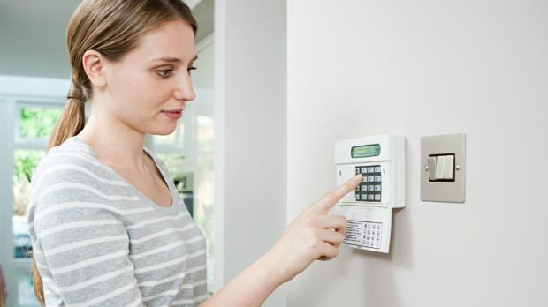
Re-Entering
This Photo by Unknown Author is licensed under CC BY-SA-NC
If you re-enter the alarmed location, turn off the alarm.
Don’t play beat the clock.
Notes:
If you re-enter the premises because you've forgotten something, turn off the alarm & re-set it when you leave again. Do this even if you think it will only be a few seconds!

Slide 32
Canceling Alarms
Answer the phone
Save your alarm company’s phone number as a favorited contact
Stay put
Be prepared
Follow your alarm company's instruction
Notes:
When an alarm is activated, most systems will send a signal to a monitoring station. If the alarm is a mistake, it is important for the user to communicate with the monitoring station to make sure that no police dispatch request is made. Keep the monitoring company phone number in a convenient, easily visible place near the phone, enter it as a contact in your cell phone, and put the phone number on a label at the keypad.
Many alarm companies instruct their customers to wait for a phone call. Unfortunately, the alarm system often uses the same phone line to send in the alarm signal that the user would use to call the monitoring station. This is why many alarm companies will instruct users to wait for them to call after the alarm. Some companies want users to call them as soon as the line clears. It is a common complaint that the alarm company never called. What people don’t realize is that the operator may have tried to call while the phone line was still tied up with the alarm. The operator has satisfied their requirement and they have moved on to the next alarm. Users are the ones who will pay the bill for a false alarm, if you don’t hear from the monitoring center in a reasonable time, contact them.
The second thing that users should do when they have an alarm is to stay put! Do not leave the alarm site until you have spoken with the monitoring station and assured them there is no emergency. If law enforcement response was requested, users need to wait until they have confirmation that the response was cancelled.
When the user makes contact with the monitoring station, they will need to verify that they are an authorized user. All alarm users should be prepared for this and know how to identify themselves to the alarm company.
And remember, it May Not Be Too Late When The Alarm Sounds. If the disarm code is entered fast enough, some systems will stop the alarm signal before it is sent to the monitoring station. Other systems may change the type of signal that is sent, so that the monitoring station knows there is no emergency. In any case, turning off the system as fast as possible after a mistake is a good idea.

Slide 33
Request ECV!
Tell your monitoring company to use Enhanced Call Verification (ECV)
ECV requires making two calls to a responsible party prior to requesting a dispatch
Notes:
Tell your monitoring company to use Enhanced Call Verification (ECV), which requires making two calls to a responsible party prior to requesting a law enforcement dispatch.

Slide 34
Bypassing Zones
Learn how to by-pass or turn off sensors if you plan to remain when your alarm is on
34
Notes:
Alarm users should know what activity is permitted if the system is going to be armed and someone will be moving around inside.
Many alarm systems will allow interior motion and/or glass break sensors to be bypassed or “ignored” by the system when the alarm is turned on. The idea behind this is to allow the rest of the system to be active while the user occupies the site. Sometimes, the way that the user tells the system to turn on all or just part of the system is very similar. If the interior sensors are activated by mistake while the user is on site, this will lead to an alarm.
Some systems are designed to rely on doors to be closed to keep pets or people from entering certain rooms. If one of these doors is left unlocked or a person goes through the door by mistake, it will lead to an alarm. This happens frequently at local stores with cash rooms.

Slide 35
Inspect the System
Check the battery
Test your system
Schedule yearly system inspections
Notes:
A good way to prevent false alarms is to make frequent inspections of the system.
Almost all security systems have a rechargeable battery that powers the system in the event of a power outage. Low batteries are the most common equipment reason for false alarm activations. Even a short power failure of a second or less may be long enough to cause a false alarm if the battery is not charged.
The battery’s life depends on how often power outages occur and how many accessories the system is driving (i.e., keypads, motion detectors, smoke detectors, etc.) Most panels will send a low battery signal to the monitoring station when the battery’s voltage lowers to a certain level.
For battery backup to be successful, the alarm panel transformer must be plugged into a 24-hour outlet. The alarm system must have AC power. NEVER unplug the transformer, because you may forget to plug it back in. If you know your power must be off for more than 10 hours, please call your alarm company. They can give instructions on how to preserve the battery life. If you have a wireless system, you may have batteries in the sensors as well that will require maintenance.
Alarm users should test the system monthly & have annual inspections by the alarm company.
Always contact your alarm company before you test the system so that they won’t call the police.
At a minimum, have your system tested by a technician annually and any time you have an unexplained false activation.
Your system battery should be checked during the annual inspection and after any storm-related false alarm. It should be replaced when needed.

Slide 36
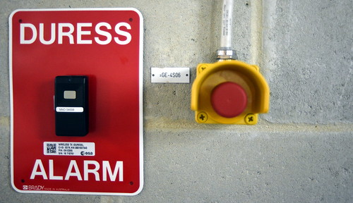
Holdup Buttons
Is this needed?
Proper training on When to activate
This Photo by Unknown Author is licensed under CC BY-SA
36
Notes:
The features that we will be discussing next are particularly prone to false alarms if users are not adequately trained.
Duress, hold-up and panic alarms are designed to allow alarm users to activate the system under specific emergency situations. They generally result in a heightened response, sometimes with lights and sirens, due to a raised likelihood of a criminal event in progress. It is very important that you understand that activation of these types of alarms in non-emergency or improper situations may place law enforcement officers, alarm users and the general public at increased risk.
The use of hold-up alarms is not recommended for the general public, and businesses should consider carefully if this option is needed. Hold-up alarms should be reserved for those alarm users who are at greater risk because they have custody of large amounts of money or highly valuable goods, or for those who can otherwise demonstrate an extreme need for a hold-up alarm. If a hold-up or panic option is available with your alarm system, training is a must.
These systems are usually activated by inconspicuous devices, such as a foot rail, money clip, or hidden button. Effective use of hold-up alarms requires special training and frequent drills to prevent false activations. Remember, nothing gets law enforcement response faster than placing a call to 9-1-1 --so do not use these except for what they are designed—to summon help without alerting the criminal. The problem with hold-up devices is that they are used improperly which causes increased risk to law enforcement and the general public. The following instances are examples of when NOT to use the hold-up:
When you need fire or medical assistance.
To check to see how long it takes law enforcement officers to respond.
When someone has shoplifted merchandise.
To report a fight in a parking lot.
Any other circumstances in which you are not in a life-threatening or emergency situation.

Slide 37
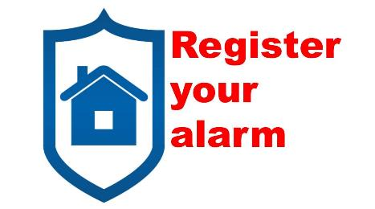
The Alarm Ordinance/Bylaw
Your local government may require each alarm system must be registered
Notes:
Fill in the blanks to explain your requirements

Slide 38
The Alarm Ordinance
Permit Fees:
Residential $ ________
Renewal(annual) $ ________
Commercial $ ________
Renewal(annual) $ ________
Notes:
Fill in the blanks to explain your requirements

Slide 39
The Alarm Ordinance
_______"Free" false alarms per year
Review Schedule of fines for false alarms in excess of this number
Notes:
Fill in the blanks to explain your requirements

Slide 40
The Alarm Ordinance
Suspension:
Alarm permit may be suspended after ____ false alarms or non-payment of false alarm fees
One chargeable false alarm waived if you attend Alarm User Awareness School
Notes:
Fill in the blanks to explain your requirements

Slide 41
