Slide 1
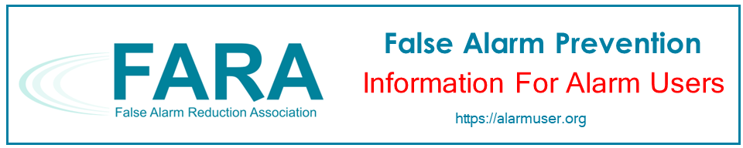

FARA False Alarm Prevention
For Banks
Notes:
Thank you for taking an interest in preventing false alarms at banks. This presentation is brought to you by the False Alarm Reduction Association, an international organization dedicated to supporting false alarm reduction professionals in their mission to reduce false alarms.

Slide 2

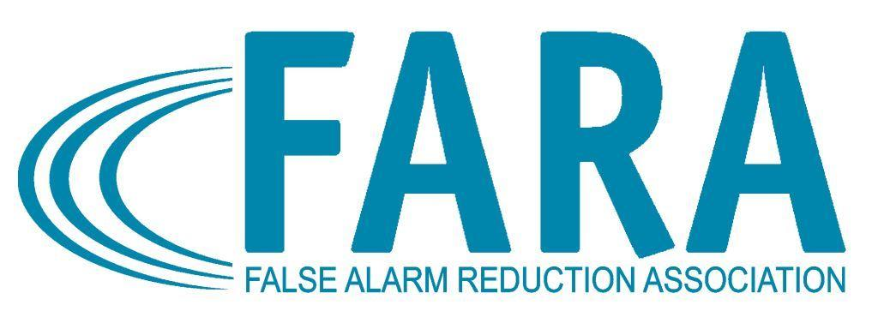
Introduction
What is a false alarm?
Why are false alarms a problem?
How do alarm systems work?
What are some causes of false alarms?
What can you do to prevent false alarms?
Notes:
This purpose of this presentation is to educate the alarm user on false alarms in banks. We will go over these topics:
What is a false alarm?
Why are false alarms a problem?
How do alarm systems work?
What are some common causes of false alarms?
Tips for avoiding false alarms

Slide 3

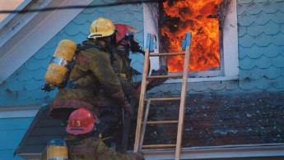
What is a False Alarm?
False Burglar Alarm - A notification of an alarm to law enforcement when the responding authority finds no evidence of criminal offense or attempted criminal offense
False Fire Alarm - A notification of a fire signal, resulting from a cause other than an actual fire
Notes:
Any time an alarm activation is caused for any reason other than criminal or fire-related activity is considered a “False Alarm!”

Slide 4

Impacts of False Alarms
Takes officers and firefighters away from real emergencies
Delays response when you really need it
Wastes public resources
Notes:
False alarms take officers and firefighters away from real emergencies. The time emergency officials spend responding to false alarms can have devastating effects. This takes away from their ability to do their job effectively, wasting valuable taxpayer resources and it delays response when you really need it.

Slide 5
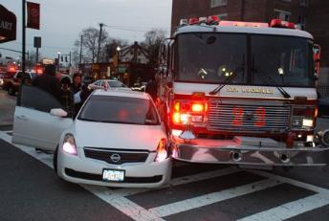
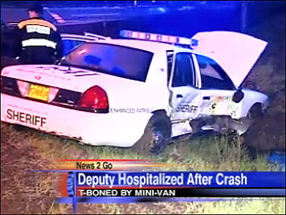
Impacts of False Alarms
Endangers responding authorities and everyone in the community
Notes:
Time emergency officials spend responding to false alarms can have devastating effects. This takes away from their ability to do their job effectively, wasting valuable taxpayer resources.

Slide 6

Another False Alarm
Desensitizes to actual crime/fire
Leads to ignoring alarms going off
Notes:
When your alarm “cries wolf” several times, the community as a whole will not take the actual valid alarm seriously when it happens. False alarms desensitize communities to actual incidents of crime and fire.

Slide 7


Impacts Continued…
May make you reluctant to arm your system, exposing your bank to undetected theft or hold-up
Notes:
When your alarm is not used or maintained effectively, it cannot do the job it was designed to do.

Slide 8
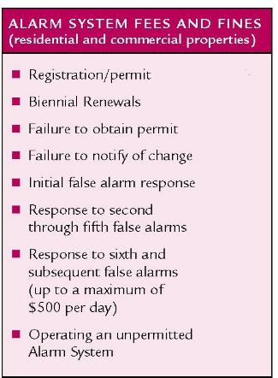

Impacts Continued…
Cost time & money
False alarm fines
Lost time
Service charges
Notes:
This is basically “throwing money down the drain.” Multiply this factor by many careless alarm users and everyone pays in the end, including those individuals who are responsible for their alarm systems or choose not to use one. Many cities and counties have passed ordinances imposing stiff fines or fees for excessive false alarm responses.

Slide 9



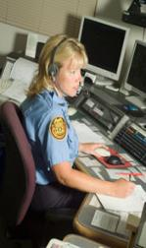
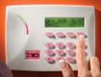

The Alarm Process
Siren Sounds- But Silent On Hold-up
Employee Trips
Control Panel
Alarm Sent to Alarm Company Central Station
Intruder Trips
Control Panel
Police Dispatched
Alarm Company
Calls to Verify
Then Calls
Public Safety
Fire Dispatched
Fire Trips
Control Panel
Notes:
Sensors Report - A master control unit - the brains of an alarm - system interprets signals from the sensors based on the nature of the emergency. It can notify all occupants of the home or business by noise or beeping.
Monitoring Center Notification - A monitored security system sends a signal to the alarm dealer's central station. Automation within the central station interprets the signal and directs the central station operator to the proper course of action.
Alarm is Verified - The monitoring operator contacts your location to obtain a code word confirming or discounting the alarm activation prior to requesting public safety dispatch.
Responding Authority Notification - This may include notification to the police, fire, medical, or just owner notification for non-emergency events.

Slide 10
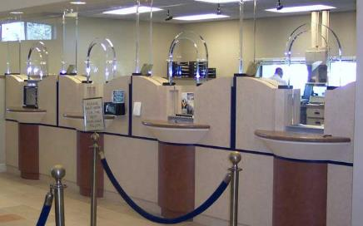
Did You Know?
Banks can generate more false alarms than the average commercial establishment
Notes:
DID YOU KNOW? Banks can generate more false alarms than the average commercial establishment? (“Banks” include credit unions and other financial institutions.)

Slide 11



Common Causes of False Alarms…
Lack of proper training for people given access to your bank, such as cleaning people, repairmen, delivery personal, etc…
Notes:
Majority of false alarms are caused by human error, usually by those individuals who have not been properly trained on how to use the system.

Slide 12

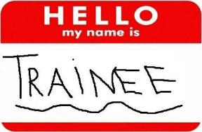
More Common Causes
Improperly trained new staff
Notes:
In many businesses, frequent turnover of managers and staff can lead to false alarms unless the new staff is properly trained.

Slide 13
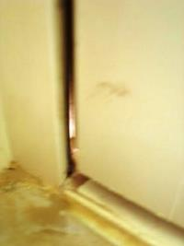
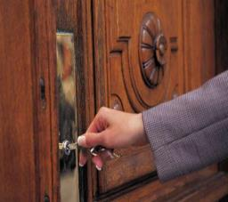
More Common Causes
Open, unlocked, or loose-fitting doors and windows
Notes:
It is not uncommon for alarm users, particularly those in a hurry, to fail to properly secure their doors or windows when setting the alarm system. If doors or windows do not fit properly, this may also cause false activations.

Slide 14
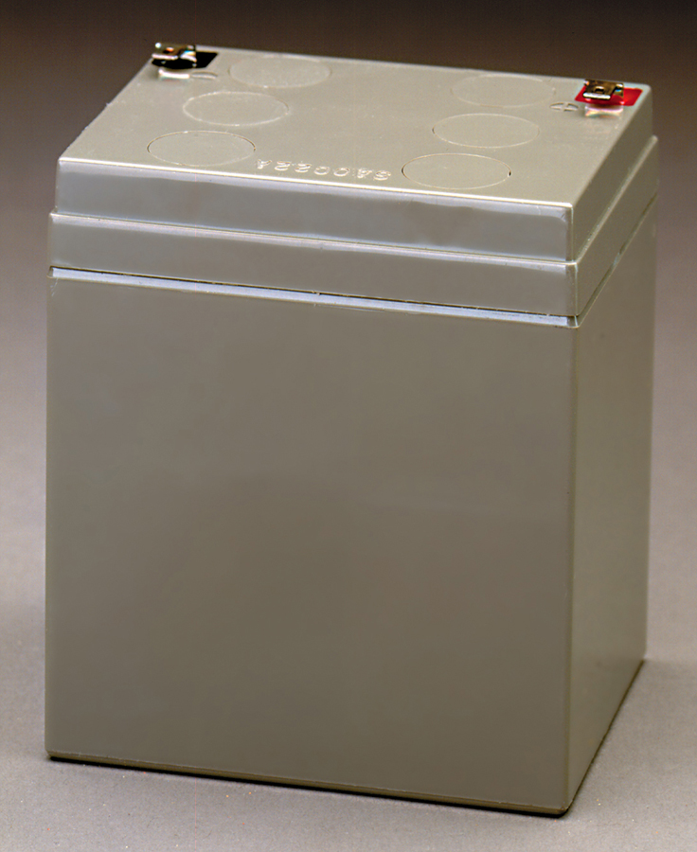
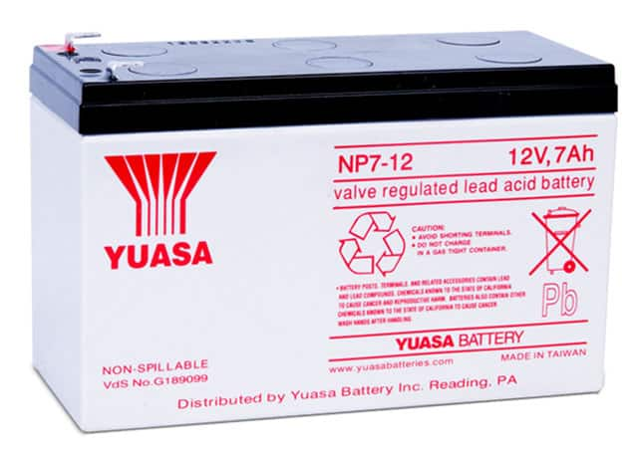
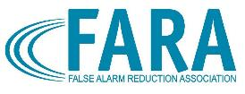
More Common Causes
Weak batteries
Notes:
It is not uncommon for alarm users, particularly those in a hurry, to fail to properly secure their doors or windows when setting the alarm system. If doors or windows do not fit properly, this may also cause false activations.
Emergency personnel often find loose animals in the home that have set-off the motion sensors.
It is also not uncommon for an old or weak battery to set off alarm activations after a power outage or surge.

Slide 15


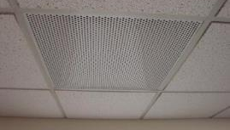
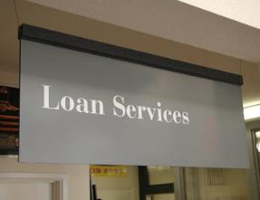
Another...
Drafts from heating/air conditioning systems and signs, moving plants, balloons, etc.
Notes:
Motion sensors will not only pick up movement of humans in the premises, but they will also detect movement from the “non-human” variety. This will include drape and plant movements caused by drafts from heating/ac vents and the like.
Another frequent offender are balloons floating in front of motion sensors.

Slide 16


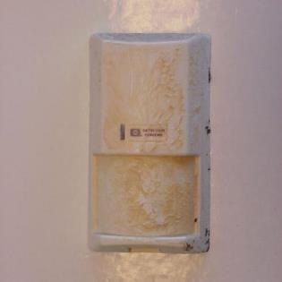
And A Few More...
Insects, dust, and dirt on motion / smoke sensors
Notes:
Cleaning motion sensors are important, because things like insects. heavy dust, and dirt on them will cause false activations.
Remember! Motion sensors are designed to pick up movement!

Slide 17
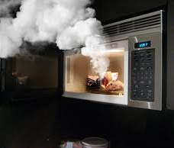
Last but not Least...
Cooking fumes will trip smoke detectors

Slide 18

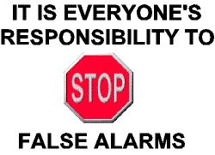
False Alarm Prevention Tips for Banks
Notes:
So, what can you do to prevent false alarms in your bank? Let’s talk about that.

Slide 19
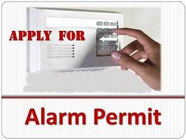
Before You Activate
Check with your local jurisdiction for registration requirements
Notes:
Check with your local jurisdiction for registration requirements.
Notify your local Alarm Coordinator when phone numbers or situations change.

Slide 20


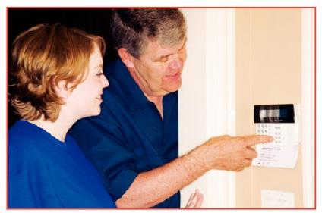
Before You Activate
Understand how the alarm system works; what it does and does not do
Ask your alarm company for written instructions, a DVD, and a demonstration
Notes:
This checklist is an important tool for what to do when decide to install an alarm system in your bank.
Completely understand how the alarm system works; what it does and does not do.
Ensure that all users of your system are provided thorough instruction on using and testing the system and cancelling unnecessary false alarm dispatch requests.
Ask your alarm company for written instructions and a physical demonstration of the use of your alarm system.
Be sure all new system users are fully trained before attempting to use the system. Hold monthly training classes to ensure existing users are aware of any changes to the system, designated entry/exit doors, proper opening/closing procedures, correct passcodes and arming codes, and rehearse how to cancel accidental activations.

Slide 21

Before Activating your Alarm System when leaving…
Keep balloons, fans, heaters, plants, curtains, and decorations from motion sensor areas
Make sure all alarmed doors and windows are locked
Notes:
Take time to do a check anytime you leave your home before turning on your alarm system. Make sure all windows and doors are secured and properly locked.
Secure move fans, heaters, plants, curtains, and decorations away from motion sensor areas.

Slide 22
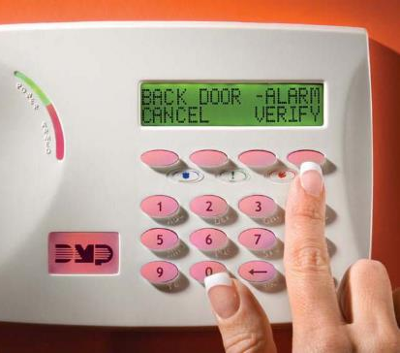
Identify the Cause
Make sure your alarm system identifies the sensor that caused the alarm activation
Notes:
Ensure your alarm system identifies the device that caused the alarm activation.

Slide 23


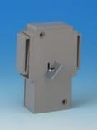
Hold-up or Panic Switches
Use switches that need simultaneous two-button activation
Train all personnel on when the button should and should not be used
Do not use in areas where items will be stored around or on top of the device
Notes:
Use switched that need simultaneous two-button activation.
Train all personnel on when the button should and should not be used.
Do not use in areas where items will be stored around or on top of the device.
Eliminate wireless $$$ clips and hold up buttons that must be reset with a key. Replace these types of devices with a dual-action hold-up button.
Ensure that each device is zoned to identify to the central station dispatcher which button was activated.

Slide 24
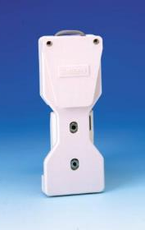
Money Clip Switches
Train all personnel on when the money clip should and should not be used
Periodically check and replace wiring between money clip and counter or wall
Wire clips so that bills need to be removed from more than one clip to generate an alarm

Slide 25
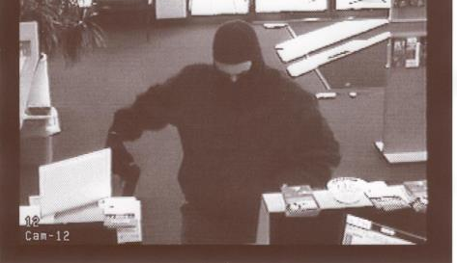
Consult on Procedure
Consult with your local law enforcement agency on proper procedures to follow during a hold-up
Notes:
Consult with your local law enforcement agency on proper procedures to follow during a hold-up.

Slide 26
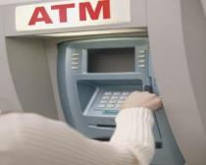
ATM Tips
Make it easy for ATM and armored car providers to cancel accidental activations
Have your central station contact the ATM company
Replace “Deadman’s Keyswitches” and “Blind Keyswitches” with proper central station opening/closing procedures
Notes:
Make it easy for ATM and armored car providers to cancel accidental activations.
Make your central station aware of the provider company and their phone number.
Prior to dispatching officers on an ATM alarm, consider having your central station immediately contact the ATM company’s dispatcher to verify whether a technician is at the site. The one-time cost of phones at the ATM machine is significantly less than the on-going “hidden cost” of false alarm fines.

Slide 27
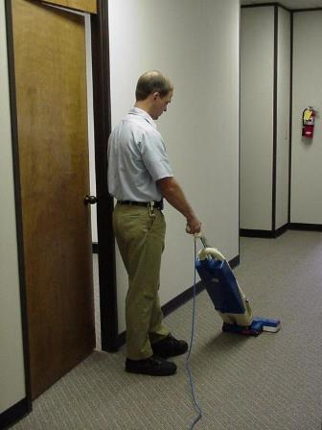
Training is Important!
Teach ALL users how to operate your system, including:
Arming codes
Passwords
Phone numbers
Cancellation procedures
Notes:
Educate everyone who has legal access to your bank such as tellers, cleaners, repairmen or ATM technicians.
All users should be properly trained in how to operate your system, including knowledge of correct arming codes, passwords, telephone numbers, and cancellation procedures for accidental activations.

Slide 28

Train Early & Often
Train
Train all new employees
Include in
Include in monthly meetings
Follow
Follow-up after false alarms
Be
Be proactive - cover common causes before they occur
Notes:
Thoroughly train all authorized alarm users. Thoroughly train temporary employees to avoid false alarms.
Be sure all new system users are fully trained before attempting to use the system. Hold monthly training classes to ensure existing users are aware of any changes to the system, designated entry/exit doors, proper opening/closing procedures, correct pass codes and arming codes, and rehearse how to cancel accidental activations
Have your alarm system instructions readily available in case of an accidental alarm activation.

Slide 29


Notify your alarm company …
Before you test your system
If your system is not working properly
If you plan to remodel or install new wiring of any kind (telephone, DSL, VoIP, etc.)
Notes:
Notify your security company if…
Your system is not working properly
You plan to remodel or install new wiring of any kind (telephone, DSL, VoIP, etc.)
Before you test your system

Slide 30
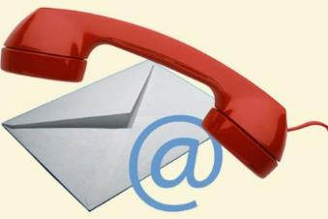
Update Your Alarm Company
When you get new employees who will open or close
When phone numbers change
Before you do remodeling
Notes:
Update Your Alarm Company:
When you get new employees who will open or close your site
When phone numbers for the site or contacts change
When you do remodeling
Update contact information annually.

Slide 31
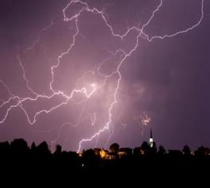
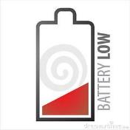
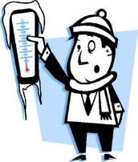
Tell Your Alarm Company
Do Not dispatch public safety on
Power outages
Weather-related signals
Low battery signals
Temperature sensors
Notes:
Your central monitoring station should not request a public safety dispatch for power outages, low battery signals, or loss of telephone connections, weather-related signals, or temperature sensors.
Your central monitoring station should be notifying you so someone at the location can make sure the system is working properly. Call for Technical Assistance if required.

Slide 32



Request ECV!
Tell your monitoring company to use Enhanced Call Verification (ECV)
ECV requires making two calls to a responsible party prior to requesting a dispatch
Notes:
Tell your monitoring company to use Enhanced Call Verification (ECV), which requires making two calls to a responsible party prior to requesting a public safety dispatch.

Slide 33
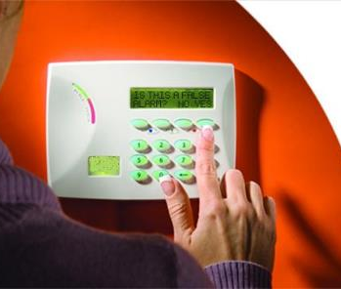
Cancel False Alarms
Follow your alarm company’s instructions to cancel all false alarms
Notes:
Review alarm cancellation procedures with anyone who has access to the alarm site.

Slide 34
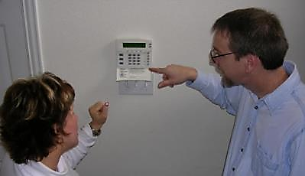
Ask For Help!
Ask your alarm company for help :
To train new users
To find the cause for each false alarm
To plan for a new addition or remodel

Slide 35
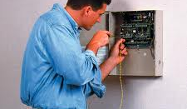
Maintain Your Alarm
Keep your alarm system in proper operating condition
Upgrade old systems
Notes:
Accept the responsibility to keep your alarm system in proper operating condition.
Immediately contact your alarm provider if you believe your alarm system is not working properly.
Service and maintain your system (including batteries) regularly before false alarms occur.
Upgrade old alarm systems to current equipment that conform to Security Industry Association (SIA) false alarm prevention standards.
Have the alarm battery changed every 3-4 years.

Slide 36
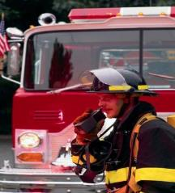
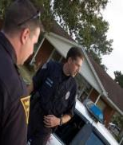
Why?
Public safety resources are limited and should never be wasted
Thousands of hours are spent investigating alarm reports that turn out to be “false alarms”
Notes:
Public safety resources are limited and should never be wasted. Thousands of patrol hours are spent investigating alarm reports that turn out to be “false alarms”.
When used and maintained properly, alarm systems are important tools for Public Safety and the community. When you pay for an alarm system, you want it to do its job and assist in protecting your home. Everyone is entitled to quick emergency response, so make sure your system is not depriving someone else in need by taking the steps to prevent false alarms.
In the end, everyone benefits.

Slide 37
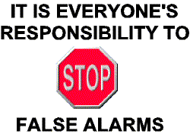
Remember

Slide 38

Contact Us
False Alarm Reduction Association
10024 Vanderbilt Circle #4
Rockville MD 20850
301- 519-9237
Brad Shipp, Executive Director
bradshipp@4yoursolution.com
www.faraonline.org
Notes:
There is a great deal of information available at our website Faraonline.org. If you have any questions, please contact FARA’s Executive Director Brad Shipp.
Thank you so much for your participation and I hope that you found the information helpful.

