Slide 1

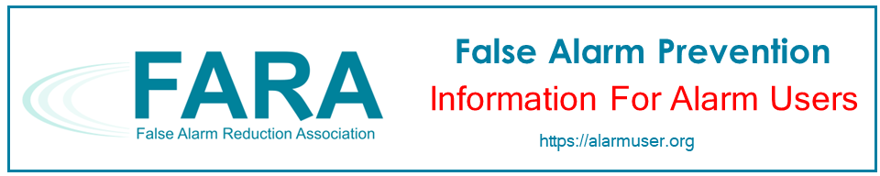
FALSE ALARM PREVENTION FOR YOUR HOME
Notes:
Thank you for taking an interest in preventing false alarms in your home. This presentation is brought to you by the False Alarm Reduction Association, an international organization dedicated to supporting false alarm reduction professionals in their mission to reduce false alarms.

Slide 2


Introduction
What is a false alarm?
Why are false alarms a problem?
How do alarm systems work?
What are some causes of false alarms?
What can you do to prevent false alarms?
Notes:
This purpose of this presentation is to educate the alarm user on false alarms in the home. We will go over these topics:
What is a false alarm?
Why are false alarms a problem?
How do alarm systems work?
What are some common causes of false alarms?
Tips for avoiding false alarms

Slide 3
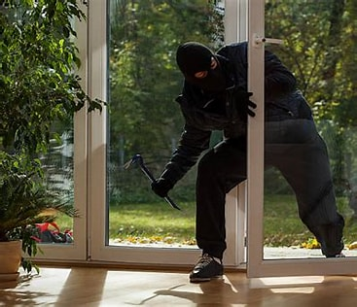
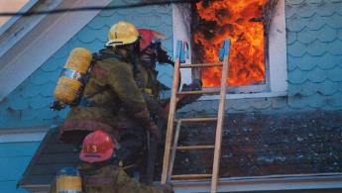
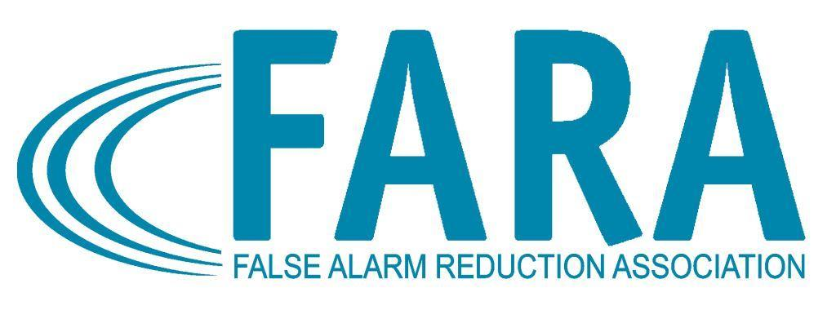
What is a False Alarm?
False Burglar Alarm - A notification of an alarm to law enforcement when the responding authority finds no evidence of criminal offense or attempted criminal offense
False Fire Alarm - A notification of a fire signal, resulting from a cause other than an actual fire
Notes:
An alarm activation caused for any reason other than criminal or fire-related activity is considered a “False Alarm!”

Slide 4

Impacts of False Alarms
Takes officers, EMS, and fire fighters away from real emergencies
Delays response when you really need it
Wastes public resources
Notes:
False alarms take officers, EMS, and fire fighters away from real emergencies. The time emergency officials spend responding to false alarms can have devastating effects. This takes away from their ability to do their job effectively, wasting valuable taxpayer resources and it delays response when you really need it.

Slide 5
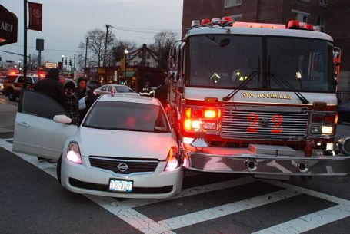
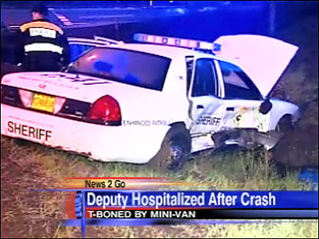
False Alarm Effects
Endangers responding authorities and the community
Notes:
When you have false alarms, it may cause others to question the validity of your alarm (false or real).

Slide 6

Effects Continued…
Can lead to neighbors ignoring your alarm when it activates, making you’re alarm system less reliable and credible
Notes:
False alarms desensitize communities and responders to actual incidents of crime and fire.

Slide 7


Effects Continued…
May make you reluctant to arm your system, exposing your home to undetected theft
Notes:
When your alarm is not used or maintained effectively, it cannot do the job it was designed to do.

Slide 8

Effects Continued…
Wastes time & money
False alarm fines
Lost time
Service & delinquent fees
Alarm Permit Fees & Fines
(residential & commercial)
Registration/permit
Renewals
Unpermitted alarm system
1st false alarm response
2nd and subsequent false alarms
Failure to notify of changes
Notes:
This is basically “throwing money down the drain.” Multiply this factor by large numbers of irresponsible alarm users and everyone pays in the end, including those individuals who are responsible for their alarm systems or choose not to use one. Many cities and counties have passed ordinances imposing stiff fines or fees for excessive false alarm responses.

Slide 9



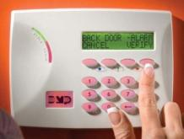
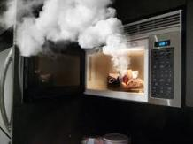
The Alarm Process
Siren Sounds
Intruder Trips Control Panel On site
Alarm Sent to Alarm Company Central Station
Police Dispatched
Alarm Company Calls Public Safety
Fire Trips Control Panel On site
Fire Dispatched
Notes:
Sensor Notification
A master control unit - the brains of an alarm - system interprets signals from the sensors based on the nature of the emergency. It can notify all occupants of the home or business by noise or beeping.
Monitoring Center Notification
A monitored security system sends a signal to the alarm dealer's central station. Automation within the central station interprets the signal and directs the central station operator to the proper course of action.
Responding Authority Notification
This may include notification to the police, fire, medical or just owner notification for non-emergency events.

Slide 10




Common Causes of False Alarms…
Lack of proper training for people given access to your home, such as cleaning people, real estate agents, children, neighbors, guests, relatives, babysitters, workers, etc.
Notes:
Majority of false alarms are caused by human error, usually by those individuals who have not been properly trained on how to use the system.

Slide 11
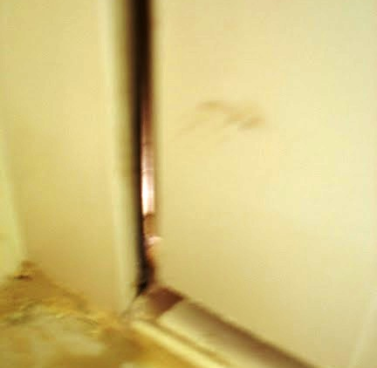
More Common Causes
Open, unlocked loose fitting sensors or defective doors and windows
Notes:
It is not uncommon for alarm users to fail to properly secure their doors or windows when setting the alarm system. If doors or windows do not fit properly, this may also cause false activations.
Often times, emergency personnel find loose animals in the home, setting off motion sensors.

Slide 12

More Common Causes:
Unsecured Pets
Notes:
It is not uncommon for alarm users, particularly those in a hurry, fail to properly secure their doors or windows when setting the alarm system. If doors or windows do not fit properly, this may also cause false activations.
Often times, emergency personnel find loose animals in the home, setting off motion sensors.
It is also not uncommon for an old or weak battery to set off alarm activations after a power outage or surge.

Slide 13
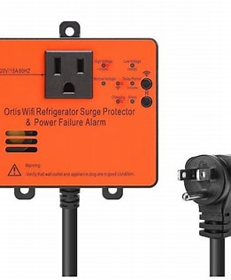
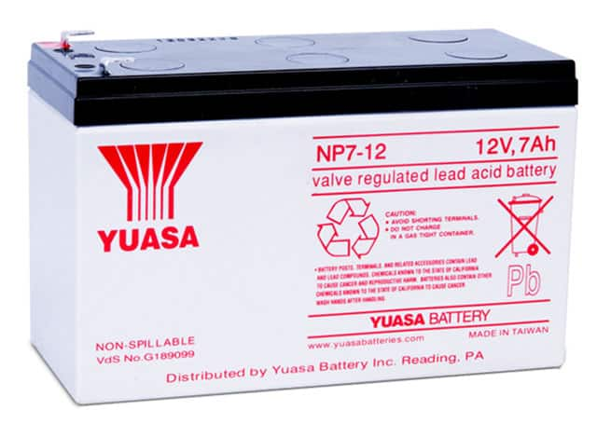
More Common Causes
Weak batteries
Lack of surge protector
Notes:
It is not uncommon for an old or weak battery to set off alarm activations after a power outage or surge. Surge protectors help during storms and power outages. A battery should be able to provide power around 4 hours when an outage or storm occurs.

Slide 14

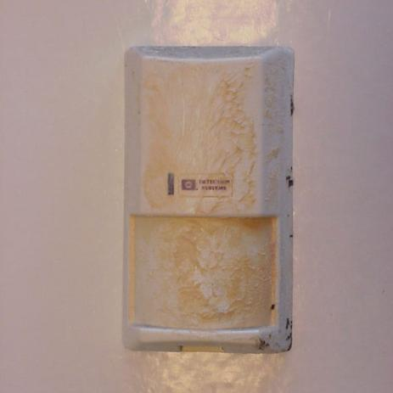

And a Few More...
Insects, dust, dirt or cobwebs on motion or smoke sensors
Notes:
Cleaning motion sensors is important. Things like insects or heavy dust and dirt on them will cause false activations.
Remember! Motion sensors are designed to pick up movement!

Slide 15
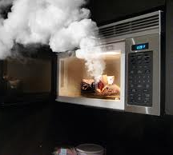
Last but not Least...
Cooking fumes will trip smoke detectors
Notes:
Cooking on an indoor grill, air fryer, microwave, oven or stovetop can cause smoke detector activations.

Slide 16
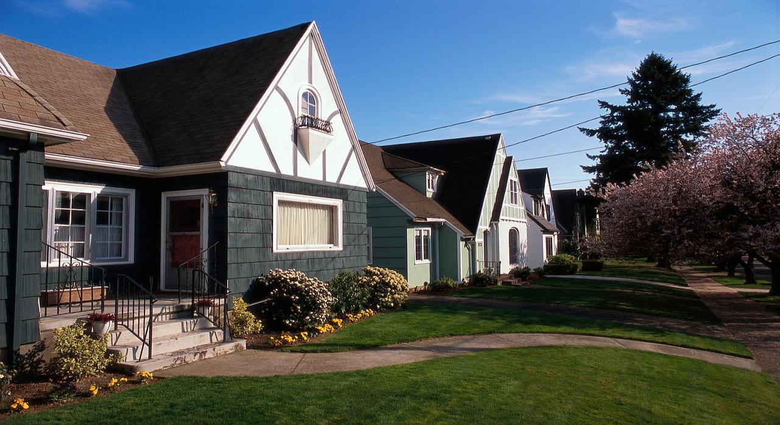
False Alarm Prevention Tips for your home
Notes:
What can you do to prevent false alarms in your home? Let’s talk about that.

Slide 17
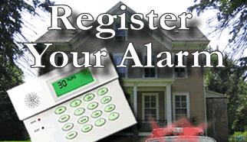
Before You Activate
Check with your local jurisdiction for registration requirements
Notes:
Check with your local jurisdiction for registration requirements.
Notify your local Alarm Coordinator when phone numbers or situations change.

Slide 18


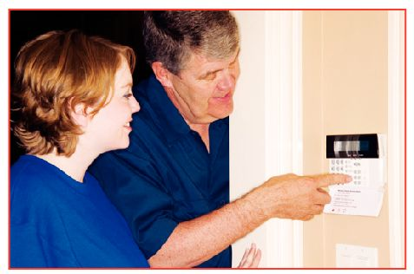
Before You Activate
Understand how the alarm system works; what it does and does not do
Ask your alarm company for written instructions, a video and a demonstration
Notes:
Completely understand how the alarm system works; what it does and does not do.
Ensure that all users of your system are provided thorough instruction on using and testing the system and cancelling unnecessary false alarm dispatch requests.
Ask your alarm company for written instructions and a physical demonstration of the use of your alarm system.

Slide 19

Before Turning on your Alarm System when leaving…
Make sure all alarmed doors and windows are locked
Notes:
Take time to do a check anytime you leave your home before turning on your alarm system.
Make sure all windows and doors are secured and properly locked.

Slide 20
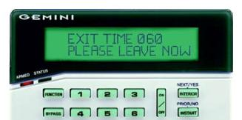
Before Turning on your Alarm System when leaving…
Restart the exit time if you reenter
Notes:
Restart the exit time if you reenter the home (forgot something, get the phone, etc.)

Slide 21
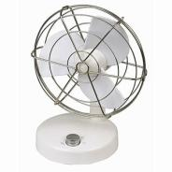

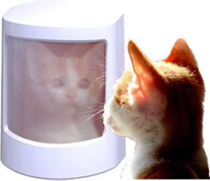

Keep Clear of Motion Detectors
Keep balloons, fans, heaters, plants, curtains, decorations & pets from motion sensor areas
Notes:
Look for items that can move within the “view” of your motion detectors, causing false alarms.
Secure or move fans, heaters, plants, curtains and decorations away from motion sensor areas.

Slide 22
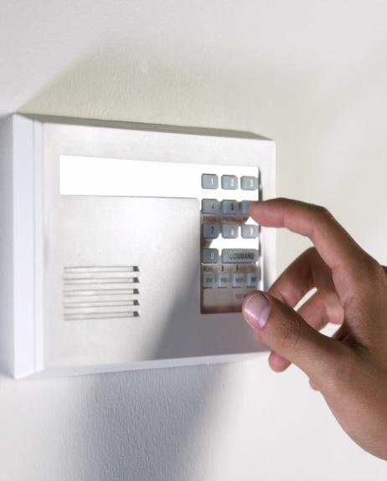

Training is Important!
Teach ALL users how to operate your system, including:
Arming codes
Passwords
Phone numbers
Cancellation procedures
Notes:
Educate everyone who has legal access to your home such as family members, key holders or domestic help.
All users should be properly trained in how to operate your system, including knowledge of correct arming codes, passwords, telephone numbers and cancellation procedures for accidental activations.
Don’t change pass codes and arming codes without advising the appropriate authorized users. If pass codes are changed notify your alarm company.

Slide 23
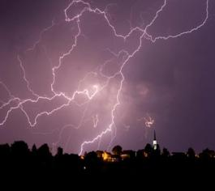
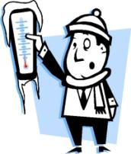
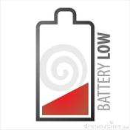
Tell Your Alarm Company
Do Not dispatch public safety on
Power outages
Weather related signals
Low battery signals
Temperature sensors
Notes:
Your central monitoring station should not request a public safety dispatch for power outages, low battery signals or loss of telephone connections, weather related signals, or temperature sensors.
Your central monitoring station should be notifying you so someone at the location can make sure the system is working properly. Call for Technical Assistance if required.

Slide 24
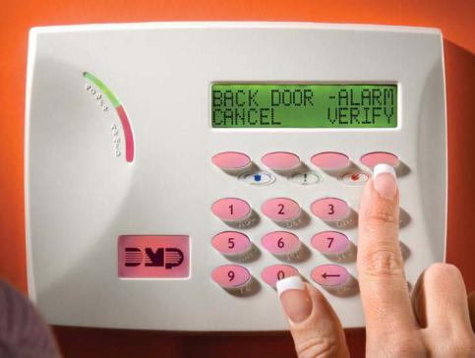
Identify the Cause
Make sure your alarm system identifies the area of activation that caused the alarm.
Notes:
Ensure your alarm system identifies the area that caused the alarm activation. (back door, front door, etc.)

Slide 25


Notify your alarm company …
Before you test your system
If your system is not working properly
If you plan to remodel or install new wiring of any kind (telephone, DSL, VoIP, FIOS, etc.)
Notes:
Notify your security company if…
Your system is not working properly
You plan to remodel or install new wiring of any kind (telephone, DSL, VoIP, etc.)
Before you test your system

Slide 26


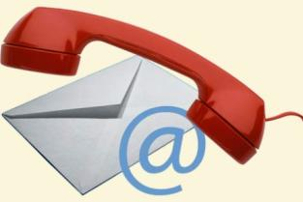
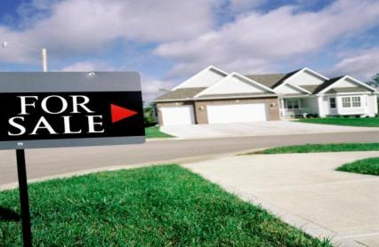
Update Your Alarm Company
If you ….
Hire domestic help
Get a new pet
Change phone numbers
Plan to sell your house
Notes:
Update Your Alarm Company:
When you get domestic help who will open or close your site
Get a new pet
When phone numbers for the site or contacts change
When you do remodeling
If you plan to sell your house

Slide 27



Request ECV!
Ask your monitoring company to use Enhanced Call Verification (ECV)
ECV requires making two calls to a responsible party prior to requesting a dispatch
Notes:
Ask your monitoring company to use Enhanced Call Verification (ECV), which requires making two calls to a responsible party prior to requesting a law enforcement dispatch.

Slide 28
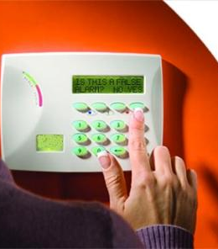
Cancel False Alarms
Follow your alarm company’s instructions to cancel all false alarms
Notes:
Review alarm cancellation procedures with anyone who has access to the alarm site.

Slide 29
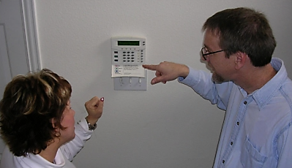
Ask For Help!
Ask your alarm company for help
To train new users
Find the cause for each false alarm
Plan for a new addition or remodel
Notes:
Ask your alarm company for materials, videos, etc. informing how to use the system.
Review with your alarm company the reason for each alarm activation.
Inform them if planning to remodel your home.

Slide 30
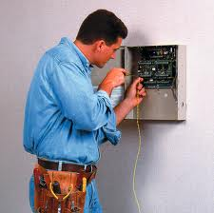
Maintain Your Alarm
Keep your alarm system in proper operating condition
Upgrade old systems
Notes:
Accept the responsibility to keep your alarm system in proper operating condition.
Immediately contact your alarm provider if you believe your alarm system is not working properly.
Service and maintain your system (including batteries) per your alarm company/alarm manufacturer’s recommendation before false alarms occur.
Upgrade old alarm systems to current equipment that conform to Security Industry Association (SIA) false alarm prevention standards.

Slide 31
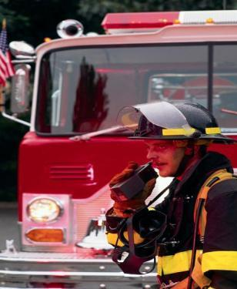


Why?
Public safety resources are limited and should never be wasted
Thousands of hours are spent investigating alarm reports that turn out to be “false alarms”
Notes:
Public safety resources are limited and should never be wasted. Thousands of patrol hours are spent investigating alarm reports that turn out to be “false alarms”.
When used and maintained properly, alarm systems are important tools for Public Safety and the community. When you pay for an alarm system, you want it to do its job and assist in protecting your home. Everyone is entitled to quick emergency response, so make sure your system is not depriving someone else in need by taking the steps to prevent false alarms.
In the end, everyone benefits.

Slide 32
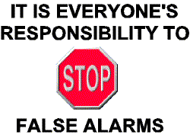
Remember
Notes:
Do your part to reduce/eliminate false alarms.

Slide 33

Contact Us
False Alarm Reduction Association 10024 Vanderbilt Circle #4 Rockville MD 20850
301- 519-9237
Brad Shipp, Executive Director bradshipp@4yoursolution.com
www.faraonline.org

