Slide 1


FALSE ALARM PREVENTION FOR SCHOOLS
Notes:
Thank you for taking an interest in preventing false alarms at school sites. This presentation is brought to you by the False Alarm Reduction Association, an international organization dedicated to supporting false alarm reduction professionals in their mission to reduce false alarms.

Slide 2


Overview
What is a false alarm?
Why are false alarms a problem?
How do alarm systems work?
What are some causes of false alarms?
What can you do to prevent false alarms?

Slide 3


What is a False Alarm?
False Burglar Alarm - A notification of an alarm to law enforcement when the responding authority finds no evidence of criminal offense or attempted criminal offense
False Fire Alarm - A notification of a fire signal, resulting from a cause other than an actual fire

Slide 4
Effects of False Alarms
REDUCE
FALSE
ALARM
COSTS
Takes officers and fire fighters away from real emergencies
Delays response when you really need it
Wastes public resources
4

Slide 5
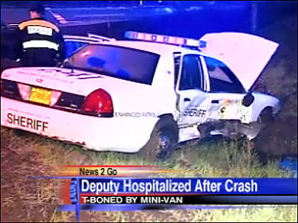
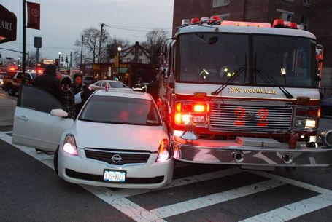
False Alarm Effects
Endangers responding authorities and the community

Slide 6

Another False Alarm
Desensitizes to actual crime/fire
Leads to ignoring alarms going off
Notes:
When your alarm “cries wolf!”, several times, the community will not take the actual valid alarm seriously when it happens.
Numerous false alarms desensitize communities to actual incidents of crime and fire.

Slide 7

False Alarm Effects Continued…
May make you reluctant to arm your system, exposing your school to unauthorized entry, theft, fire, or vandalism.
Notes:
When your alarm is not used or maintained effectively, it cannot do the job it was designed to do.

Slide 8

False Alarm Effects Continued…
Wastes time & money
False alarm fines
Lost time
Service & delinquent fees
Alarm Permit Fees & Fines
(residential & commercial)
Registration/permit
Renewals
Unpermitted alarm system
1st false alarm response
2nd and subsequent false alarms
Failure to notify of changes
Notes:
This is basically “throwing money down the drain.” Multiply this factor by many careless alarm users and everyone pays in the end, including those individuals who are responsible for their alarm systems or choose not to use one. Many cities and counties have passed ordinances imposing stiff fines or fees for excessive false alarm responses. The list of alarm system fees and fines are some examples of items that could accrue fees and will change depending on your local alarm ordinance.

Slide 9
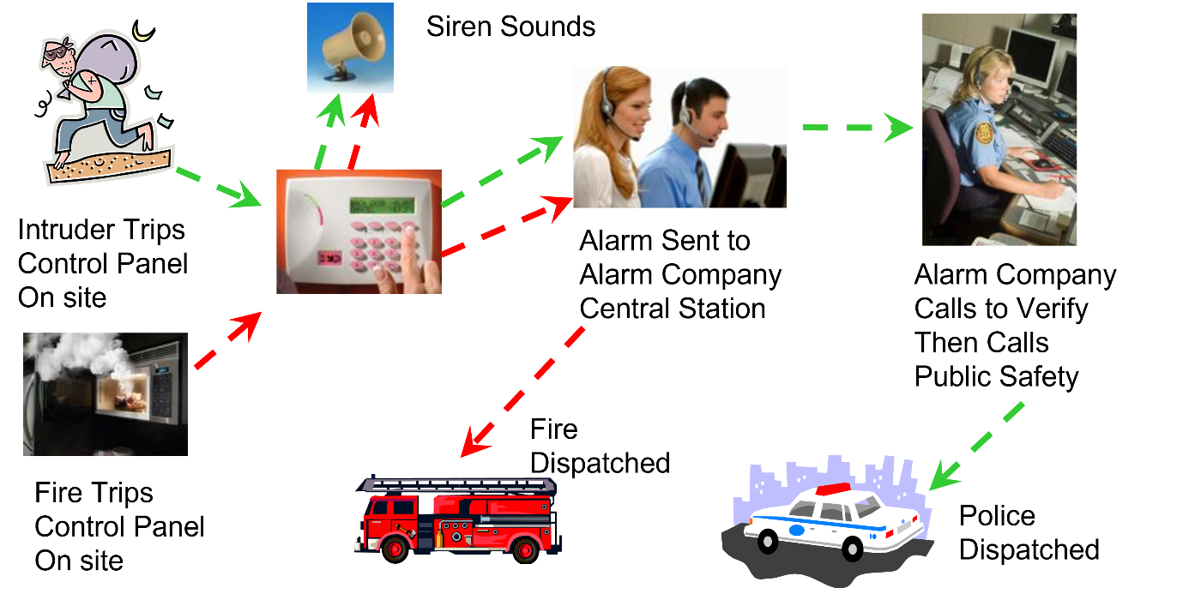
The Alarm Process

Slide 10



Common Causes of False Alarms
Lack of proper training for people given access to your school, such as teachers, coaches, contractors, meeting attendees, etc.

Slide 11

More Common Causes
Improperly trained new staff leads to false alarms
How do You Train New Employees About the Alarm System?

Slide 12
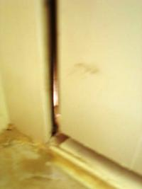
More Common Causes
Open, unlocked or loose-fitting doors and windows
If the door or window can open, it can cause a false alarm

Slide 13
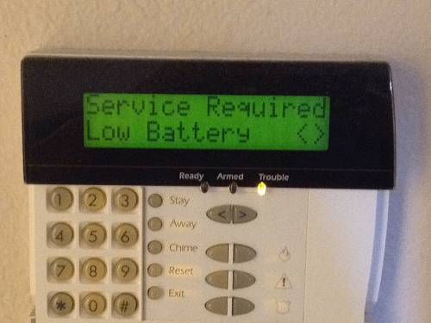
More Common Causes
Weak batteries can lead to erratic operation of motion, glass break or fire alarm sensors

Slide 14




Another Cause...
Drafts from heating/air conditioning systems, signs, banners, moving plants, balloons, etc.
Notes:
Motion sensors not only pick up movement of humans in the premises, but they will also detect movement from the “non-human” variety.
Look for items that can move within the “view” of your motion detectors causing false alarms. This will include drape and plant movements caused by drafts from heating/ac vents and the like. Another frequent offender are balloons or signs floating in front of motion sensors.

Slide 15
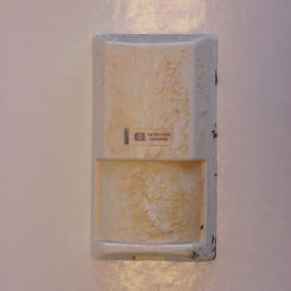


And a Few More...
Insects, dust, dirt, or cobwebs on motion or smoke sensors
Notes:
Cleaning motion sensors are important, because things like insects or heavy dust and dirt on them will cause false activations.
Remember! Motion sensors are designed to pick up movement!

Slide 16

Last but not Least...
Fumes may trip smoke detectors
Notes:
Classrooms equipped with cooking equipment or science labs, or similar equipment may be suspectable to smoke detector activations caused by fumes.
This Photo by Unknown Author is licensed under CC BY-NC-ND

Slide 17
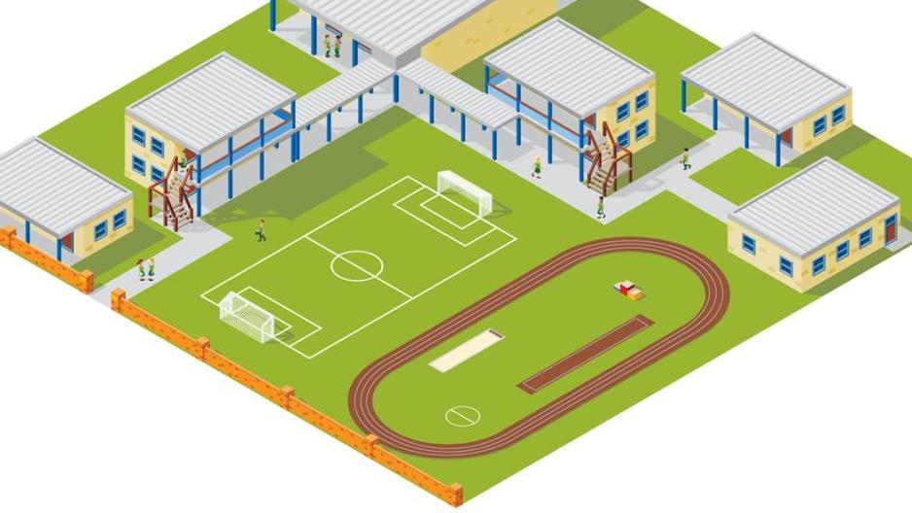
False Alarm Prevention Tips for Schools
How to Prevent False Alarms

Slide 18
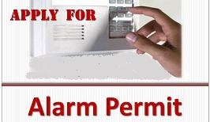
Before You Activate
Check with your local jurisdiction for registration requirements
Notify your local alarm coordinator when phone numbers or situations change
Notes:
Check with your local jurisdiction for registration requirements.
Notify your local Alarm Coordinator when phone numbers or situations change.

Slide 19

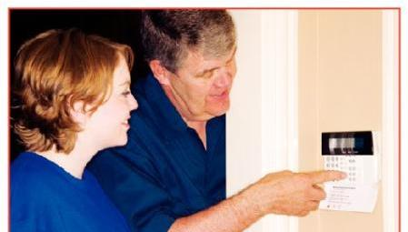

Before You Activate
Understand how the alarm system works
Educate all users
Ask your alarm company for written instructions, videos and/or physical demonstration
Notes:
Completely understand how the alarm system works; what it does and does not do.
Ensure that all users of your system are provided thorough instruction on using and testing the system and cancelling unnecessary false alarm dispatch requests.
Ask your alarm company for written instructions, video links and a physical demonstration of the use of your alarm system.

Slide 20

Before Turning on your Alarm System when leaving…
Check to make sure that all people have left.
Make sure all alarmed doors and windows are locked
Notes:
Take time to do a check anytime you leave your school before turning on your alarm system.
Make sure all windows and doors are secured and properly locked.
Restart the exit time if you reenter the school (forgot something, get the phone, etc.)

Slide 21
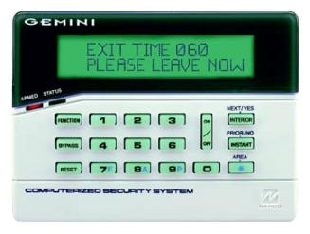
Before Turning on your Alarm System when leaving…
Restart the exit time if you reenter

Slide 22
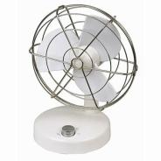



Keep Clear of Motion Detectors
Keep balloons, fans, heaters, plants, curtains, decorations & birds from motion sensor areas
Notes:
Look for items that can move within the “view” of your motion detectors, causing false alarms.
Secure or move fans, heaters, plants, curtains and decorations away from motion sensor areas.
Give special consideration to the installation of motion detectors in high bay areas with overhead doors, large exhaust fans or ceiling vents, which allow entry of birds.
Ensure items are securely stored on shelves.

Slide 23

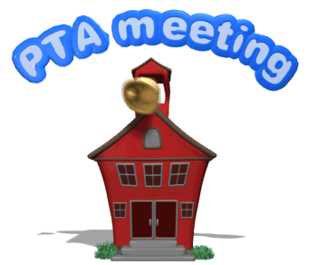


After Hours Visitors
Develop a plan to deal with after hour visitors
Identify parties responsible for evening/weekend use.
Disarm active areas where access is needed after hours.
Audible alarm should sound when system is armed.
Ensure all people have left before arming the system.
Make sure all doors and windows are locked before arming the system.
Notes:
Is the school facility used by outside groups on evenings and weekends?
Identify the parties responsible for the evening and/or weekend use.
Ensure that all people have left the building.
Secure and lock the entire facility.
Properly arm the security system.
Thoroughly train the responsible party on proper operation of the alarm system, including the appropriate codes for canceling an alarm dispatch.
Sports teams using your athletic fields in the evenings or on weekends may try to gain access to the facility for water and/or bathroom breaks. If your doors are unlocked, the kids will enter.
Don’t give users a key until they are trained on the proper use of the system.

Slide 24
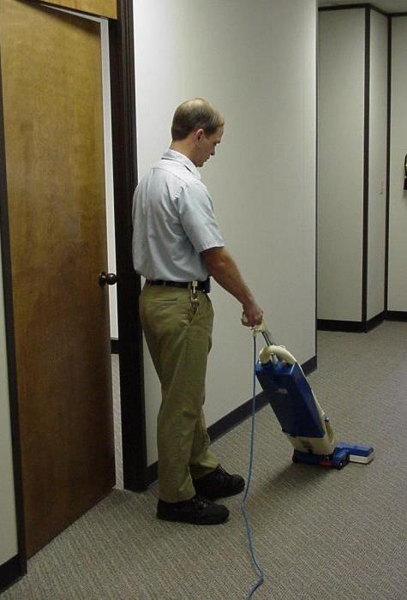
Training is Important!
Teach ALL users how to operate your system, including:
Arming codes
Passwords
Phone numbers
Cancellation procedures
Notes:
Educate everyone who has legal access to your school such as cleaners, repairmen or delivery persons.
All users should be properly trained in how to operate your system, including knowledge of correct arming codes, passwords, telephone numbers and cancellation procedures for accidental activations.
Don’t change pass codes and arming codes without advising the appropriate authorized users. If pass codes are changed notify your alarm company.

Slide 25

Train Early & Often
Train all new employees
Include in monthly meetings
Follow-up after false alarms
Be proactive - cover common causes before they occur
When was the last training for all staff?
Notes:
Thoroughly train all authorized alarm users.
Hold monthly training sessions to teach proper operation of the alarm system and how to cancel accidental activations.
Thoroughly train temporary employees to avoid false alarms.

Slide 26
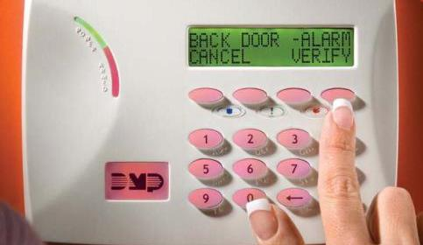
Identify the Cause
Make sure your alarm system identifies the area of activation that caused the alarm.
The school security director should review alarm activation reports daily.
Have the Principal work with staff and outside users to determine the arming & disarming times for each monitored area.
Communicate schedules to the monitoring company.
Notes:
Ensure your alarm system identifies the device that caused the alarm activation.

Slide 27
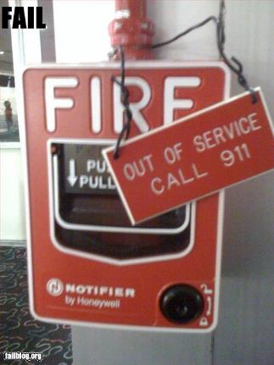

Notify your alarm company …
Before you test your system
If your system is not working properly
If you plan to remodel or install new wiring of any kind (network, telephone, DSL, VoIP, etc.)
Notes:
Notify your security company if…
Your system is not working properly
You plan to remodel or install new wiring of any kind (telephone, DSL, VoIP, etc.)
Before you test your system

Slide 28
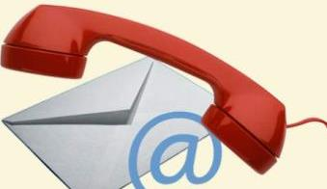
Update Your Alarm Company
When you get new employees who will open or close
When phone numbers change
Before you do remodeling

Slide 29

Train New Alarm Users
To provide their own unique verbal passcode
Use card access to track who is accessing the building and limit to authorized users
To properly arm/disarm the system
To program the alarm company’s number into their phone
To answer the phone
Only provide key when they are trained
Train before school begins and after each break
Notes:
Each alarm user should have their own verbal password to provide the alarm company. This will help confirm who the company is speaking with and ensure they have authority to convey alarm updates or requests.
It is important to train your employees to arm and disarm the system properly to avoid false alarms.
Programing the alarm company’s phone number into your cell phone will increase the likelihood that the employee doesn’t miss a call from the alarm company. Be sure they pick up the phone when the alarm company calls so they can advise on a false alarm or actual alarm event.

Slide 30
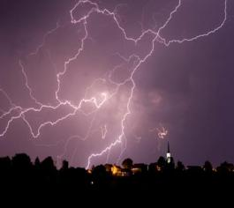
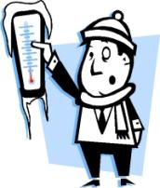

Tell Your Alarm Company
Do Not dispatch public safety on
Power outages
Weather related signals
Low battery signals
Temperature sensors
Notes:
Your central monitoring station should not request a public safety dispatch for power outages, low battery signals or loss of telephone connections, weather related signals, or temperature sensors.
Your central monitoring station should be notifying you so someone at the location can make sure the system is working properly. Call for Technical Assistance if required.

Slide 31



Require ECV!
Tell your monitoring company to use Enhanced Call Verification (ECV)
ECV requires making two calls to a responsible party prior to requesting a dispatch
Notes:
Tell your monitoring company to use Enhanced Call Verification (ECV), which requires making two calls to a responsible party prior to requesting a law enforcement dispatch.

Slide 32
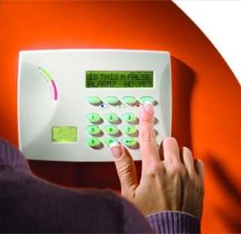
Cancel False Alarms
Follow your alarm company’s instructions to cancel all false alarms
Notes:
Review alarm cancellation procedures with anyone who has access to the alarm site.

Slide 33
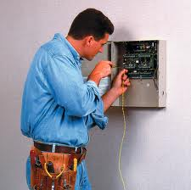
Maintain Your Alarm
Keep your alarm system in proper operating condition
Upgrade old systems
Schedule annual system inspections
Notes:
Accept the responsibility to keep your alarm system in proper operating condition.
Immediately contact your alarm provider if you believe your alarm system is not working properly.
Service and maintain your system (including batteries) per your alarm company/alarm manufacturer’s recommendation before false alarms occur.
Upgrade old alarm systems to current equipment that conform to Security Industry Association (SIA) false alarm prevention standards.

Slide 34
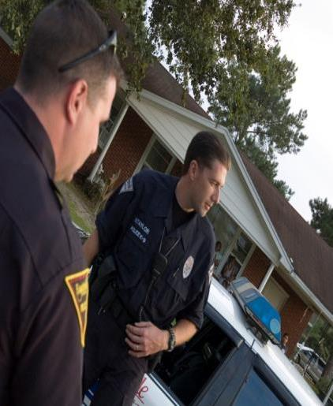
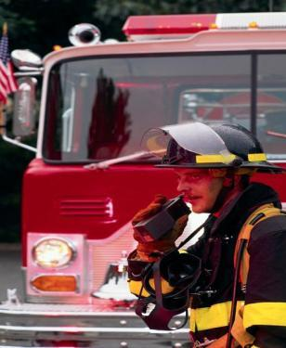
Why?
Public safety resources are limited and should never be wasted
Thousands of hours are spent investigating alarm reports that turn out to be “false alarms”
Notes:
Public safety resources are limited and should never be wasted. Thousands of patrol hours are spent investigating alarm reports that turn out to be “false alarms”.
When used and maintained properly, alarm systems are important tools for Public Safety and the community. When you pay for an alarm system, you want it to do its job and assist in protecting your school. Everyone is entitled to quick emergency response, so make sure your system is not depriving someone else in need by taking the steps to prevent false alarms.
In the end, everyone benefits.

Slide 35
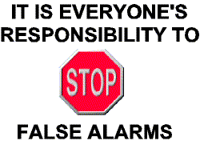
Remember

Slide 36

Contact Us
False Alarm Reduction Association
10024 Vanderbilt Circle #4
Rockville MD 20850
301- 519-9237
Brad Shipp, Executive Director
bradshipp@4yoursolution.com
www.faraonline.org

